Slide 1
Beheersen van bloedingsrisico’s:
Wat is de balans?
Antistollingstherapie
Freek Verheugt
Onze Lieve Vrouwe Gasthuis
Amsterdam

Slide 2
What is the balance?
bleeding
thrombosis

Slide 3
TRITON – TIMI 38 – Efficacy and safety
N = 13,600 pts. with ACS
15
138
events
Clopidogrel
12.1
HR 0.81
(0.73–0.90)
P = .0004
CV death / MI / stroke
10
9.9
Endpoint (%)
Prasugrel
NNT = 46
5
TIMI Major
non-CABG bleeds
35
events
Prasugrel
2.4
HR 1.32
(1.03–1.68)
P = .03
Clopidogrel
1.8
0
0
30
60
90
180
270
360
450
NNH = 167
Days
N Engl J Med 2007;357:2001-2015
Notes:
This slide depicts the balance of efficacy and safety observed in the trial.
At the top is shown the significant reduction in the primary endpoint as presented a few moments ago. The number needed to treat to prevent one event was 46
At the bottom is the rate of TIMI major non CABG bleeds--a key safety endpoint-- which was 2.4% with prasugrel and 1.8% with clopidogrel—a 0.6% Absolute risk increase.
The excess of 35 major bleeds with prasugrel corresponded to an HR of 1.32 and P value of 0.03 .
The number of subjects who would need to be treated to result in one excess major bleed (NNH) was 167.

Slide 4
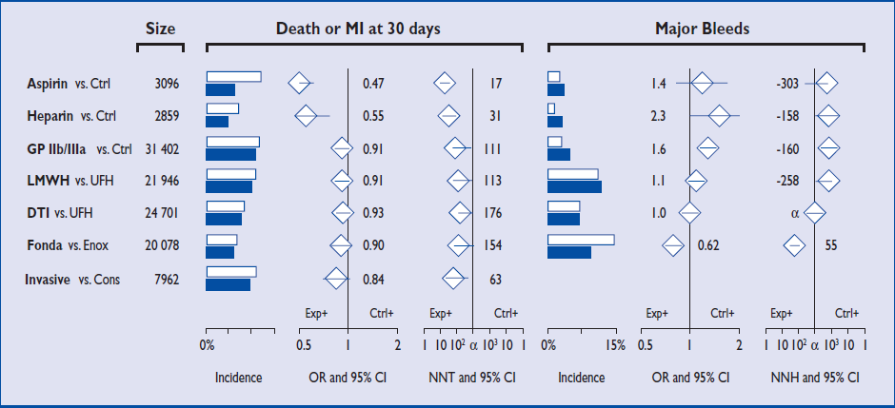
Summary of ACS Treatments
ESC NSTE-ACS Guidelines. Eur Heart J 2011;32:Epub Sep 21

Slide 5
Antiplatelet therapy: efficacy vs safety
Cardiovascular death, MI, or stroke
Major bleeding
↓25%
↓20%
↓18%
↑38%
↑33%
↓33%
0.8%
↑60%
20%
15%
1.3%
12%
1.8%
10%
2.4%
10%
1.8%
None
ASA^{1,2}
ASA +
clopidogrel³
ASA +
prasugrel³
ASA +
ticagrelor⁴
1. Antiplatelet Trialists' Collaboration, BMJ 1994; 2. Antithrombotic Trialists' Collaboration, BMJ 2002;
3. Wiviott et al. N Engl J Med 2007; 4. Wallentin et al. N Engl J Med 2009
Notes:
Reduction in ischaemic events
Increase in major bleeding
There is an unmet medical need for new antithrombotic therapy, as the event rate is still around 10% despite prasugrel
Abbreviations
ASA, acetylsalicylic acid; MI, myocardial infarction
References
Antiplatelet Trialists' Collaboration. BMJ 1994;308:81–106.
Antithrombotic Trialists' Collaboration. BMJ 2002;324:71–86.
Wiviott et al. N Engl J Med 2007;357:2001–2015.
Wallentin et al. N Engl J Med 2009;361:1045–1057.

Slide 6
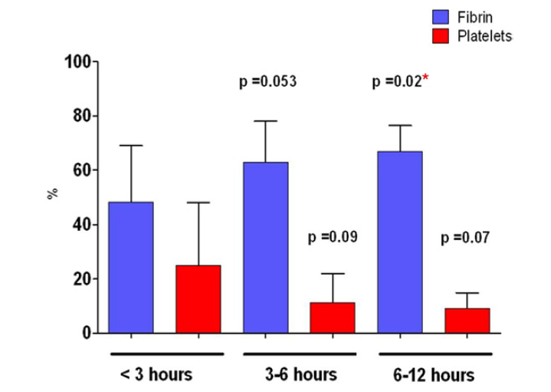
Thrombus composition in STEMI
Impact of time on thrombus composition
Silvain J. J Am Coll Cardiol 2011;57:1359–1367

Slide 7
N Engl J Med 2006;354;1464-1476

Slide 8
N Engl J Med 2006;354;1464-1476

Slide 9
N Engl J Med 2006;354;1464-1476

Slide 10
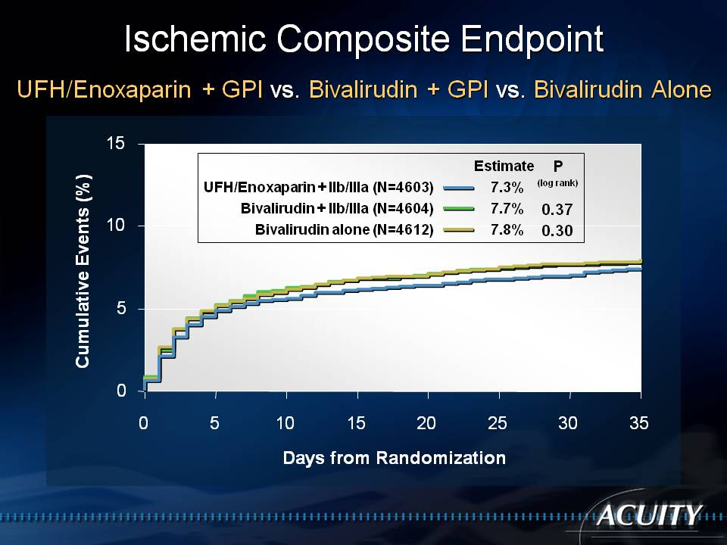
N Engl J Med.2006 ;355:2203-2216

Slide 11
Major Bleeding Endpoint
UFH/Enoxaparin + GPI vs. Bivalirudin + GPI vs. Bivalirudin Alone
15
Estimate
P
(log rank)
UFH/Enoxaparin + IIb/IIIa (N=4603)
5.7%
Bivalirudin + IIb/IIIa (N=4604)
5.3%
0.41
10
Bivalirudin alone (N=4612)
3.0%
<0.0001
Cumulative Events (%)
5
0
0
5
10
15
20
25
30
35
Days from Randomization
N Engl J Med.2006 ;355:2203-2216

Slide 12
Impact of MI and Major Bleeding (non-CABG) in the First 30 Days on Risk of Death Over 1 Year
1 year
Estimate
Both MI and Major Bleed (N=94)
28.9%
Major Bleed only (without MI) (N=551)
12.5%
30
MI only (without Major Bleed) (N=611)
8.6%
No MI or Major Bleed (N=12,557)
3.4%
28.9%
25
20
Mortality (%)
15
12.5%
10
8.6%
5
3.4%
0
0
30
60
90
120
150
180
210
240
270
300
330
360
390
Days from Randomization
JAMA 2007; 298:2497-2506

Slide 13
Influence of Non-CABG Major Bleeding and MI in the First 30 Days on the Risk of Death Over 1 Year
HR ± 95% CI
HR (CI)
Deaths (n/%)
P-value
Day 0 – 2 after MI | 12.6 (7.8-20.4) |  | 29 (37.6) | <0.0001
Day 3 – 7 after MI | 5.3 (2.7-10.4) |  | 11 (14.3) | <0.0001
Day 8 – 35 after MI | 1.6 (0.8-3.1) |  | 12 (15.6) | 0.18
Day > 35 after MI | 1.2 (0.8-1.9) |  | 25 (32.5) | 0.34
Day 0 – 2 after Major Bleed | 3.0 (1.6-5.6) |  | 12 (12.9) | 0.0009
Day 3 – 7 after Major Bleed | 4.0 (2.1-7.5) |  | 15 (16.1) | <0.0001
Day 8 – 35 after Major Bleed | 4.5 (2.8-7.4) |  | 25 (26.9) | <0.0001
Day > 35 after Major Bleed | 2.2 (1.5-3.2) |  | 41 (44.1) | <0.0001
0.5 1 2 4 8 16
JAMA 2007; 298:2497-2506

Slide 14
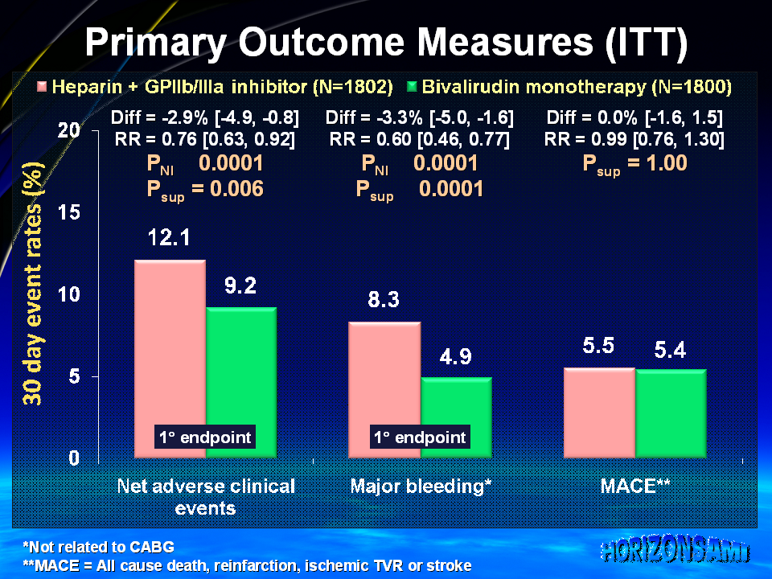
N Engl J Med 2008;358:2218-2230

Slide 15
Three-Year All-Cause Mortality
10
Bivalirudin alone (n=1800)
Heparin + GPIIb/IIIa (n=1802)
9
8
7.7%
7
6
4.8%
5.9%
All-Cause Mortality (%)
5
4
3-yr HR [95%CI]=
3
3.4%
0.75 [0.58, 0.97]
2
P=0.03
1-yr HR [95%CI]=
1
0.71 [0.51, 0.98]
0
P=0.04
0
3
6
9
12
15
18
21
24
27
30
33
36
Months
Number at risk
Bivalirudin alone
1800
1689
1660
1633
1611
1574
1098
Heparin+GPIIb/IIIa
1802
1670
1643
1593
1568
1525
1043
Stone GW. Presented TCT 2010

Slide 16
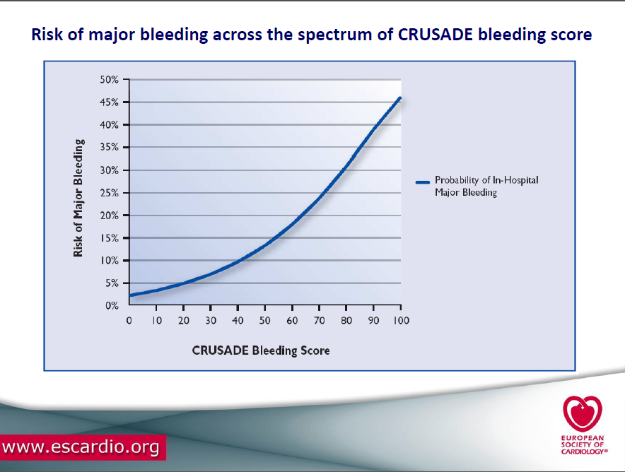

Slide 17
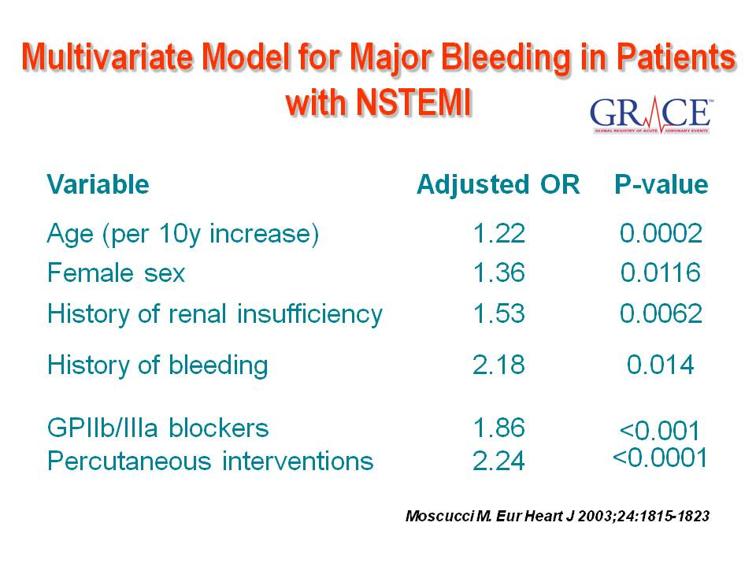

Slide 18
Sources and Incidence of Bleeding Among 17,393 PCI Patients (REPLACE-2. ACUITY, HORIZNS-AMI)
5.2%
5.3%
Access site-only accounts for 39.6% of TIMI bleeding events.
1.6%
Verheugt FWA. J Am Coll Cardiol Interv 2011;4:191-197

Slide 19
Relative Risk of 1-Year Mortality Based on TIMI Bleeding and Source Compared to No Bleeding
P<0.0001 for all bleeding versus none
Verheugt FWA. J Am Coll Cardiol Interv 2011;4:191-197

Slide 20
Impact of Randomized Antithrombotic Therapy: All Bleeding Sources
RR=0.55
P<0.0001
RR=0.55
P<0.0001
RR=0.52
P<0.0001
Verheugt FWA. J Am Coll Cardiol Interv 2011;4:191-197

Slide 21
Impact of Randomized Antithrombotic Therapy on TIMI Major Bleeding by Source
 | Relative Risk | P-Value
Access Only | 0.45 | 0.0003
Both | 0.20 | 0.0002
Non Access Only | 0.41 | 0.04
No Location | 0.89 | 0.63
All Bleeding Excluding Access | 0.57 | 0.002
Bivalirudin better
Hep + GPI better
Verheugt FWA. J Am Coll Interv Cardiol 2011;4:191-197

Slide 22
Time from CABG to any death
(CABG population)
Held C. J Am Coll Cardiol 2010 in press
10
9
8
7
6
5
4
3
2
1
0
Clopidogrel
9.7
K-M estimated rate (%)
4.7
Ticagrelor
HR: 0.49 (95% CI 0.32–0.77), p<0.01
0 1 2 3 4 5 6 7 8 9 10 11 12
No. at risk
Ticagrelor
Clopidogrel
Months
629 583 557 491 415 291 119
629 565 539 472 404 269 130

Slide 23
Bleeding from time of CABG
Characteristic
Ticagrelor
(n=632)
Clopidogrel
(n=629)
Odds Ratio (95% CI)
p-value
CABG-related bleeding
Major bleeding
81.2
80.1
1.07 (0.80, 1.43)
0.67
Life-threatening/
fatal bleeding
43.7
42.6
1.04 (0.83, 1.31)
0.73
Fatal bleeding
0.8
1.0
0.83 (0.20, 3.28)
0.77
All intracranial
bleeding post-CABG*
0.2
0.2
1.01 (0.06, 16.09)
1.00
TIMI major bleeding
59.3
57.6
1.08 (0.85, 1.36)
0.53
TIMI minor bleeding
21.0
21.6
0.97 (0.73, 1.28)
0.84
GUSTO severe bleeding
10.6
12.2
0.85 (0.59, 1.22)
0.38
0.2
0.5
1.0
2.0
Ticagrelor better
Clopidogrel better
Held C. J Am Coll Cardiol 2010 in press
Notes:
23

Slide 24
Transfusions from time of CABG
Characteristic
Ticagrelor
(n=632)
Clopidogrel
(n=629)
Hazard/Odds Ratio (95% CI)
p-value
Transfusions within 7 days post-CABG
Any transfusion
55.2
55.8
0.98 (0.85, 1.14)
0.83
PRBC or whole blood*
52.7
51.2
1.03 (0.88, 1.20)
0.69
Platelets
15.3
17.3
0.88 (0.67, 1.16)
0.37
Fresh frozen plasma
25.2
24.0
1.05 (0.84, 1.31)
0.67
Transfusions post CABG-related bleeding†
>4 units blood
17.9
16.2
1.12 (0.83, 1.53)
0.45
>5 units whole blood/
PRBC (2 days)
4.9
4.0
1.25 (0.70, 2.23)
0.49
Chest tube output >2L
(24 hours)†
3.3
2.7
1.24 (0.61, 2.52)
0.62
0.2
0.5
1.0
2.0
Ticagrelor better
Clopidogrel better
Held C. J Am Coll Cardiol 2010 in press
Notes:
24

Slide 25
Conclusions Bleeding in ACS-1
The efficacy of antithrombotics largely outweighs the bleeding risk in most megatrials
Bleeding, irrespective of the source, is significantly associated with increased mortality during the first year after ACS
The majority of bleeds (about 60%) does not occur at the PCI access site
1.
2.
3.

Slide 26
Conclusions Bleeding in ACS-2
Non-access-site related bleeding is associated with more than double the risk of mortality than is access site bleeding
To improve ACS outcome bleeding should be diminished with all means, by the use of e.g.:
- safer antiplatelet agents (e.g. ticagrelor)
- safer anticoagulants (e.g. fondaparinux, bivalirudin)
- use of radial rather than femoral access
4.
5.

Slide 27
Risk factors for anticoagulant-related bleeding: systematic review of nine studies
Risk factor | Independent risk factor | Significant association
Age | 3 studies | –
Uncontrolled hypertension | – | 2 studies
Prior bleeding/anaemia | 1 study | –
MI or ischaemic heart disease | – | 1 study
Cerebrovascular disease or thromboembolism | 1 study | –
Polypharmacy | 3 studies | 1 study
Hughes M et al. QJM 2007;100:599–607
Notes:
Risk factors for anticoagulant-related bleeding: systematic review of nine studies
In a systematic review of clinical trials of patients with AF, Hughes and colleagues¹ also assessed risk factors for bleeding
Nine studies reporting bleeding data were reviewed. Age and polypharmacy were identified as an independent risk factor in three studies each; prior bleeding or cerebrovascular disease/thromboembolism were identified as an independent risk factor in one study each
A significant association between hypertension and bleeding was identified in two studies. A history of MI/ischaemic heart disease was significantly associated with an increased bleeding risk in one study, as was polypharmacy
Notably, some of these risk factors for bleeding are also risk factors for stroke in AF (e.g. advanced age, uncontrolled hypertension, history of MI and cerebrovascular disease)
This suggests that patients at higher risk of stroke and most in need of anticoagulation are also at greatest risk of bleeding (which complicates evaluation of benefit–risk for individual patients)
Reference
Hughes M et al. QJM 2007;100:599–607

Slide 28
Higher stroke risk = higher bleeding risk
 | Risk factor for stroke | Risk factor for anticoagulant-related bleeding
Advanced age¹⁻⁴ | ✓ | ✓
History of hypertension^{1,3,4} | ✓ | ✓
History of MI or ischaemic heart disease^{1,3,4} | ✓ | ✓
Cerebrovascular disease^{1,3,4} | ✓ | ✓
Anaemia^{3,4} |  | ✓
Previous history of bleeding^{3,4} |  | ✓
Kidney failure^{4,5} | ✓ | ✓
Concomitant use antiplatelets^{3,4} |  | ✓
1. Lip GY et al. Chest 2010;137:263–272; 2. Hylek EM et al. Ann Intern Med 1994;120:897–902; 3. Hughes M et al. QJM 2007;100:599–607; 4. Pisters R et al. Chest 2010;138:1093–1100; 5. Lip GY. Europace 2011;13:145–148
Notes:
Higher stroke risk = higher bleeding risk
Some of these risk factors for bleeding are also risk factors for stroke in AF (e.g. advanced age, uncontrolled hypertension, history of MI and cerebrovascular disease)
Patients at higher risk of stroke and most in need of anticoagulation are also at greatest risk of bleeding (which complicates evaluation of benefit–risk)
This poses particular challenges when choosing the most appropriate antithrombotic therapy for patients with AF, and also in the management of these patients
References
Lip GY et al. Chest 2010;137:263–272
Hylek EM et al. Ann Intern Med 1994;120:897–902
Hughes M et al. QJM 2007;100:599−607
Pisters R et al. Chest 2010;138:1093–1100
Lip GY. Europace 2011;13:145–148

Slide 29
HAS-BLED bleeding risk score
Clinical characteristic | Points
Hypertension (systolic BP >160 mm Hg) | 1
Abnormal renal or liver function | 1 + 1
Stroke | 1
Bleeding | 1
Labile INRs | 1
Elderly (age >65 years) | 1
Drugs or alcohol | 1 + 1
Cumulative score | Range 0−9
Pisters R et al. Chest 2010;138:1093–1100
Notes:
HAS-BLED bleeding risk score
The ESC 2010 guidelines also indicate that an assessment of bleeding risk should be part of every patient’s assessment before starting anticoagulation²
The HAS-BLED risk score, based on data from the Euro Heart survey (involving over 3,000 subjects with AF), is recommended as a new, simple-to-use bleeding risk score¹
For patients with a HAS-BLED score ≥3 (high risk of bleeding), caution and regular review is recommended regardless of whether an anticoagulant or ASA is given
HAS-BLED is defined thus:¹
’Hypertension’, systolic BP >160 mm Hg
‘Abnormal kidney function’, the presence of chronic dialysis or renal transplantation or serum creatinine ≥200 μmol/l
‘Abnormal liver function’, chronic hepatic disease (e.g. cirrhosis) or biochemical evidence of significant hepatic derangement
Stroke (previous history, particularly lacunar)
‘Bleeding’, previous bleeding history and/or predisposition to bleeding, e.g. bleeding diathesis, anaemia, etc.
‘Labile INRs,’ unstable/high INRs or poor time in therapeutic range (e.g. <60%)
‘Elderly age’, patients aged >65 years
‘Drugs/alcohol’, concomitant use of drugs, such as antiplatelet agents, non­steroidal anti-inflammatory drugs, etc.
Reference
Pisters R et al. Chest 2010;138:1093–1100
Camm AJ et al. Eur Heart J 2010;31:2369–2429

Slide 30
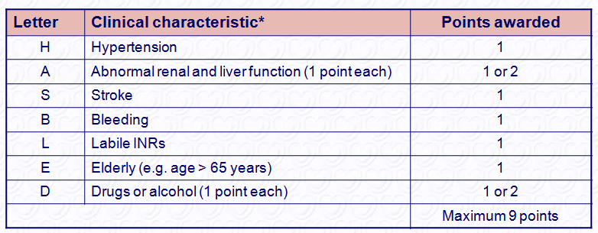
The HAS-BLED bleeding risk score
*Hypertension is defined as systolic blood pressure > 160 mmHg.
INR = international normalized ratio.
Notes:
30

Slide 31
Higher bleeding rates seen with high HAS­BLED score (p-value for trend <0.001)
Cumulative incidence of bleeding* by HAS-BLED score
10
HAS-BLED
8
Score 7
Score 6
6
Score 5
Cumulative incidence (%)
Score 4
4
Score 3
Score 2
Score 1
2
Score 0
0
0
100
200
300
Days from discharge
*Non-OAC cohort
Olesen J et al. J Thromb Haem 2011
Notes:
Increased rates of bleeding are observed with increasing HAS-BLED score
In Denmark, all citizens have a permanent and personal registration number which enables individual level-linkage of nationwide data registry sources. This makes it possible to validate and compare bleeding risk stratification schemes in real-world AF patients with and without an OAC
The study identified all patients (n=118,584) discharged with non-valvular AF in Denmark in the period 1997–2006; with and without an OAC. Major bleeding rates during one year of follow-up were determined
The results demonstrated an increasing bleeding rate with increasing HAS-BLED score, irrespective of OAC use
The figure shows the cumulative incidence curves for major bleeding in the non-OAC cohort based on competing-risks regression. The curve for HAS-BLED score 8 was omitted because only two patients were in this category
Reference
Olesen J et al. J Thromb Haem 2011

Slide 32
Predictive value of contemporary bleeding risk stratification schemes
 | C-statistics (95% CIs)
 | Whole cohort (n=7329) | Warfarin (n=3,665) | Warfarin-naïve (n=769) | Warfarin + ASA (n=772)
HAS-BLED | 0.65 (0.61 – 0.68) | 0.66 (0.61 – 0.70) | 0.66 (0.55 – 0.74) | 0.60 (0.53 – 0.68)
Shireman et al. 2006 | 0.64 (0.61 – 0.68) | 0.63 (0.58 – 0.67) | 0.61 (0.52 – 0.71) | 0.58 (0.51 – 0.66)
HEMORR₂HAGES | 0.62 (0.58 – 0.65) | 0.61 (0.56 – 0.65) | 0.62 (0.52 – 0.72) | 0.58 (0.51 – 0.66)
Beyth et al. 1998 | 0.57 (0.53 – 0.60) | 0.56 (0.51 – 0.60) | 0.50 (0.44 – 0.57) | 0.52 (0.46 – 0.57)
Kuijer et al. 1999 | 0.49 (0.46 – 0.52) | 0.52 (0.48 – 0.56) | 0.44 (0.38 – 0.51) | 0.49 (0.45 – 0.55)
Lip GY et al. JACC 2011;57:173–180
Notes:
Predictive value of contemporary bleeding risk stratification schemes
Lip and colleagues investigated predictors of bleeding in a cohort of 7,329 patients with AF participating in the SPORTIF III and V clinical trials and evaluated the predictive value of several risk stratification schemes by multivariate analysis
Among those treated with warfarin, the HAS-BLED scheme exhibited a marginally better C-statistic value (0.66) than the other 4 schemes evaluated, with the lowest C-statistic (0.52) associated with the scheme of Kuijer et al. (1999)
Among patients who were warfarin naive at entry (n=769) and in those treated with warfarin plus aspirin concurrently (n=772), the HAS-BLED scheme displayed the highest C-statistic values (0.66 and 0.60, respectively) of the 5 risk schemes evaluated
Reference
Lip GY et al. JACC 2011;57:173–180

Slide 33
The net clinical benefit (NCB) of VKA treatment is higher in patients with a high bleeding risk
 | NCB VKA vs no treatment (95% CI)
HAS-BLED score | ≤2 | ≥3 |  | ≤2 | ≥3
CHADS₂ |  |  | CHA₂DS₂-VASc
0 | –0.02 (–0.09–0.06) | 0.19 (–1.39–1.77) | 0 | –0.11 (–0.20––0.03) | –
1 | 0.84 (0.70–0.99) | 0.56 (0.16–0.95) | 1 | –0.02 (–0.15–0.11) | 0.25 (–0.86–1.36)
2–6 | 1.95 (1.70–2.20) | 2.68 (2.33–3.04) | 2–9 | 1.19 (1.07–1.32) | 2.21 (1.93–2.50)
Values >0 favours treatment
Olesen JB et al. Thromb Haemost 2011;106
Notes:
NCB of antithrombotic treatment versus no treatment
Olesen and colleagues investigated the risk of thromboembolism and bleeding in a ‘real-world’ nationwide cohort of AF patients in large nationwide Danish registries. The thromboembolic risk of all patients was assessed using both the CHADS₂ and CHA₂DS₂-VASc scoring schemes while the risk of bleeding for all patients was assessed using HAS­BLED. The NCB balancing ischaemic stroke against intracranial haemorrhage was calculated by the formula: NCB = (ischaemic stroke rate with no treatment – ischaemic stroke rate on treatment) – 1.5* (intracranial haemorrhage rate on treatment – intracranial haemorrhage rate with no treatment)
The results indicated that thromboprophylaxis with VKA significantly reduced the risk of thromboembolism compared with no treatment. This finding is evident in all risk strata classified according to the CHADS₂, CHA₂DS₂-VASc and HAS-BLED score systems. The NCB analyses suggested that the effect of VKA is even more positive in patients with a high HAS-BLED score
Although there is a positive NCB of VKA treatment in patients at high risk of bleeding, fear of haemorrhage is a common reason for not prescribing VKA therapy, particularly in elderly patients^{2–4}
Abbreviation
NCB, net clinical benefit
References
Olesen JB et al. Thromb Haemost 2011;106
Deplanque D et al. Br J Clin Pharmacol 2004;57:798–806
Waldo ALF et al. J Am Coll Cardiol 2005;46:1729–1736
Robert-Ebadi H et al. Clin Interv Aging 2009;4:165–177

Slide 34
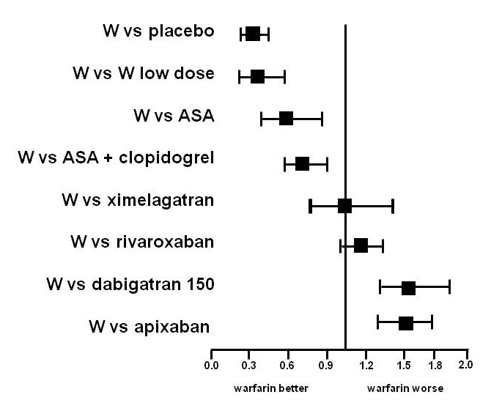
Stroke Prevention in AF
1999
2006
2011

Slide 35
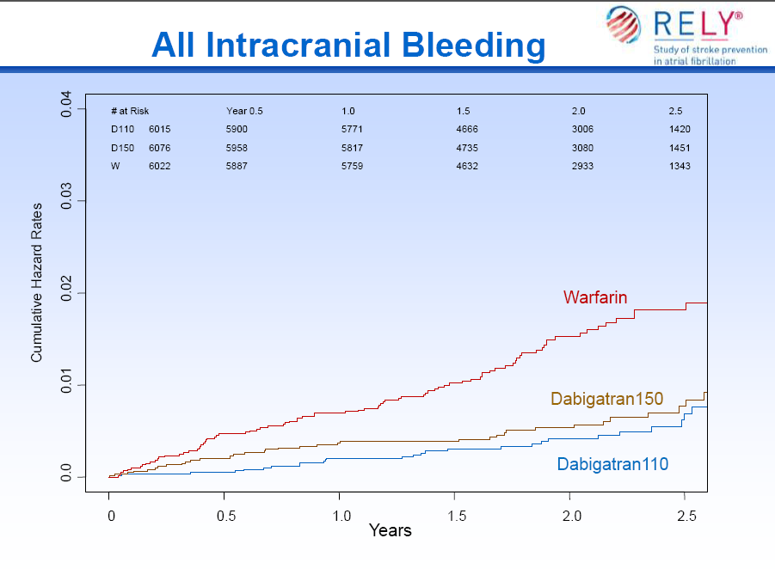
N Engl J Med 2009:361:2671-2675

Slide 36
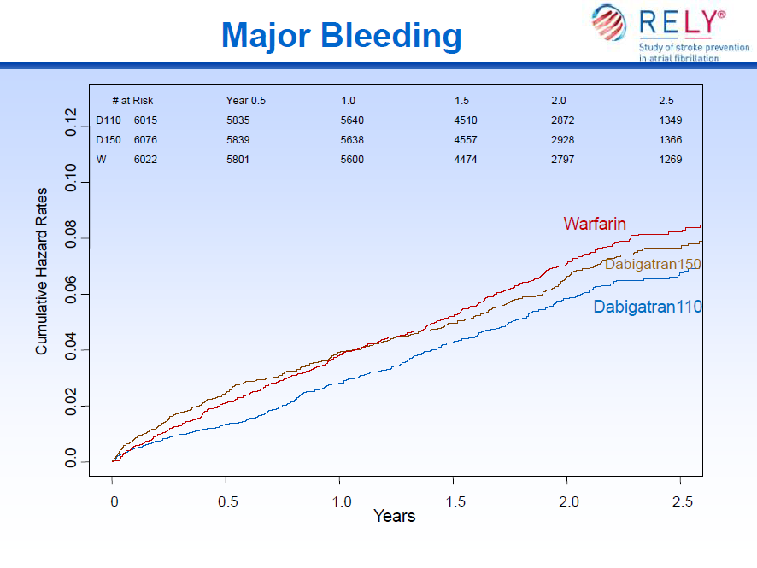
N Engl J Med 2009:361:2671-2675

Slide 37
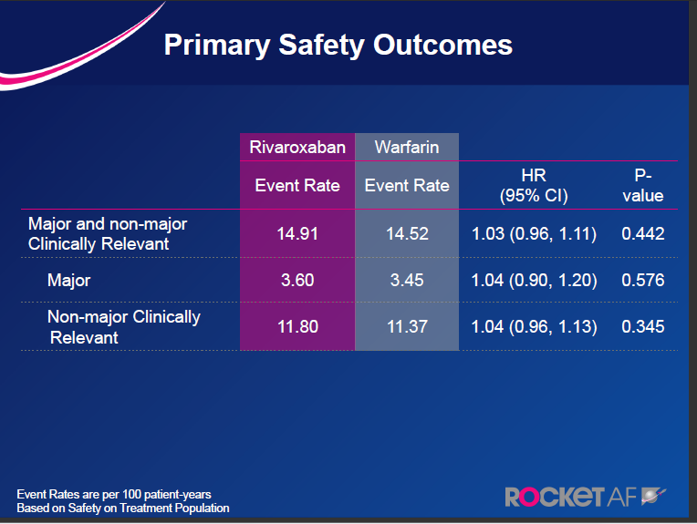

Slide 38
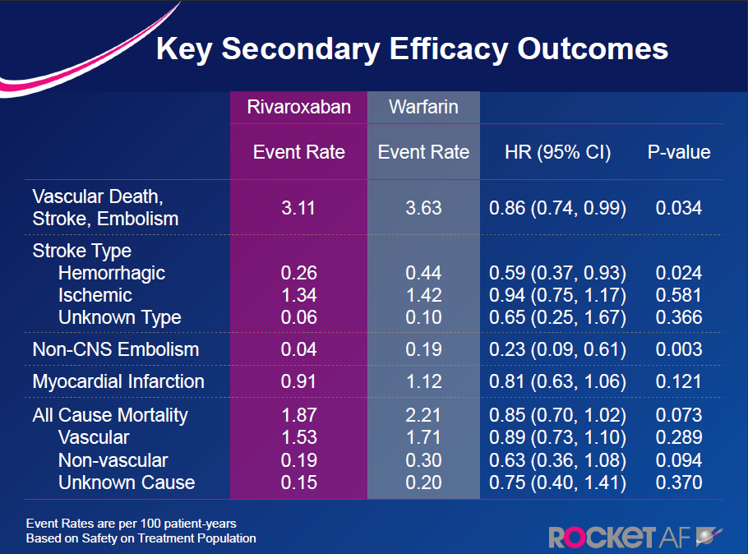
New Engl J Med 2011 Aug 10 Epub

Slide 39
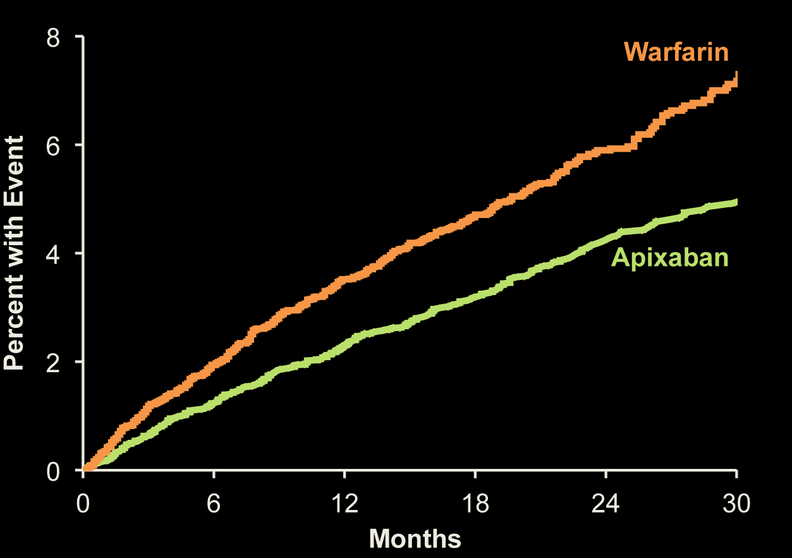
Major Bleeding
ISTH definition
31% RRR
Apixaban 327 patients, 2.13% per year
Warfarin 462 patients, 3.09% per year
HR 0.69 (95% CI, 0.60–0.80); P<0.001
No. at Risk
Apixaban 9088 8103 7564 5365 3048 1515
Warfarin 9052 7910 7335 5196 2956 1491

Slide 40
Conclusions Bleeding in AF
1.
Bleeding risk in AF is strongly associated with thromboembolic risk
Bleeding in AF can now be predicted by the HASBLED score
To improve ACS outcome bleeding should be diminished with all means, e.g.:
- use of the HASBLED score
- use of safer anticoagulants
2.
3.

