Slide 1
^{ASN Review 2012}
Therapie voor Diabetisch Nefropathie:
Meer dan RAAS blokkade alleen
Marjolijn van Buren
HagaZiekenhuis-Den Haag

Slide 2
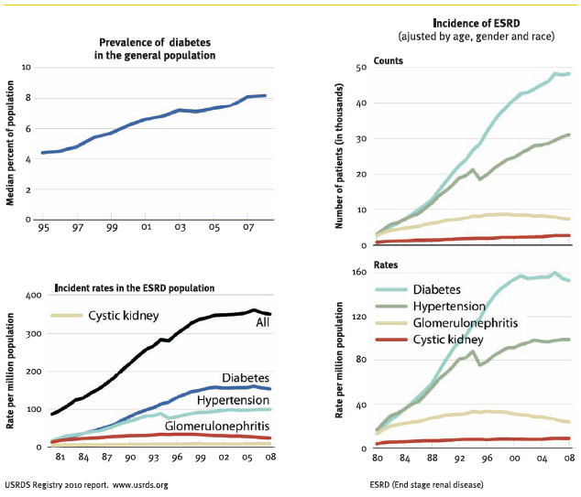
Diabetische nefropathie: een hardnekkig probleem

Slide 3
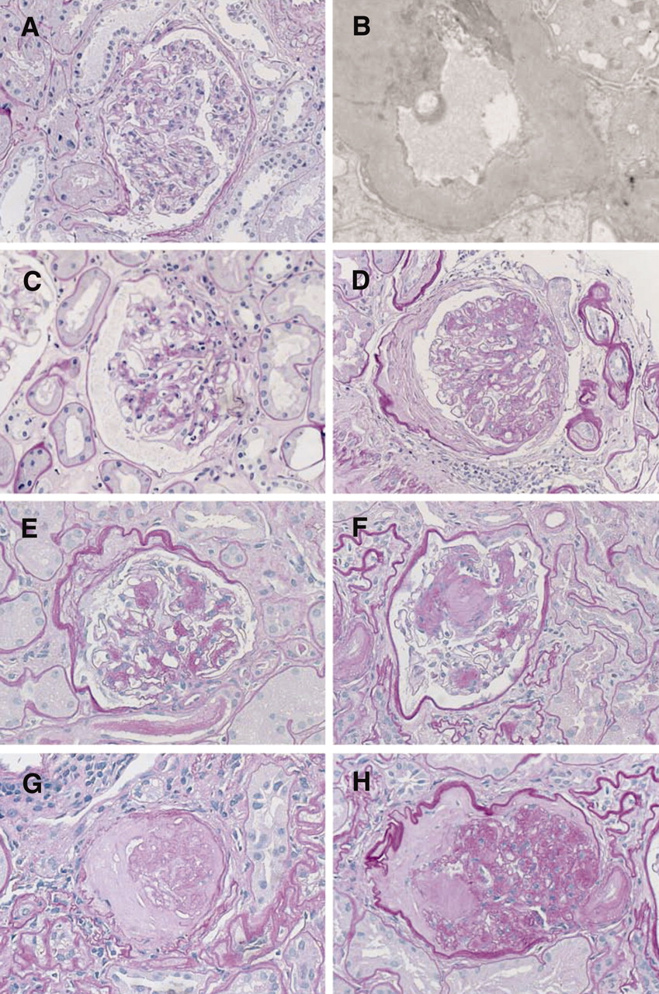
Histopathologie in DN
Histopathologische veranderingen in DN:
GBM verbreding
Mesangiale matrix expansie
Kimmelstiel-Wilson laesies
Glomerulosclerose
Tervaert T W C et al. JASN 2010;21:556-563
©2010 by American Society of Nephrology
Notes:
Representative examples of the morphologic lesions in DN. (A) Glomerulus showing only mild ischemic changes, with splitting of Bowman's capsule. No clear mesangial alteration. (B) EM of this glomerulus: the mean width of the GBM was 671 nm (mean taken over 55 random measurements). EM provides the evidence for classifying the biopsy with only mild light microscopic changes into class I. (C, D) Class II glomeruli with mild and moderate mesangial expansion, respectively. In panel C, the mesangial expansion does not exceed the mean area of a capillary lumen (IIa), whereas in panel D it does (IIb). (E, F) In panel F is a class III Kimmelstiel–Wilson lesion. The lesion in panel E is not a convincing Kimmelstiel–Wilson lesion, therefore (on the basis of the findings in this glomerulus) the finding is consistent with class IIb. For the purpose of the classification, at least one convincing Kimmelstiel–Wilson (as in panel F) needs to be present. In panel H, signs of class IV DN consist of hyalinosis of the glomerular vascular pole and a remnant of a Kimmelstiel–Wilson lesion on the opposite site of the pole. Panel G is an example of glomerulosclerosis that does not reveal its cause (glomerulus from the same biopsy as panel H). For the purpose of the classification, signs of DN should be histopathologically or clinically present to classify a biopsy with global glomerulosclerosis in >50% of glomeruli as class IV.

Slide 4
Classificering DN
Class | Description | Inclusion Criteria
I | Mild or nonspecific LM changes and EM-proven GBM thickening | Biopsy does not meet any of the criteria mentioned below for class II, III, or IV
 |  | GBM > 395 nm in female and >430 nm in male individuals 9 years of age and olderª
IIa | Mild mesangial expansion | Biopsy does not meet criteria for class III or IV
 |  | Mild mesangial expansion in >25% of the observed mesangium
IIb | Severe mesangial expansion | Biopsy does not meet criteria for class III or IV
 |  | Severe mesangial expansion in >25% of the observed mesangium
III | Nodular sclerosis (Kimmelstiel–Wilson lesion) | Biopsy does not meet criteria for class IV
 |  | At least one convincing Kimmelstiel–Wilson lesion
IV | Advanced diabetic glomerulosclerosis | Global glomerular sclerosis in >50% of glomeruli
 |  | Lesions from classes I through III
Tervaert T W C et al. JASN 2010;21:556-563

Slide 5
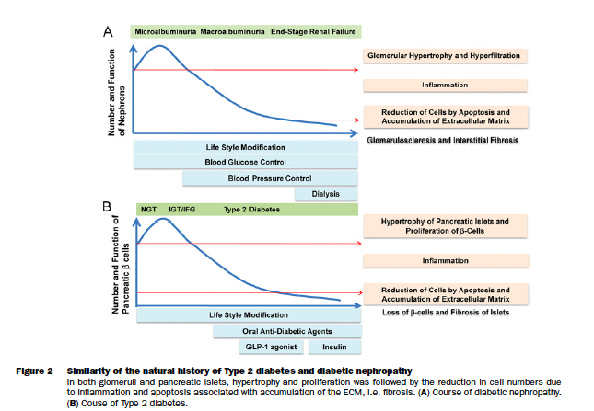
Natuurlijk beloop DN

Slide 6
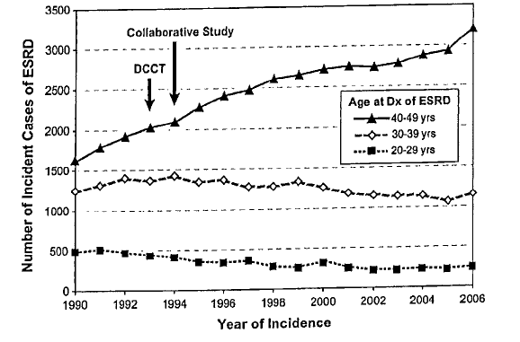
Diabetische nefropathie
Incidentie ESRD ten gevolge van DM1
RAS blokkade en strikte glucose controle niet genoeg

Slide 7
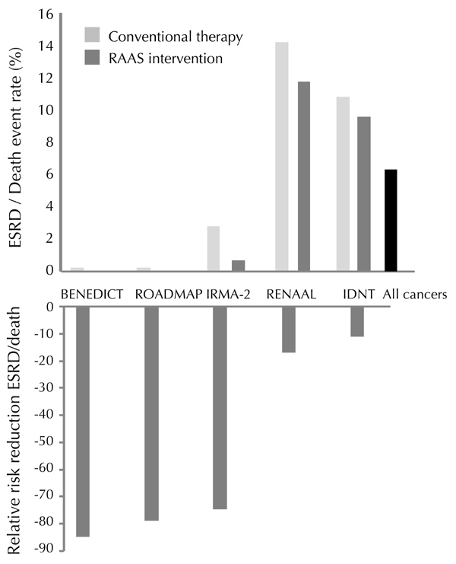
Vroege interventie van DN loont

Slide 8
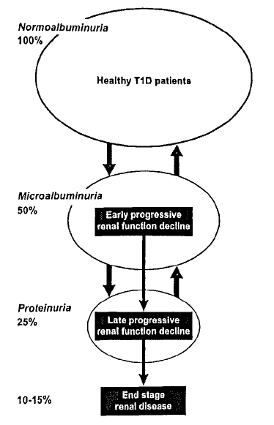
Screening voor DN:
Een groot deel van patienten met
micro-albuminurie en proteinurie
ontwikkelt geen progressieve DN
De snelheid van achteruitgang eGFR in
stadium CKD 1 en 2 DN is een betrouwbare
voorspeller van risico voor ESRD
Behoefte aan nieuwe markers

Slide 9
DN is reversibel!
10 jaar na pancreas transplantatie is diabetische nefropathie verdwenen
Fioretto, KI 2006/NEJM 1998

Slide 10
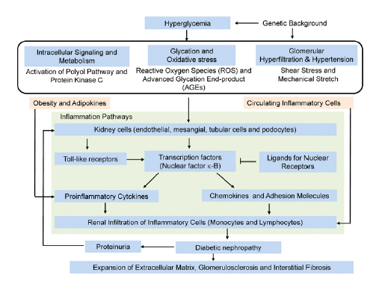
Pathogenese DN
Clin Sci (Lond). 2013 Feb;124(3):139-52.

Slide 11
Interventie mogelijkheden DN
Hyperglycemia
Pyridoxamine
Sevelamer
Diabetic Kidney Injury
Nephron Loss
Glomerular Hypertension Inflammation/Oxidative Stress
Interstitial Fibrosis
Further Nephron Loss
Progressive Kidney Disease
AGE formation
Bloodpressure
control
NRf2 inhibitors
(Bardoxolone)
Allopurinol
RAS blockade
Urinezuur
Aldosterone + Na
Protein Kinase C β1
CTGF
Angiotensin II
TGF-β
Mineralocorticoid blockade
(Spironolactone)
TGF-β blockade
(Pirfenidone)

Slide 12
Alternatieve behandelingen DN
Therapeutische opties naast RAS blokkade???
- Aliskiren
- Mineralocorticoid blokkade
- Allopurinol
- Bardoxolone
- Sevelamer
- Pirfenidone
- Pyridoxamine

Slide 13
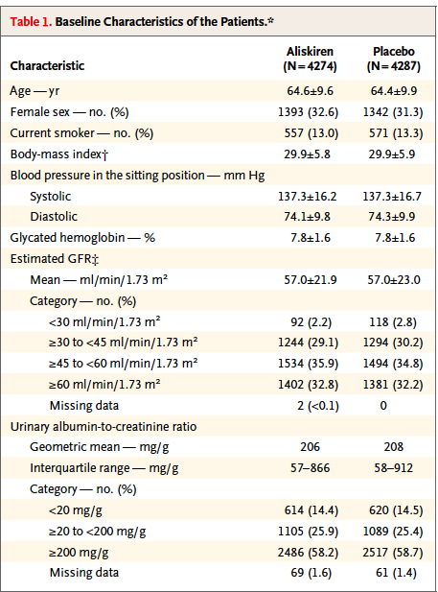
Aliskiren (ALTITUDE trial)
Aliskiren vs placebo on top of
standaard ACEi/ARB
8561 DM2 patienten
NEJM dec 2012
Parving et al

Slide 14
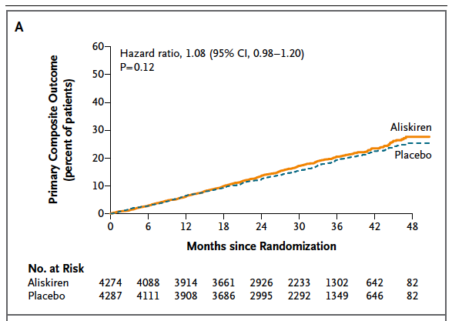
Aliskiren
NEJM dec 2012
Parving et al

Slide 15
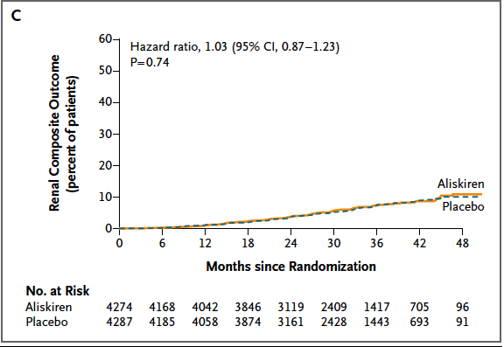
Aliskiren
NEJM dec 2012
Parving et al

Slide 16
Alternatieve behandelingen DN
Therapeutische opties naast RAS blokkade???
- Aliskiren
- Mineralocorticoid blokkade
- Allopurinol
- Sevelamer
- Bardoxolone
- Pirfenidone
- Pyridoxamine

Slide 17
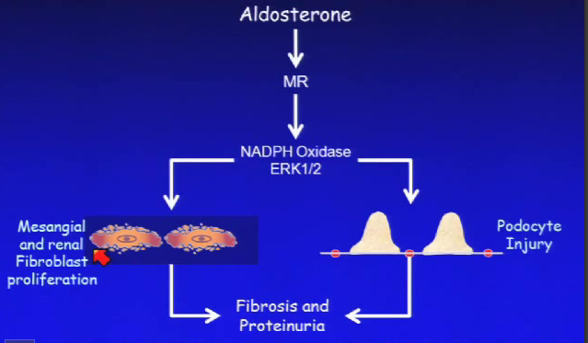
Mineralocorticoid blokkade
Aldosterone-Induced Glomerular Injury & Proteinuria
Hemodynamic effects
Mesangial and renal
Fibroblast proliferation
Podocyte Injury
Fibrosis and Proteinuria
Terada et al JASN 2005
Nagese et al ClinExpNephrol 2008

Slide 18
Mineralocorticoid blokkade
20-50% extra reduction in proteinuria
JASN 2009, 20(12), 2641
No cardiovascular outcome studies using MC blockade in CKD
No studies of CKD progression using MC blockade

Slide 19
Alternatieve behandelingen DN
Therapeutische opties naast RAS blokkade???
- Aliskiren
- Mineralocorticoid blokkade
- Allopurinol
- Sevelamer
- Bardoxolone
- Pirfenidone
- Pyridoxamine

Slide 20
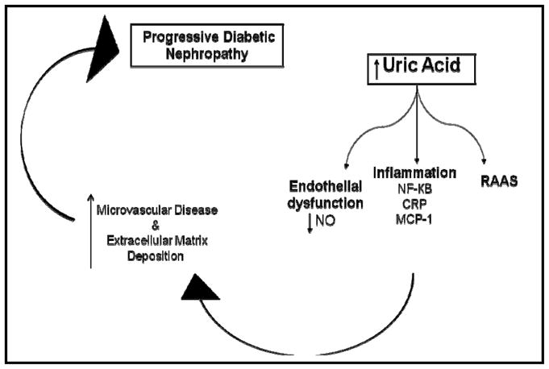
Urinezuur en DN

Slide 21
Urinezuur en DN

Slide 22
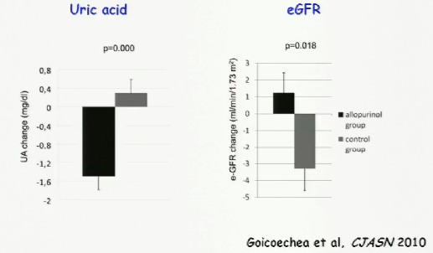
Urinezuur en DN: effect allopurinol
N=113 (37% met DM)
eGFR < 60 ml/min
Placebo vs Allopurinol 100 mg
Follow up 24 mnd

Slide 23
Urinezuur en DN: de toekomst

Slide 24
Alternatieve behandelingen DN
Therapeutische opties naast RAS blokkade???
- Aliskiren
- Mineralocorticoid blokkade
- Allopurinol
- Bardoxolone
- Sevelamer
- Pirfenidone
- Pyridoxamine

Slide 25
Anti-inflammatory molecules: Nrf2
Nuclear factor erythroid-2-related factor-2 (Nrf2) Activation
=> Anti inflammatory & Tissue Protective
Notes:
Nrf2 is a master switch for anti-inflammatory and anti-oxidant mediators
Repressed by binding to Keap1 (cytroplasm)
Inflammatory mediators allow release of NRF2 from Keap 1 allowing translocation to nucleus
Upregulation of anti-inflammatory mediators
Counterbalnces effect of NF-kB

Slide 26
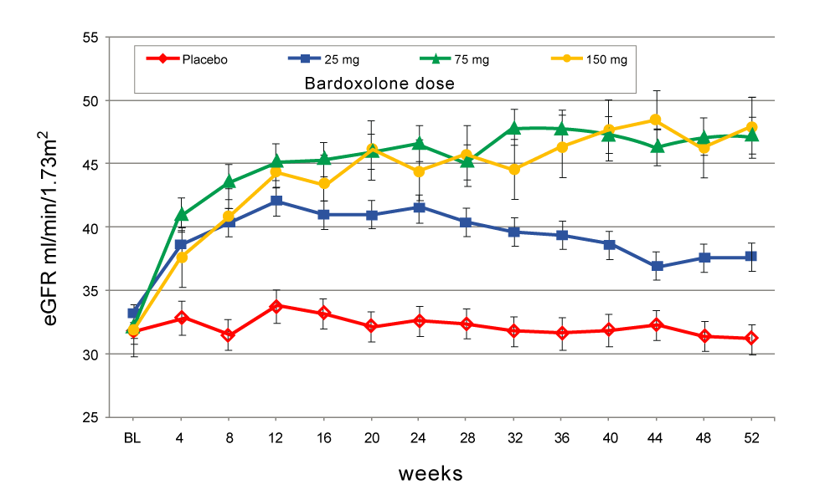
Nrf2 en DN: Effect Bardoxolone
Bardoxolone in T2D (BEAM)
Dose-effect of bardoxolone in T2D (n=227) with eGFR 20-45 ml/min
Follow up 52 wk
Pergola et al, NEJM 2011; 365:327-36

Slide 27
Nrf2 en DN: einde Bardoxolone?

Slide 28
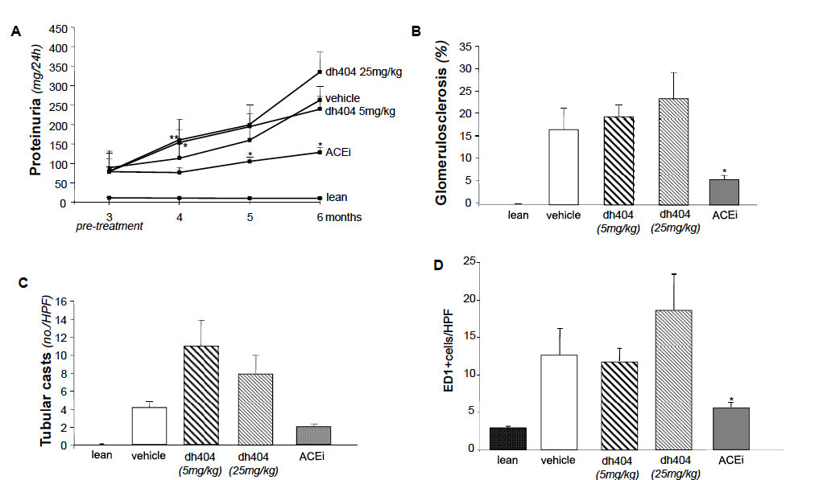
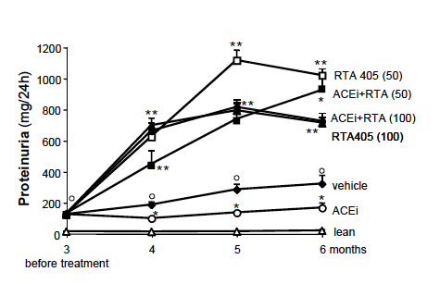
Nrf2 en DN: Effect Bardoxolone
ANALOGUES OF BARDOXOLONE METHYL WORSEN DIABETIC
NEPHROPATHY IN RATS WITH ADDITIONAL ADVERSE EFFECTS
Am J Physiol Renal Physiol (November 7, 2012).

Slide 29
Alternatieve behandelingen DN
Therapeutische opties naast RAS blokkade???
- Aliskiren
- Mineralocorticoid blokkade
- Allopurinol
- Bardoxolone
- Sevelamer
- Pirfenidone
- Pyridoxamine

Slide 30
AGEs en DN

Slide 31
AGEs

Slide 32
AGEs in dieet

Slide 33
AGEs en DN: effect dieet

Slide 34
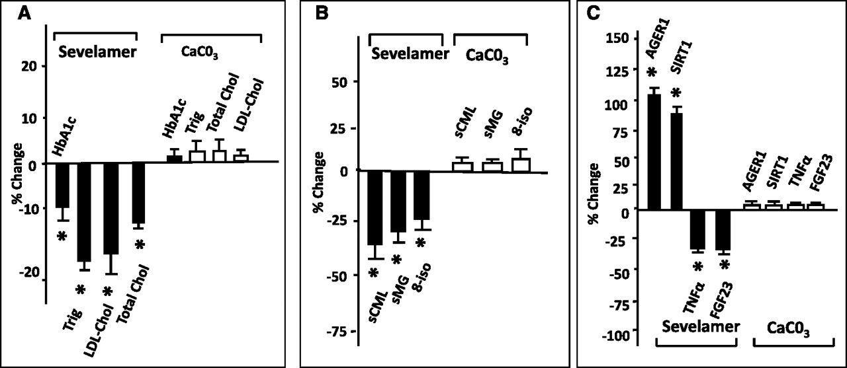
AGEs en DN: effect Sevelamer
Effects of sevelamer on metabolic, AGE, oxidant, and antioxidant factors.
Vlassara H et al. CJASN 2012;7:934-942
Notes:
Effect of sevelamer on metabolic, AGE, oxidant, and antioxidant factors. The differential effects of calcium carbonate and sevelamer carbonate on (A) metabolic factors, (B) AGEs and oxidized lipids, and (C) antioxidant status and markers of inflammation. Changes are expressed as the mean percentage change from baseline to the end of the 8-week treatment period for individual patients. An asterisk denotes a significant change (P<0.05). AGE, advanced glycation end product; trig, triglycerides; LDL-Chol, LDL cholesterol; total chol, total cholesterol; sCML, serum carboxymethyllysine; sMG, serum methylglyoxal; 8-iso, 8-isoprostanes; AGER1, AGE receptor 1; SIRT1, sirtuin 1; FGF23, fibroblast growth factor 23.

Slide 35
Alternatieve behandelingen DN
Therapeutische opties naast RAS blokkade???
- Aliskiren
- Mineralocorticoid blokkade
- Allopurinol
- Bardoxolone
- Sevelamer
- Pyridoxamine
- Pirfenidone

Slide 36
AGEs en DN: effect Pyridorine
Pyridoxamine (Pyridorine)
Potent inhibitor of AGE formation
Anti-oxidant and scavenger
In pre-clinical research protection for DN
Klinische studie met 300 en 600 mg pyridorin on top of maximale RAAS blokkade:
317 DM2 patienten met gevorderde CKD 3b en 4 en proteinurie
Na 1 jaar geen effect op eGFR en proteinurie
Subgroep analyse in patienten met minder nierschade wel gunstig effect.
Vroeg inzetten in traject van DN dus mogelijk wel gunstig
Lewis et al. JASN 2012

Slide 37
Alternatieve behandelingen DN
Therapeutische opties naast RAS blokkade???
- Aliskiren
- Mineralocorticoid blokkade
- Allopurinol
- Bardoxolone
- Sevelamer
- Pyridoxamine
- Pirfenidone

Slide 38
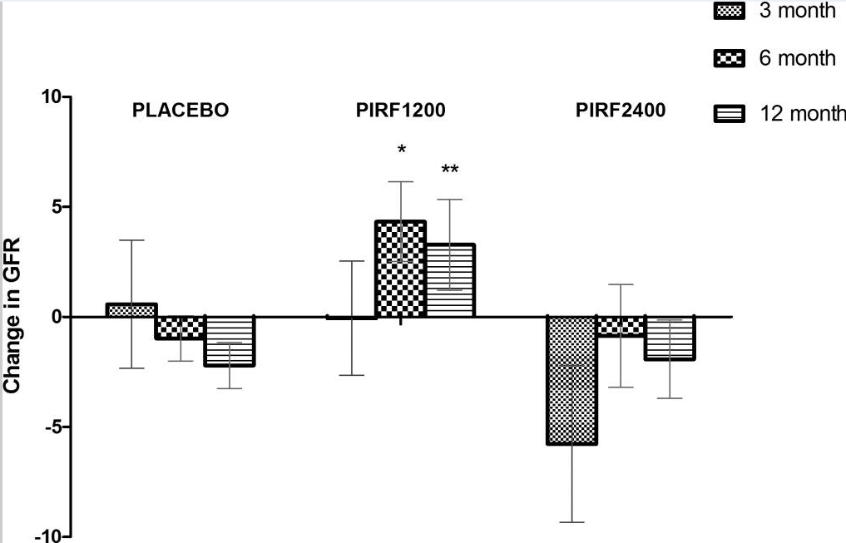
TGF-β en DN: Pirfenidone
Werking Pirfenidone :
Remt TGF-β productie
Remt TNF-α productie
=> afname matrix depositie in experimentele dier modellen van nier en longziekten
RCT in 77 DM2 met albuminurie
eGFR 20-75 ml/min
Follow-up 1 jaar
Geen effect op albuminurie
1200 mg heeft gunstig effect op eGFR achteruitgang
Veel bijwerkingen!
Veel drop-outs!
J Am Soc Nephrol. 2011 June; 22(6): 1144–1151.

Slide 39
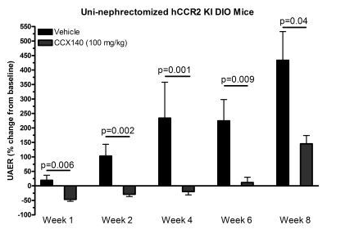
In de pijplijn……………
The CCR2 Chemokine Receptor Antagonist CCX140 Improves Renal Function in
Diabetic Mice Expressing Human CCR2
Wordt nu in fase 2 trial
In 135 DM2 patienten getest
Idem voor NOX-E36
Antagonist van CCL2/CCR2
anti-inflammatoir
Renoprotectief
Abstract: [SA-PO475] The CCR2 Chemokine Receptor Antagonist CCX140 Improves Renal Function in Diabetic Mice Expressing Human CCR2 Tim Sullivan, PhD et al
Abstract: [PUB291] Pharmacokinetics, Pharmacodynamics, Safety and Tolerability of the CCL2 Antagonist NOX-E36, a Novel Agent Being
Investigated for Treatment of Diabetic Nephropathy Grit Landgraf, PhD, et al

Slide 40
Nieuwe (vroege) biomarkers voor DN
A Urinary Proteomic Set of Biomarkers Predicts Albuminuria Progression in Type 2 Diabetes Sara S. Roscioni, PhD, Dick de Zeeuw, MD, PhD et al
Analyse van STENO en PREVEND data
“The proteomic classifier was independently associated with albuminuria transition.
The classifier predicted onset of micro- and macroalbuminuria on top of baseline
albuminuria and eGFR”
Urinary Proteomics Predict Onset of Microalbminuria in a Cohort of Normoalbuminuric
Type 1 Diabetic Patients in the DIRECT 1 Study Morten Lindhardt et al.
Analyse van DIRECT-1 data (n=782)
At baseline the CKD risk score was able to predict development of MA during follow-up,
independent of treatment (candesartan/placebo), age, gender, baseline systolic BP,
baseline UAER, baseline eGFR, baseline HbA_{1c} and diabetes duration (HR 3.7 (95% CI 1.4-9.3),
p=0.006).

Slide 41
Nieuwe (vroege) biomarkers voor DN
Copeptin => surrogaat marker voor vasopressine
Vasopressine => hyperfiltratie, albuminurie, glomerulosclerose
Analyse ZODIAC data:
976 patienten met DM2
“In diabetic patients, higher baseline copeptin level is
significantly associated with an increase in ACR and
a decline in eGFR during follow-up, independent of
and stronger than several traditional CKD risk factors”.
Abstract: [TH-PO537] Copeptin, a Surrogate Marker for Vasopressin, Is Associated with Progression of
Diabetic Nephropathy (ZODIAC-33) Wendy E. Boertien et al

Slide 42
Nieuwe (vroege) biomarkers voor DN
Bone-related peptide osteoprotegerin (OPG) =>
produced by vascular cells and involved in vascular calcification.
Finnish Diabetic Nephropathy Study (2116 T1D, 212 controls):
OPG was not only predictive of CVD events and progression to ESRD but also of
all-cause mortality.
Abstract: [FR-OR045] Osteoprotegerin (OPG) Is Increased in Patients with Type 1 Diabetes and Diabetic Nephropathy
and Predicts Mortality Aino Soro-Paavonen, MD, PhD et al
Urine Haptoglobin/Creatinin Ratio (HCR)
HCR appears equivalent to, but independent of ACR as a predictor for progressive DN;
therefore, the discriminatory power of models that combine the two biomarkers may be
superior to that of models using one biomarker.
The clinical use of HCR may enable better prediction of patients at risk for adverse
renal outcomes.
Abstract: [TH-PO508] Urine Haptoglobin Predicts Development of Diabetic Nephropathy in Patients with Type 2 Diabetes Nishant M. Bhensdadia, MD,et al.

Slide 43
Take home messages
1. Strikte glucose controle en RAS blokkade alleen zijn onvoldoende om DN te voorkomen
2. DN is in principe reversibel
3. Vroege interventie loont
4. Er is behoefte aan specifiekere en vroegere markers voor DN dan albuminurie en eGFR
-Copeptine
-Urine proteomics
-Urine haptoglobine
-Osteoprotegerin
5. Mogelijke nuttige interventies naast RAS blokkade en glucose controle zijn:
- mineralocorticoid blokkade
- urinezuur verlagende therapie
- AGEs beperkt dieet
- sevelamer
- pirfenidone
6. Bardoxolone lijkt (voorlopig?) geen toekomst te hebben voor behandeling DN

