Slide 1
Biomarkers
Cardiovascular Conference
Noordwijkerhout, 14-03-2013
Matthijs Boekholdt, MD PhD
Department of Cardiology
Academic Medical Center
Amsterdam, The Netherlands

Slide 2
Outline
Background
LDL-C, how low can we go?
Lp(a), renewed interest
Phospholipases and causality
Inflammation: CRP and the IL-6R pathway

Slide 3
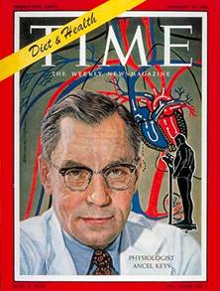
The early days
There are good enough reasons to suspect that our present high-fat diet in the United States is scarcely favorable to the health of adult men, even though it is premature to blame it as the whole cause of our excessive mortality from heart disease.
Keys. Am J Publ Health 1953

Slide 4
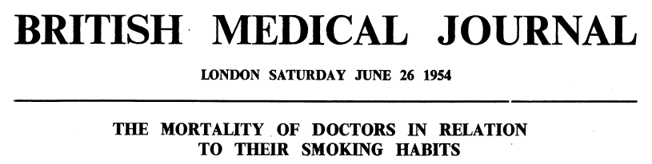
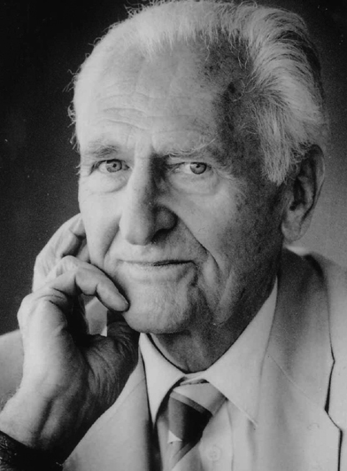
….the resulting rates reveal a significant and steadily rising mortality from deaths due to cancer of the lung as the amount of tobacco smoked increases. There is also a rise in the mortality from deaths attributed to coronary thrombosis as the amount smoked increases.
Richard Doll
1912-2005

Slide 5
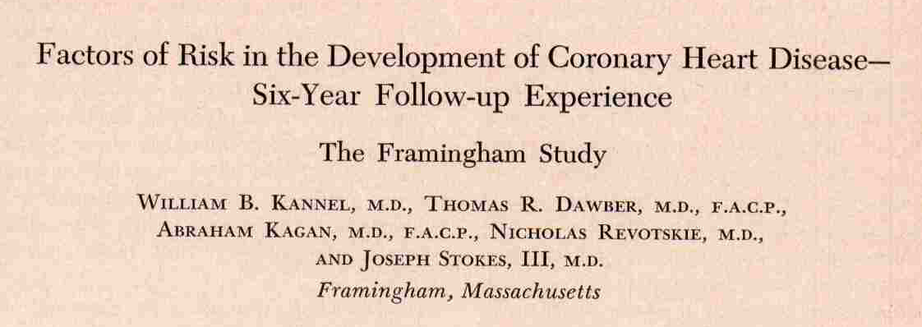
Cholesterol
Systolic and diastolic blood pressure
LVH on ECG
Ann Intern Med 1961

Slide 6
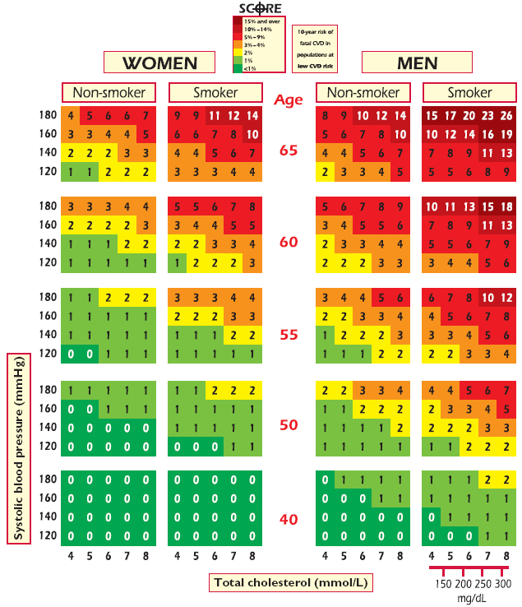
ESC guidelines. EHJ 2012

Slide 7
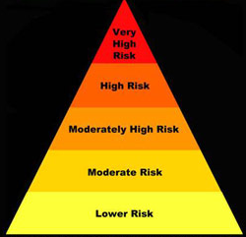
The prevention paradox

Slide 8
The quest for novel biomarkers
Clinical practice vs research
Improve risk prediction
Monitor therapeutic efficacy
Enhance understanding of biology
Identify novel treatment targets
Quantifiable
Associated with risk of cardiovascular events
Independent of other known risk factors
Response to therapy

Slide 9
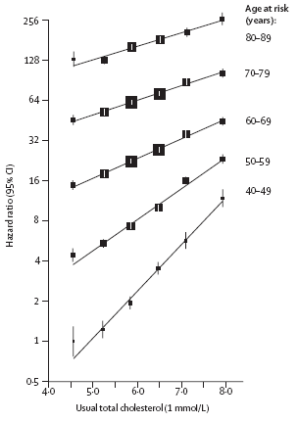
Total cholesterol
PSC. Lancet 2007

Slide 10
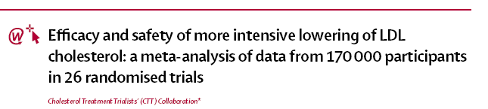
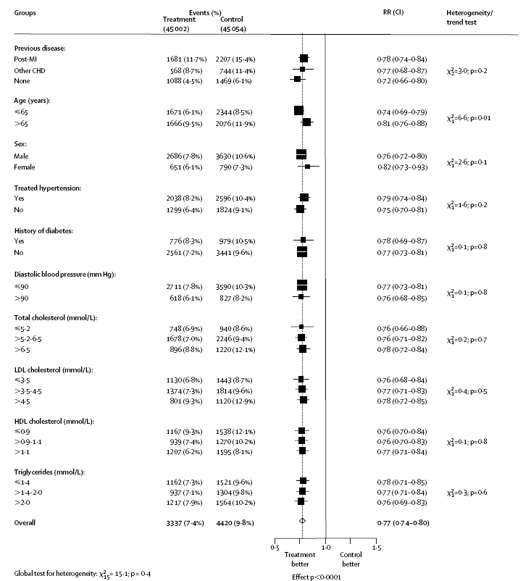
CTTC. Lancet 2005

Slide 11
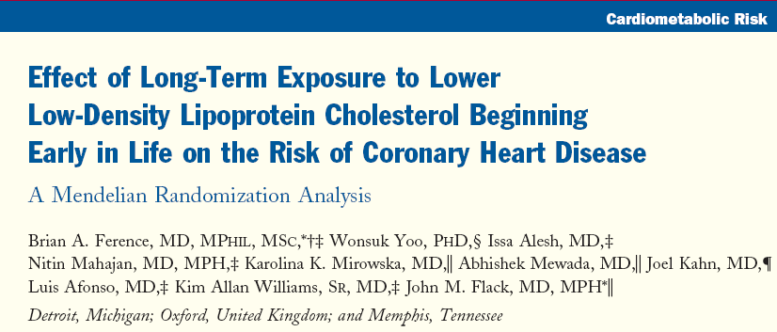
Prolonged exposure to lower LDL-C beginning early in life is associated with a reduction in the risk of CHD.
JACC 2012

Slide 12
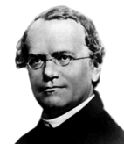
Mendel
The Law of Independent Assortment states that separate genes for separate traits are passed independently of one another from parents to offspring.
At birth, we are all randomized to genetic variants causing slight phenotypical variations, which are independent of all other characteristics.
Mendelian randomization provides an opportunity to elucidate the causal nature of associations between biomarkers and disease risk.
Gregor Mendel
1822-1884

Slide 13
Mendelian randomization
Genotype
Observed vs expected
Observed
Phenotype
Disease
Observed
Confounding, bias, reverse causality, etc

Slide 14
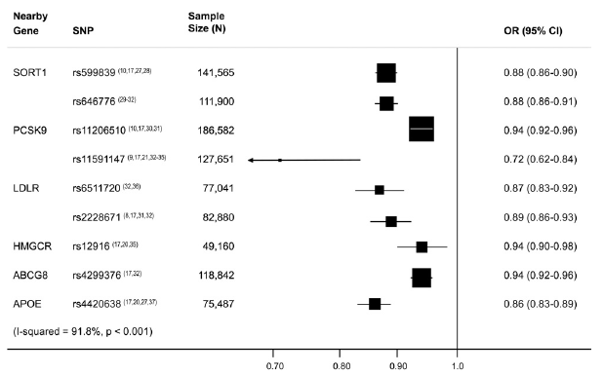
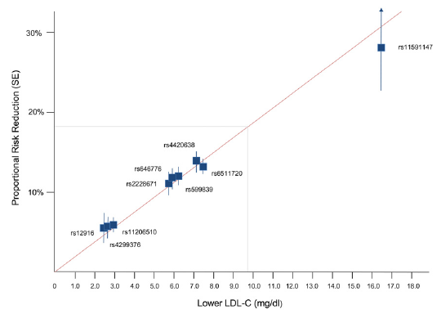
Lifelong low LDL-C
Ference et al. JACC 2012

Slide 15
Anything new in the field of LDL-C?

Slide 16
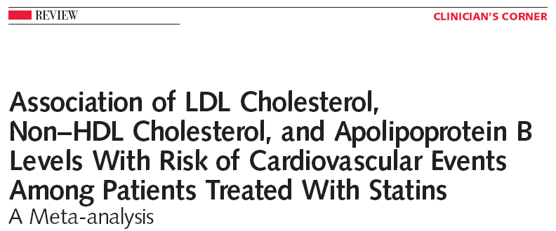
Meta-analysis
Statin trials with lipid and apolipoprotein levels available
4S, AFCAPS-TexCAPS, LIPID, TNT, IDEAL, CARDS, SPARCL, JUPITER
38.153 patients allocated to statin therapy
5.387 major cardiovascular events
Boekholdt et al. JAMA 2012

Slide 17
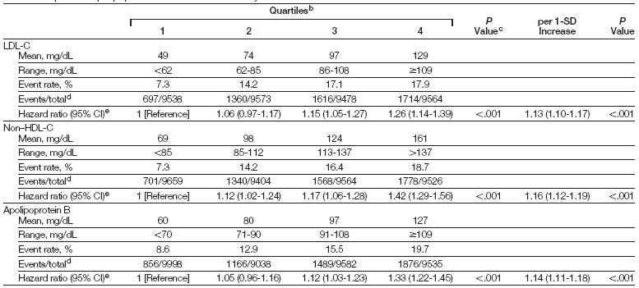
LDL-C vs non-HDL-C vs apoB
Boekholdt et al. JAMA 2012

Slide 18
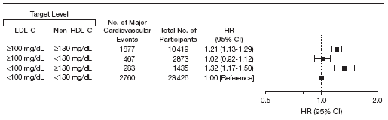
LDL-C vs non-HDL-C
2,6 mmol/L 3,3 mmol/L
Boekholdt et al. JAMA 2012

Slide 19
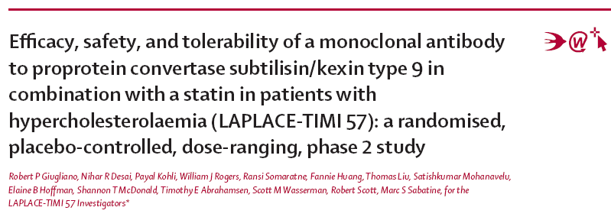
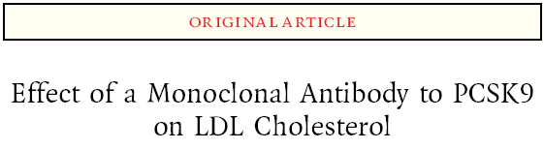
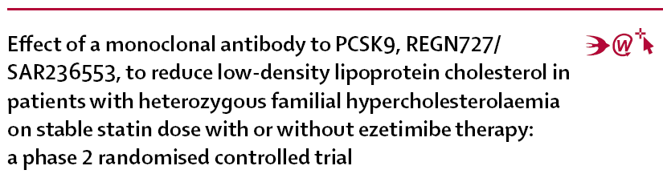
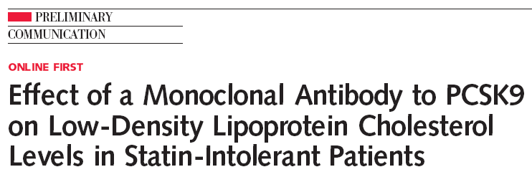
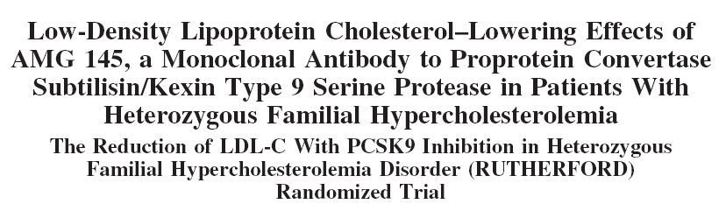
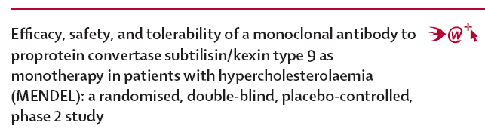
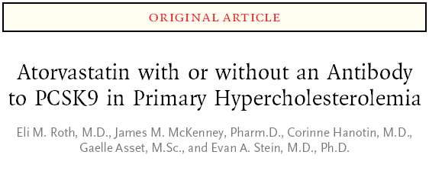
How low can we go?

Slide 20
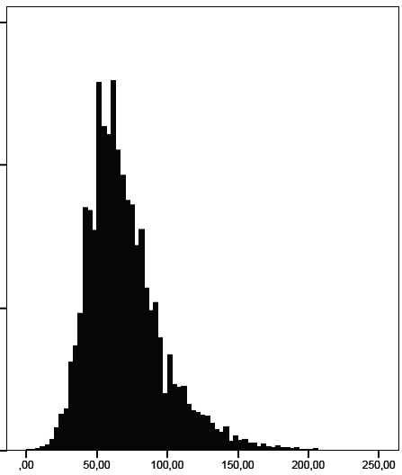
Achieved LDL-C
Among 18.661 patients assigned to high-dose statin therapy, 7.530 (40,4%) did not reach an LDL-C target <1,8 mg/dL
Manuscript in preparation

Slide 21
Very low LDL-C
LDL-C | < 25 < 0,6 | 25-50 0,6-1,3 | 50-75 1,3-1,9 | 75-100 1,9-2,6 | 100-125 2,6-3,2 | 125-150 3,2-3,9 | 150-175 3,9-4,5 | > 175 > 4,5
n | 284 | 4.091 | 10.395 | 10.091 | 8.953 | 3.128 | 836 | 375
Event rate | 2.5% | 4.6% | 11.4% | 16.5% | 16.5% | 17.8% | 22.0% | 32.8%
Manuscript in preparation

Slide 22
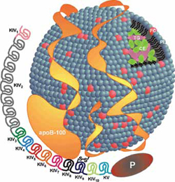
Lipoprotein(a)
Discovery in 1963 by Kåre Berg.
Lipoprotein(a) consists of an LDL-like particle and apo(a) tail, bound to apoB.
Lp(a) levels are highly heritable and mainly controlled by the LPA gene located on chromosome 6q26-27.
Apo(a) proteins vary in size due to a VNTR polymorphism, resulting in apo(a) proteins with 10 to >50 kringle IV repeats.

Slide 23
Lipoprotein(a)
Physiological inhibitor of plasminogen, creating a procoagulant state by suppressing fibrinolysis.
Lp(a) levels are strongly associated with CVD risk, independent of LDL-C.
Causality?
Non-modifiable by available therapy.

Slide 24
Lp(a) - CHD
Two LPA variants that were strongly associated with increased Lp(a) levels were proportionally associated with increased CHD risk.
These findings support a causal role of Lp(a) in CHD risk.
PROCARDIS Consortium. NEJM 2011

Slide 25
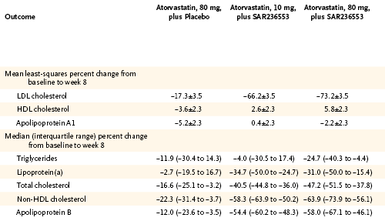
PCSK9 inhibition and Lp(a)
Roth et al. NEJM 2012

Slide 26


Slide 27
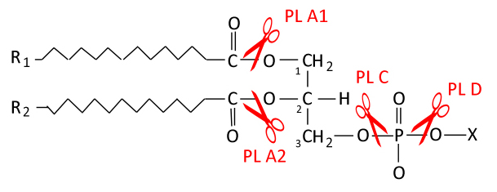
Phospholipases
Phospholipase A2 (PLA2) enzymes hydrolyze phospholipids at the
sn-2 position
Phospholipids are abundantly present in membranes of cells and lipoproteins
Products are lysophospholipids and fatty acids, leading to the activation of various proinflammatory pathways involved in atherosclerosis

Slide 28
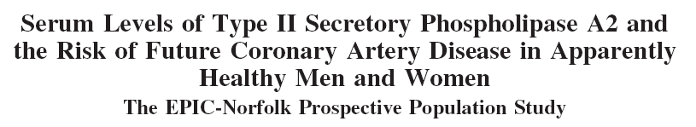
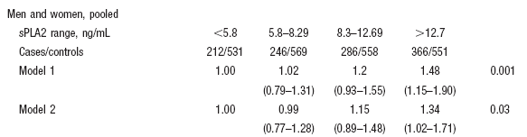
Boekholdt et al. ATVB 2005

Slide 29
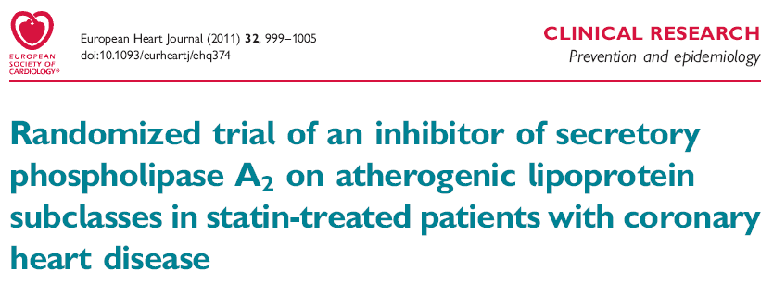
Rosenson et al. Eur Heart J 2011

Slide 30
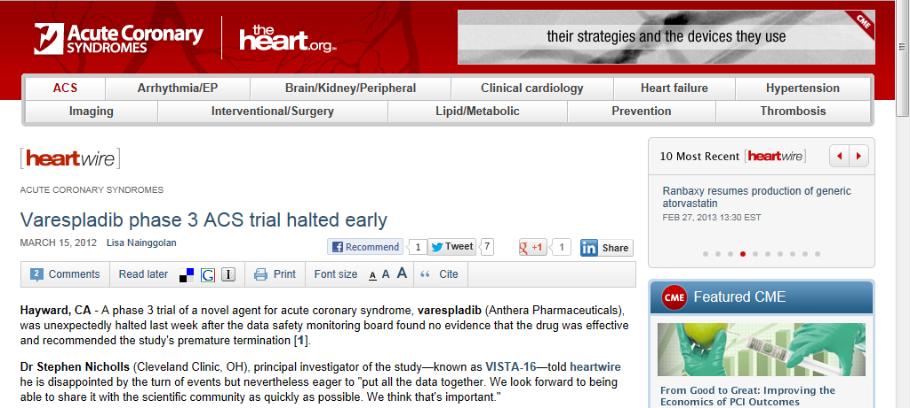

Slide 31
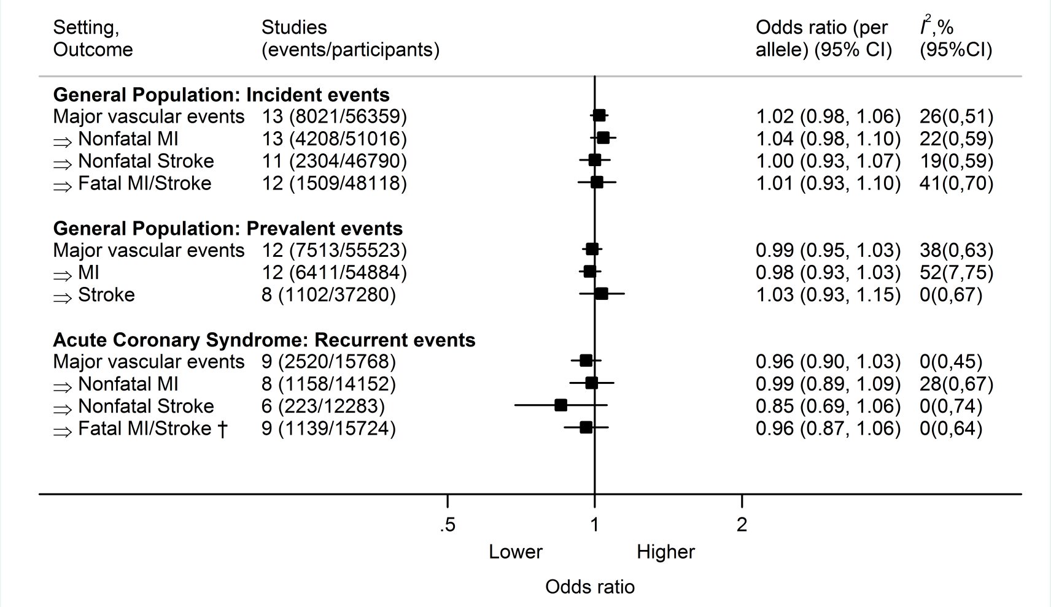
Mendelian randomization
Holmes et al. Submitted

Slide 32
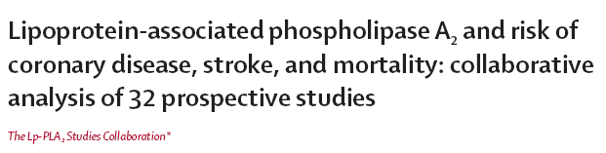
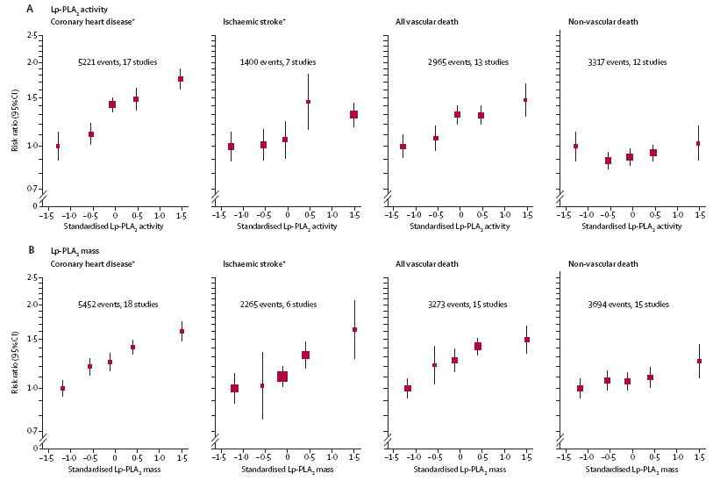
Lancet 2010

Slide 33
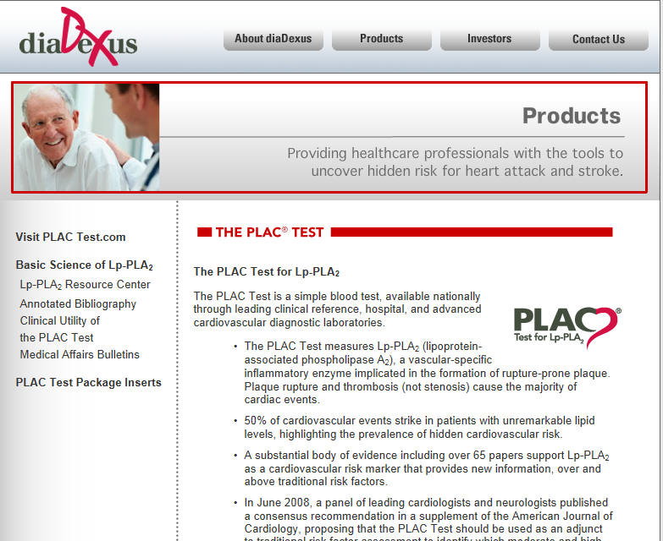

Slide 34
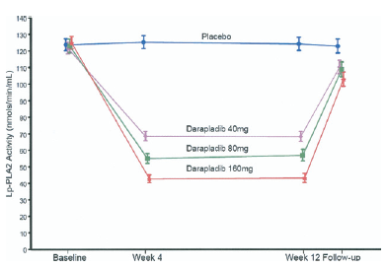
Darapladib
Mohler et al. JACC 2008

Slide 35
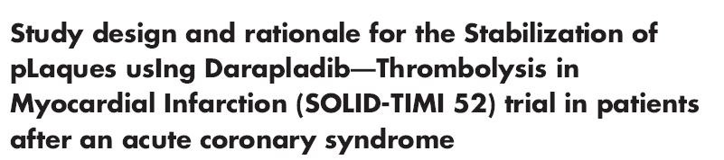
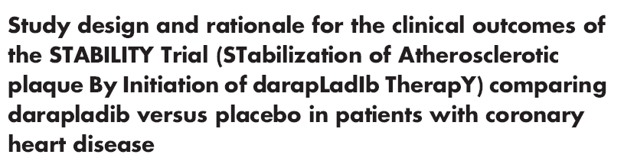
Darapladib trials
Am Heart J 2011

Slide 36
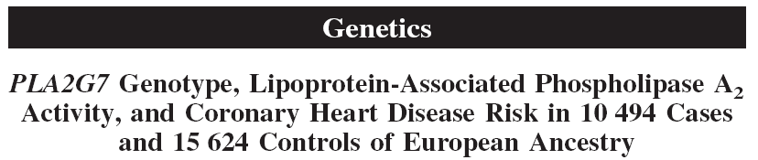
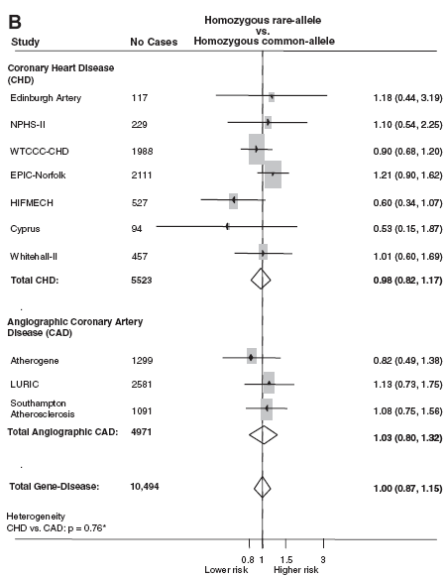
titel
Unlike Lp-PLA2 activity, PLA2G7 variants associated with modest effects on
Lp-PLA2 activity were not associated with risk of cardiovascular events.
Casas et al. Circulation 2010

Slide 37

What about inflammation?

Slide 38
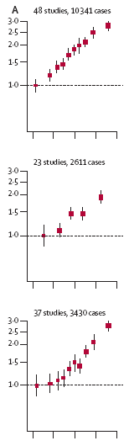
CRP and cardiovascular risk
CHD Stroke CV mortality
ERFC. Lancet 2009

Slide 39
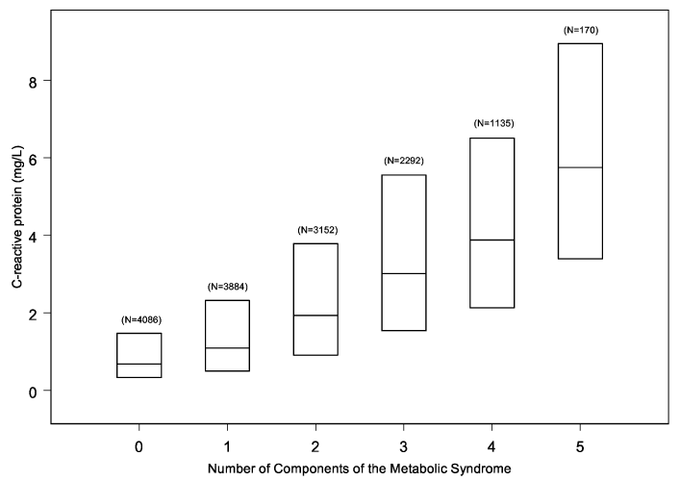
CRP is not independent of other risk factors
Ridker et al. Circulation 2003

Slide 40
In this trial of apparently healthy persons without hyperlipidemia but with elevated CRP levels, rosuvastatin significantly reduced the incidence of major cardiovascular events.
NEJM 2008

Slide 41
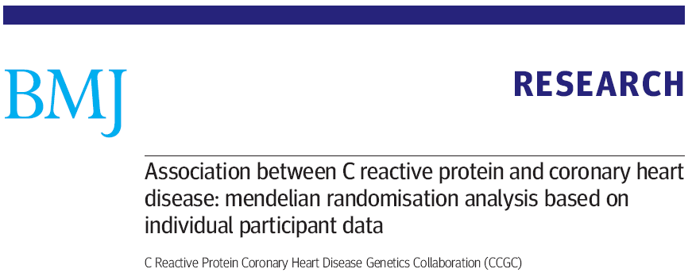
Mendelian randomisation meta-analysis of individual participant data from 47 epidemiological studies in 15 countries.
194.418 participants, including 46.557 patients with prevalent or incident coronary heart disease.
BMJ 2011

Slide 42
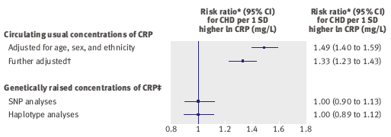
CRP: Mendelian randomization
Human genetic data indicate that CRP concentration itself is unlikely to be even a modest causal factor in coronary heart disease.
BMJ 2011

Slide 43
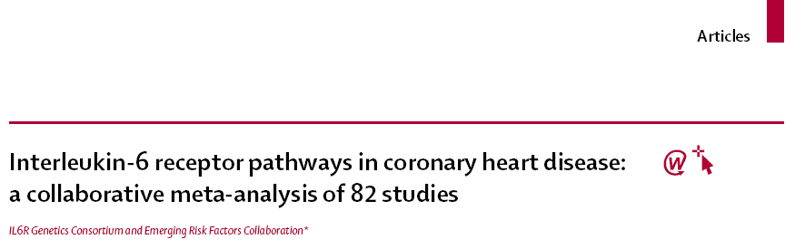
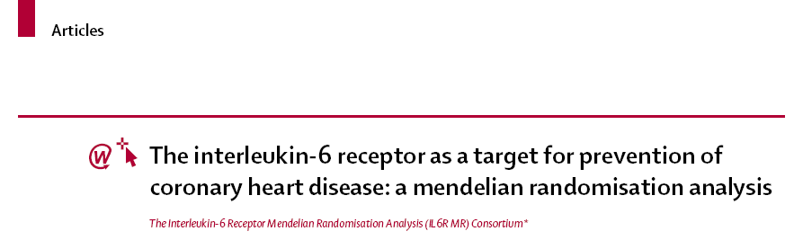
IL-6R variant Asp358Ala associated with:
per-allele 7,5% CRP reduction
per-allele 3,4% CHD risk reduction
Lancet 2012

Slide 44
IL-6 pathway
IL-6R Consortium. Lancet 2012

Slide 45
The present studies provide evidence for a causal role of the proinflammatory IL-6 pathway in determining CHD risk.
The delicate risk-benefit balance between inappropriate inflammation and anti-inflammatory interventions has confronted us with numerous unresolved issues.
Boekholdt & Stroes. Lancet 2012

Slide 46
Conclusions
LDL-C is a powerful risk factor, but the story is not over yet: how low can we go?
Lp(a) is probably a causal risk factor, novel therapeutic options?
Phospholipases are good markers, but sPLA2-IIa inhibition was not effective.
CRP is a good risk marker, but the CRP molecule itself is unlikely to be a therapeutic target.
The IL-6 pathway may be causally involved in atherogenesis, but whether therapeutic intervention in this pathway yields net benefit requires further investigation.
Plasma biomarkers and associated genetics may be helpful to improve risk prediction and identify novel therapeutic targets.

Slide 47
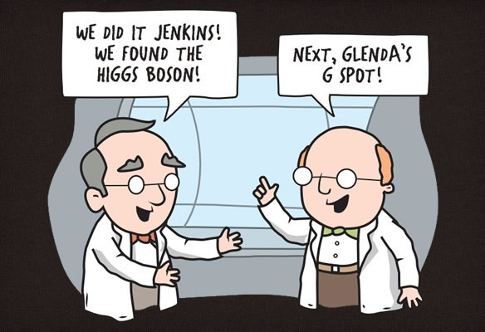
We did it Jenkins!
We found the Higgs boson!
Now let’s search for the perfect biomarker

