Slide 1
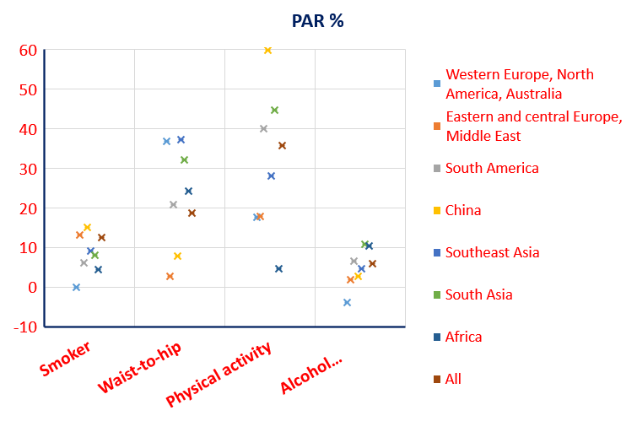
INTERSTROKE: population attributable risk (PAR)
PAR of several risk factors for stroke in different populations
Adapted from O’Donnel et al., Lancet 2016

