Slide 1

E-Vita HF
Effectiveness of an interactive web-based platform and a disease specific information website in patients with heart failure: a 3-arm randomized trial
Projectgroep:
Kim Wagenaar
Frans Rutten
Lidewij Broekhuizen
Tiny Jaarsma
Arno Hoes
Subsidie:
Zorg binnen bereik:
Opgezet door
Achmea
Philips

Slide 2
Hartfalen: ‘epidemie’

Slide 3

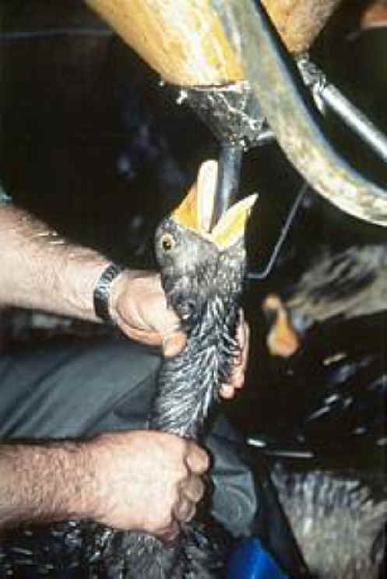

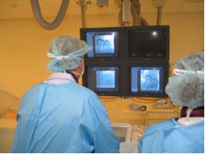

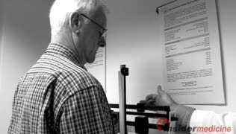
‘Managen’ hartfalen gecompliceerd

Slide 4
Disease management programs effectief
Bruggink-André de la Porte, et al. Heart 2007;93:819-25

Slide 5
Nieuwe ontwikkelingen
(tele)monitoring
e-health
“Something to do with computers, people, and health”
(Pagliari et al, 2005)
social networks / peer contacts etc
high-quality patient (carer) information website
“interactive care platform”
Werkt dit?

Slide 6
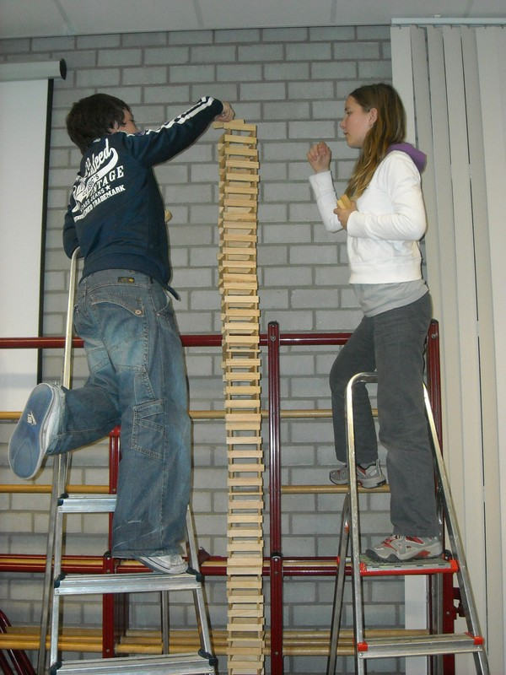
On top of everything else?

Slide 7
Hypothese 1
Selfcare ↑
Quality of life ↑
Hospitalisations, mortality ↓
Health care costs ↓
- op juiste moment (bij problemen / als patiënt het wil)
patient-tailored (persoonlijke onstandigheden)
‘finetuning’ informatie door vertrouwde, ervaren HF verpleegk
‘beroep doen’ op zelf-management, op veilige manier
betrekken mantelzorger

Slide 8
Hypothese 2
- rond medicatie
(interacties, therapietrouw, nierfunctie, waarom?, hoe lang?)
rond comorbiditeit
(meerdere artsen, samenwerking?, welke ziekte eerst)
gaat veel mis

Slide 9
Hypothese 3
na 3 maanden HF poli:
voldoende basiskennis bij patient en mantelzorger
alles ‘aan boord’ (optitratie, devices)
routine controles overbodig (als ‘vinger aan de pols’)

Slide 10
E-health; 4 pijlers
Vitale kenmerken ‘kale Motiva’ Gewicht Bloeddruk Pols |  | Medicatie Up to date Waarom Start/stop |  | Comorbiditeit Up to date samenwerking |  | eigen initiatieven patient Contact via platform Heartfailurematters ‘social network’ met lotgenoten
Bij alert: HF verpleegkundige bepaald beleid
Tel advies
poli cardiologie
opname ZH
HA gaat kijken (met terugkoppeling over beleid)
KRUISBESTUIVING

Slide 11


Slide 12
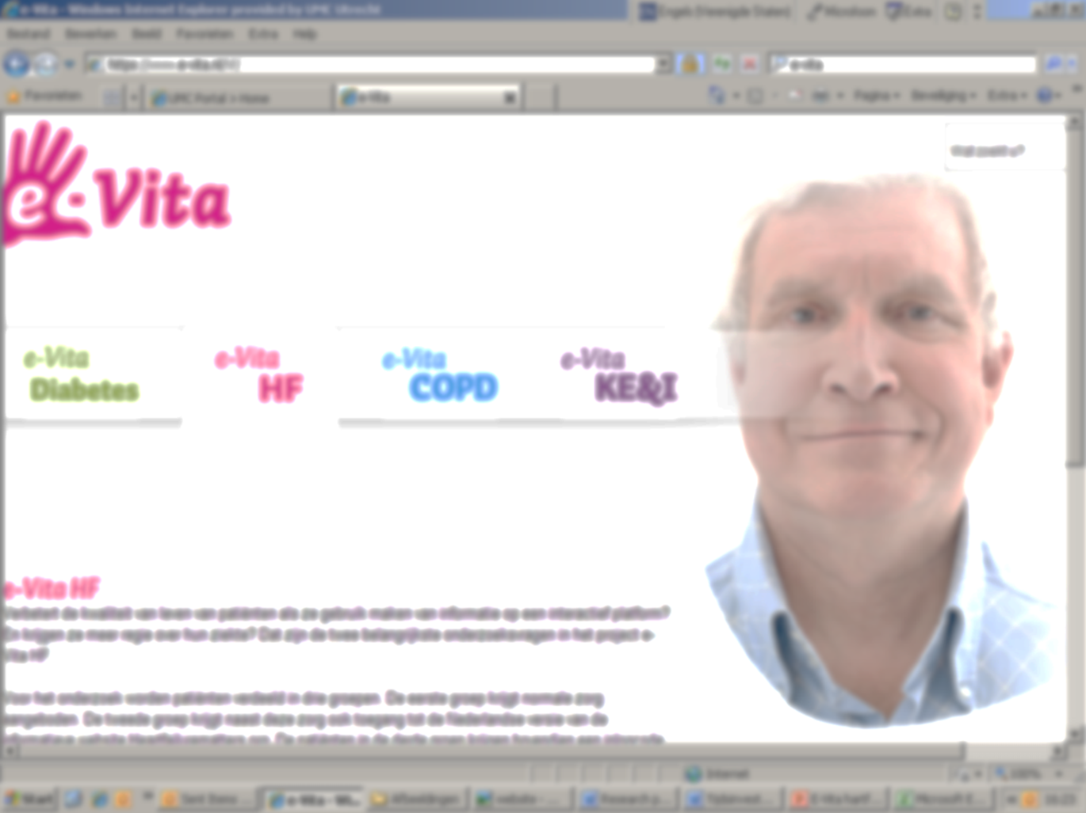
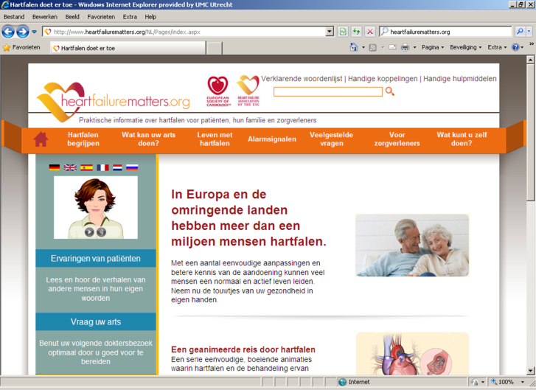
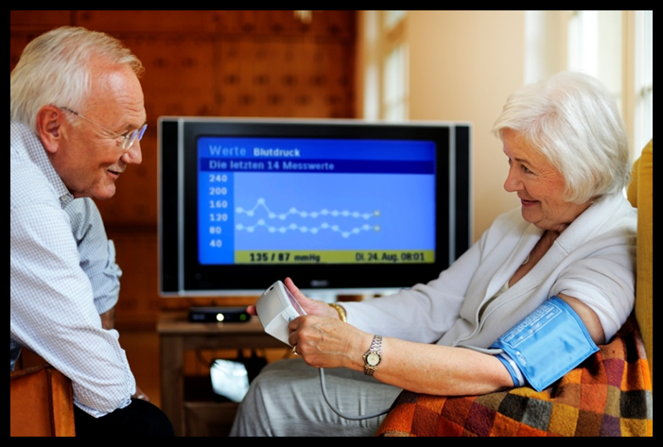
Interactief platform
WEBSITE
Telemonitoring system (Motiva®)

Slide 13
Research questions
1. Does a disease specific educational website improve knowledge about HF and its treatment, quality of life and self-care behaviour of patients with HF as compared to usual care?
2. Does a disease specific educational website plus an interactive web-based platform with telemonitoring facilities improve knowledge about HF and its treatment, quality of life, and self-care behaviour of patients with HF as compared to usual care?
3. Do these interventions reduce mortality and HF-related admissions compared to usual care?
4. Are these interventions cost-effective?

Slide 14
Study design
Randomised trial
with 3 arms
Arm 2:
Usual care + website
Arm 3:
Adjusted pathway:
1. Interactive platform
2. telemonitoring
3. no routine consultations
Arm 1:
Usual care

Slide 15
Study design
HF Poli
HA praktijk
HA praktijk
HA praktijk
HA praktijk
HA praktijk
- 750 patients with heart failure
- around 10 HF clinics and GP practices
- follow-up: 1 year
HF Poli
HA praktijk
HA praktijk
HA praktijk
HA praktijk
HA praktijk
HF Poli
HA praktijk
HA praktijk
HA praktijk
HA praktijk
HA praktijk

Slide 16
In- and exclusion criteria
Inclusion criteria: pragmatic
> 3 months established HF confirmed with echocardiography
sufficient cognitive and physical function
>18 years
Exclusion criteria: very few
non-availability internet and e-mail.
inability to work with internet and e-mail.
inability to read and understand Dutch.

Slide 17
Uitkomsten
Primary:
self-care behavior (EHFScB scale)
quality of life (SF36, EQ5D, MLWHFQ)
Secondary:
HF “biomarkers” (eg NTproBNP, eGFR)
knowledge about HF
change in HF medication
death, hospitalisation rates
use and grading of website
economic evaluation: models available

Slide 18
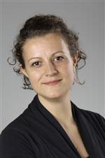
Waar staan we nu?
Kim Wagenaar, PhD student
9 ziekenhuizen ‘ja’
Toestemming METC rond
1 mei 2013 start inclusie

