Slide 1
Een specifiek antidotum voor NOACs is onnodig
PRO
Prof. dr. Saskia Middeldorp, internist
Afdeling Vasculaire Geneeskunde
Academisch Medisch Centrum, Amsterdam

Slide 2
Disclosures for Saskia Middeldorp
Research contracts: | - GSK, Bayer, BMS/Pfizer, Daiichi Sankyo, Sanquin
Consulting: | - GSK, Bayer, BMs/Pfizer, Boehringer Ingelheim, Daiichi Sankyo
Employment in industry: | - n.a.
Stockholder of a healthcare company: | - n.a.
Owner of a healthcare company: | - n.a.
Other: | - n.a.

Slide 3
Waarom een specifiek antidotum NIET NODIG is
Met een NOAC bloedt men minder vaak
Met een NOAC bloedt men minder erg
Antidotum voor VKA bestaat ook niet
Het gaat goed met NOACs (ook in de echte wereld)

Slide 4
1. Aantal bloedingen

Slide 5
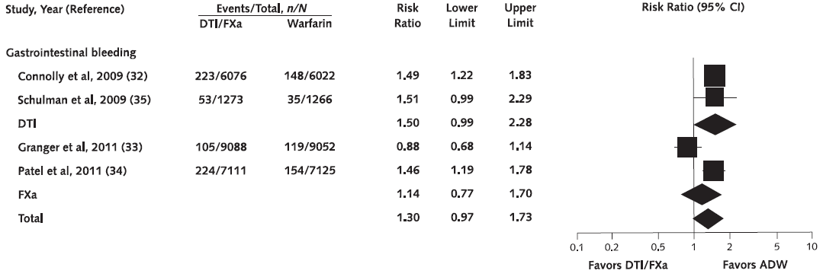
Gastrointestinal bleeding in NOAC trials
Adam, Ann Intern Med 2012

Slide 6
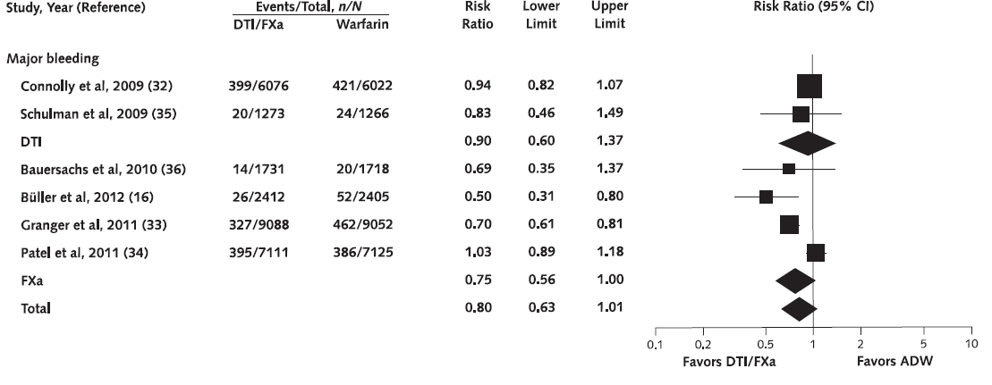
Major bleeding in NOAC trials
Adam, Ann Intern Med 2012

Slide 7
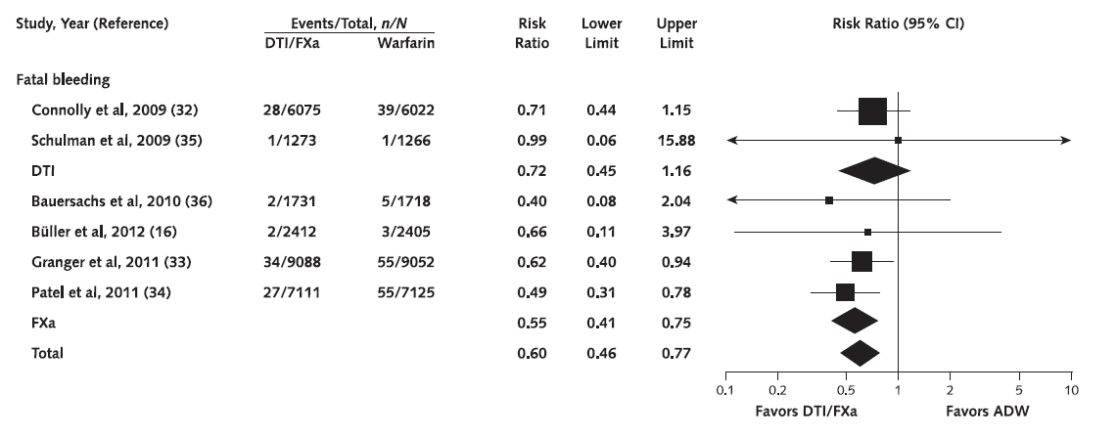
Fatal bleeding in NOAC trials
Adam, Ann Intern Med 2012

Slide 8
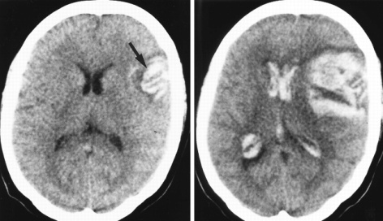
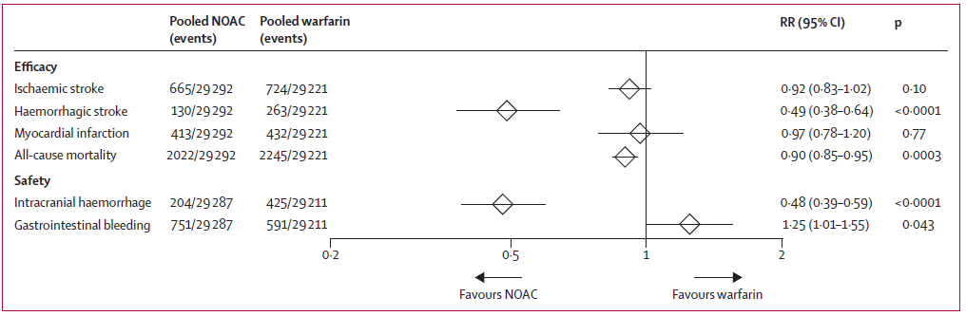
Intracraniële bloedingen (ICH)
Intracraniële bloedingen 0.7% vs 1.5%
NNT 132
Ruff, Lancet 2014

Slide 9
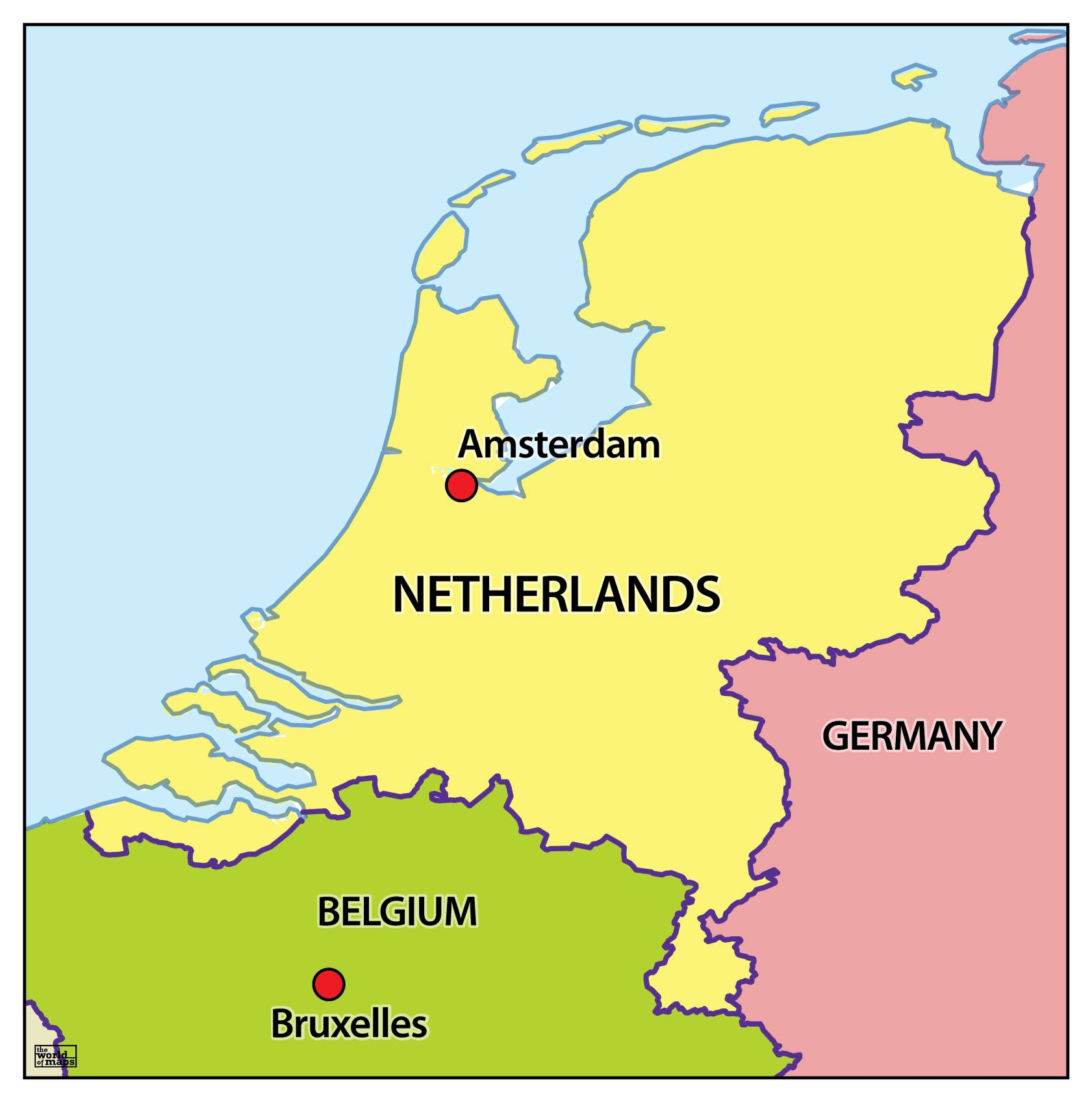
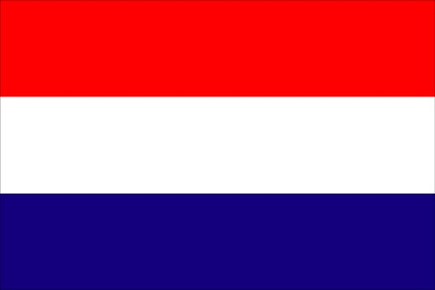
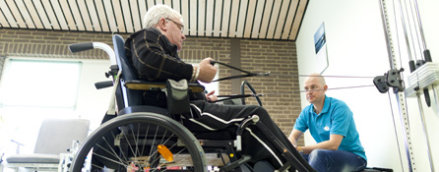
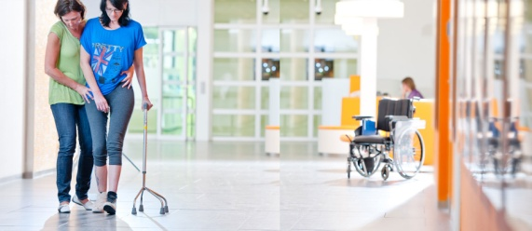
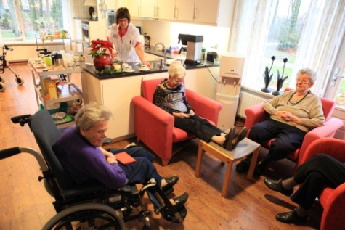
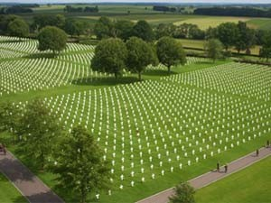
400.000 mensen ipv VKA een NOAC →
3000 minder ICH
1500 doden

Slide 10
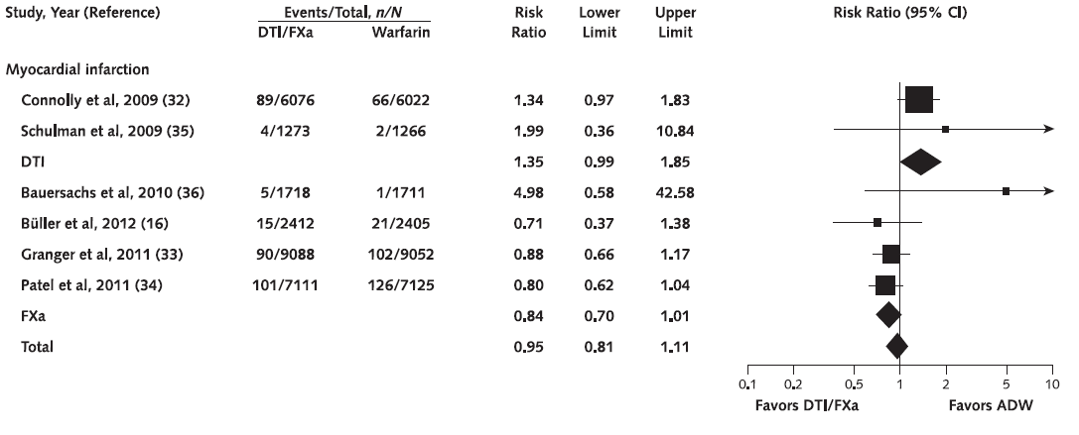
Myocardial infarction in NOAC trials
Adam, Ann Intern Med 2012

Slide 11
2. Ernst bloedingen

Slide 12
Consequences of Major Extracranial Hemorrhage
ARISTOTLE: Post-hoc Bleeding Analysis
Consequences of ISTH Major Extracranial Hemorrhage | Overall | Apixaban | Warfarin | Hazard Ratio (95% CI) | P Value
 | Event Rate (%/yr) | Event Rate (%/yr) | Event Rate (%/yr) | Apixaban vs. Warfarin
Led to hospitalization | 1.23 (374) | 1.05 (162) | 1.41 (212) | 0.747 (0.609–0.917) | 0.0052
Fall in hemoglobin 2 g/dL | 1.25 (381) | 1.06 (164) | 1.44 (217) | 0.739 (0.603–0.905) | 0.0035
Led to transfusion | 1.06 (325) | 0.89 (137) | 1.25 (188) | 0.712 (0.571–0.887) | 0.0025
Required a medical or surgical consultation | 1.74 (527) | 1.54 (236) | 1.94 (291) | 0.793 (0.668–0.941) | 0.0080
Required a medical or surgical intervention to stop | 0.77 (236) | 0.65 (100) | 0.90 (136) | 0.718 (0.555–0.930) | 0.0120
Associated with hemodynamic compromise | 0.32 (97) | 0.26 (40) | 0.38 (57) | 0.687 (0.459–1.029) | 0.0688
Caused changed in antithrombotic therapy | 1.31 (398) | 1.14 (176) | 1.47 (222) | 0.775 (0.636–0.945) | 0.0117
Adapted from a poster by Elaine M. Hylek at AHA 2012 entitled Reduction in Bleeding with Apixaban versus Warfarin Is Consistent Across Subgroups and Locations: Insights from the ARISTOTLE Trial
Notes:
Major extracranial hemorrhage associated with apixaban
Tended to be less severe as fewer led to hospitalization; fewer required a medical or surgical intervention to stop the bleeding; fewer required transfusion of 2 units of packed red blood cells; and fewer resulted in a change in antithrombotic therapy
We observed very similar results from the EINSTEIN trials (unpublished data)

Slide 13
Clinical presentation of major bleeding in the EINSTEIN studies
 | VKA |  | Rivaroxaban
Category 1 | 23% | 65% | 40% | 82%
Category 2 | 43% |  | 42%
Category 3 | 33% | 36% | 16% | 18%
Category 4 | 3% |  | 2%
P = 0.04
Eerenberg, presented at ISTH 2013

Slide 14
Clinical course of major bleeding in the EINSTEIN studies
 | VKA |  | Rivaroxaban
Category 1 | 27% | 68% | 38% | 80%
Category 2 | 42% |  | 42%
Category 3 | 22% | 32% | 11% | 20%
Category 4 | 10% |  | 9%
P = 0.66
Eerenberg, presented at ISTH 2013

Slide 15
3. Een antidotum voor VKA bestaat ook niet

Slide 16
Vitamine K
A comparison of the efficacy and rate of response to oral and i.v.
vitamin K in reversal of over-anticoagulation with warfarin
14
Orakay
Menadiol
12
Konakion 2 mg oral
Konakion 5 mg oral
Konakion 2 i.v.
10
Onset of effect: several hours
Duration of effect ~48 h (phenprocoumon)
8
INR
6
4
2
0
0
4
Time (h)
24
Vitamine K is géén acuut antidotum van VKA
Watson HG, et al. Br J Haematol 2001;115:145–149.

Slide 17
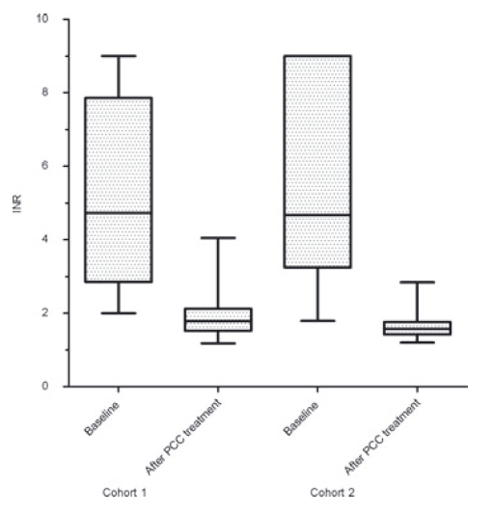
Niet-specifiek couperen
Vitamine K bij VKA – werkt na 6-12 uur
  PCC (“4 factoren concentraat) normaliseert INR
Dosis-onafhankelijk effect van PCC op bloedende VKA patient
Succesful clinical outcome 91%
Succesful clinical outcome 94%
Fixed dose
INR-based dose
Khorsand M, et al. Transfus Med 2011;21(2):116–123.

Slide 18
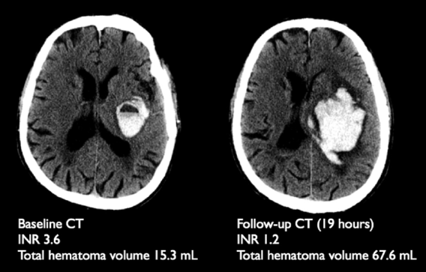
Outcomes in warfarin-associated intracranial haemorrhage
No clinical trial data
Conflicting results with regard
to haematoma growth or clinical outcome on PCC therapy
PCC and time to normalised INR most important (n=55)
INR correction alone may not
be sufficient to alter prognosis after anticoagulation-associated ICH2 (n=141)
Huttner HB, et al. Stroke 2006;37(6):1465–1470; Dowlatshahi et al. Stroke 2012;43:1812–1817.
Notes:
NB in Dowlatshahi study PCC was often given after CT scanning
Onset [of symptoms] to PCC treatment time (median IQR) 380 420 min*
Presentation to PCC treatment time (median IQR) 213 244 min†
CT to PCC treatment time (median IQR) 100 137 min†
Total PCC (Octaplex) dose (median IQR) 1000 U 500
Post-PCC INR (median IQR) 1.4 0.2
Time from infusion to post-PCC INR (median IQR) 54 min 49
INR 1.5 within 1 h of PCC infusion (%) 56/78 (71.8%)
INR 1.5 within 6 h of PCC infusion (%) 97/127 (76.4%)
Vitamin K administered (%) 107 (85.6%)†
FFP administered (%) 28 (22.4%)†

Slide 19
4. Het gaat goed met NOACs (ook in de echte wereld)

Slide 20
Reversal for NOACs
How important are they?
Peri-procedural bleeds in RE-LY(dabigatran)
No difference with warfarin despite the absence of a specific antidote (urgent surgery)
Urgent surgery | VKA N=111 | Dabigatran 110 mg bid N=107 | Dabigatran 150 mg bid N=141
% Major bleeds | 21.6 | 17.8 | 17.7
RR (95%CI) vs VKA | 1 | 0.82 (0.48-1.41) | 0.82 (0.50-1.35)
Healey, Circulation 2012

Slide 21
Data uit de echte wereld bevestigen trial bevindingen
Danish nationwide registry
  About 4000 dabigatran (110 & 150 mg BID) and about 9000 warfarin patients
FDA 13-5-2014
  > 134.000 medicare patients
Larsen TB et al. J Am Coll Cardiol 2013;61:2264–73; http://www.fda.gov/safety/medwatch/safetyinformation/safetyalertsforhumanmedicalproducts/ucm397179.htm;

Slide 22
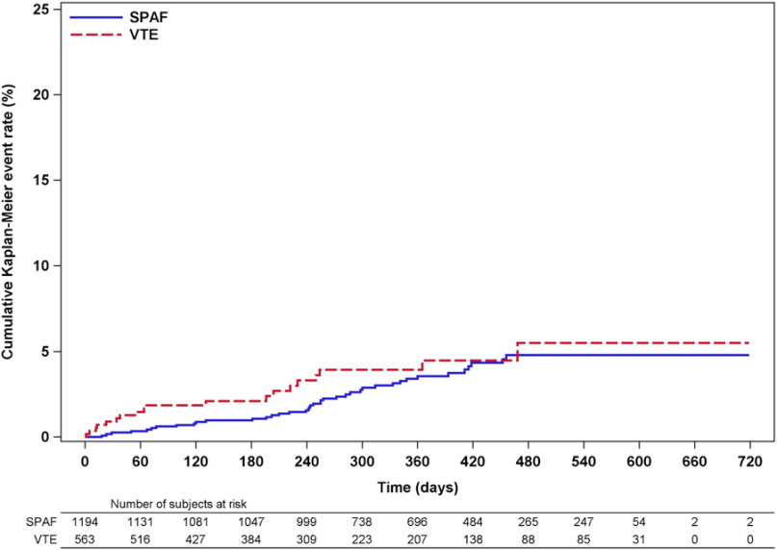
Dresden NOAC registry
1776 rivaroxaban patients
Of all bleeds
6% major
35% non-major clinically relevant
59% minor
Beyer-Westendorf, Blood 2014

Slide 23
Niet-specifiek couperen
NOAC – geen specifieke antidotes
  PCC verbetert laboratoriumtesten in niet-bloedende vrijwilligers
Dresden –registry 66 major bleedings
  62% lokale maatregelen / 38% interventie
  9% major bleedings behandeld met PCC
    4 volledig hersteld, 2 overleden (1 ICH, 1 pneumonie en sepsis)

Slide 24
DUS
Waarom een specifiek antidotum NIET NODIG is
Met een NOAC bloedt men minder vaak
Met een NOAC bloedt men minder erg
Antidotum voor VKA bestaat ook niet
Het gaat goed met NOACs (ook in de echte wereld)

Slide 25
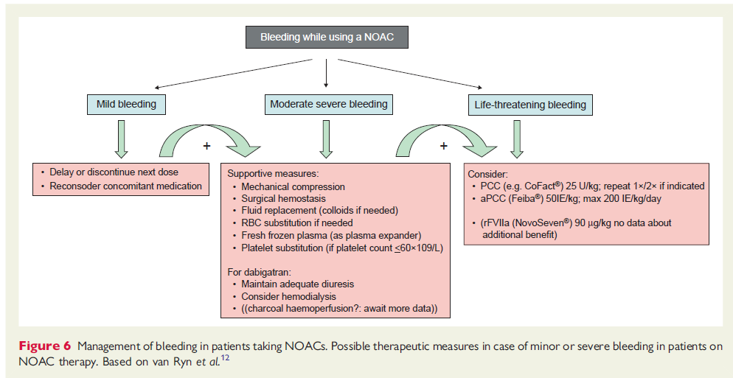
EHRA 2013 practice guidelines
Heidbuchel, Europace 2013

Slide 26
Caveats
Goed voorschrijven
  Leidraad NOACs Orde van Medisch Specialisten
  Landelijke Standaard Ketenzorg Anstolling
Therapietrouw
  Korte halfwaardetijd
Intercurrente ziekte en comorbiditeit

Slide 27
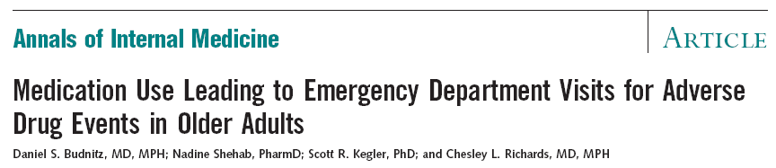
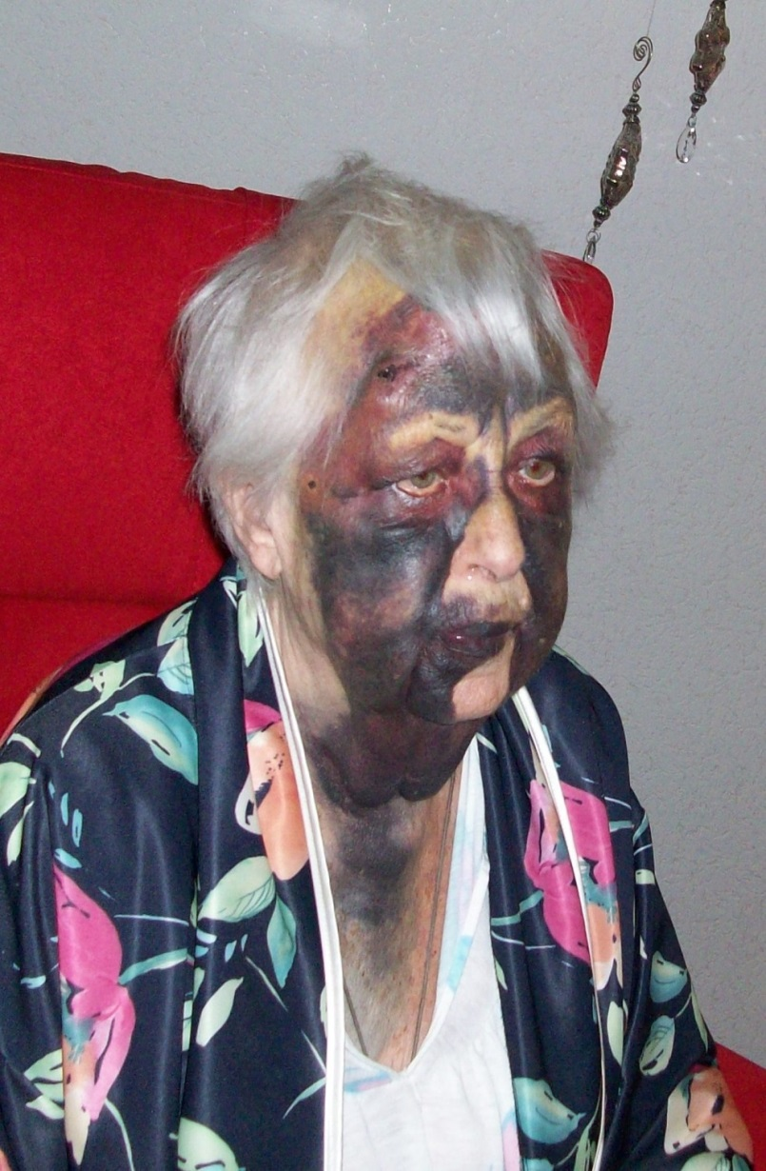
VKA in de echte wereld

Slide 28
Are we doing much better in the Netherlands?
HARM study shows similar results as US data on hospital admissions
Cohort study Trombosedienst (1988)
  All bleeding 16.5%/year
  Major bleeding 2.7%/year
    Intracranial 0.62%
    Fatal 0.65%
Van der Meer et al. Arch Intern Med 1993; http://www.knmp.nl/downloads/medicijnen-zorgverlening/medicatieveiligheid/harm-rapport.pdf
Notes:
Compared to about 3% VKA related major bleeds in VKA arms in NOAC trials

