Slide 1
Increased Plasma Fibroblast Growth Factor 23 is Associated with an Impaired Response to Intensified Antiproteinuric Therapy
J.K. Humalda
Department of Nephrology
University Medical Center Groningen
Netherlands
Corresponding address: M.H.De.Borst@umcg.nl

Slide 2
Introduction
RAAS-inhibiting therapies: cornerstone of CKD treatment
Residual proteinuria under RAASi predicts disease progression and cardiovascular complications
High serum phosphate attenuates renoprotective effect of RAASi
Zoccali C, J Am Soc Nephrol 2011 Oct;22(10):1923-1930
Notes:
Mechanisms unknown

Slide 3
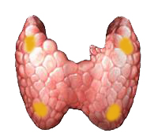
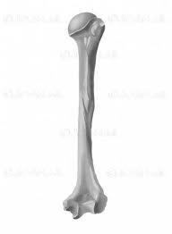
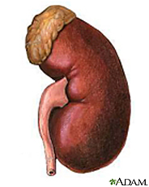
Phosphate, FGF23 and RAAS
Phosphate intake
PTH
FGF23
NaPi
PO₄
1,25D
Renin-angiotensin-aldosterone system
Renal damage
De Borst MH, J Am Soc Nephrol 2011 Sep;22(9):1603-1609

Slide 4
Research question
Does FGF23 predict the response to
intensified antiproteinuric therapy?

Slide 5
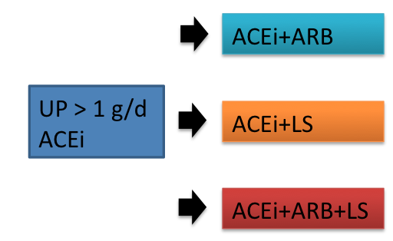
Methods
51 non-diabetic CKD patients with UP>1 g/d under ACEi (post-hoc analysis)
C-terminal FGF23, phosphorus, vitamin D, PTH
Aim: maximizing proteinuria reduction
Rotation Design
Slagman MC, BMJ 2011 Jul 26;343:d4366.
Notes:
Baseline benoemen. Patients underwent all four treatment periods.

Slide 6
Results: study population
General parameters | Unit | Total population
Number | N | 51
Male | N (%) | 42 (83%)
Age | years | 51±13
Caucasian race | N | 51(100%)
Body mass index | kg/m² | 27.6±4.2

Slide 7
Clinical and general laboratory parameters
Variables |  | ACEi+RS | ACEi+ARB+RS | ACEi+LS | ACEi+ARB+LS
UNaV | mmol/d | 188±57 | 181±68 | 105±47^{a,b} | 102±54^{a,b}
SBP | mmHg | 134±19 | 131±23 | 123±17^{a,b} | 121±18^{a,b}
DBP | mmHg | 80±14 | 77±14 | 73±11ª | 71±14^{a,b}
CrCl | mL/min | 69 [50-108] | 71 [53-103] | 70^{a,b} [43-92] | 59^{a,b} [42-77]
UP | g/d | 1.92 [0.87-3.40] | 1.61ª [0.63-3.40] | 0.83^{a,b} [0.5-1.7] | 0.67^{a,b,c} [0.37-1.40]
ª p<0.0083 vs ACEi+RS, ^{b} p<0.0083 vs ACEi+ARB+RS, ^{c} p<0.0083 vs ACEi+LS
Slagman MC, BMJ 2011 Jul 26;343:d4366.
Notes:
As published in the previous study, dual blockade and low sodium diet reduced proteinuria and blood pressure, however low sodium diet was more potent.
Alt Vervloet: Salt restriction on top of ACEi or ACEi + ARB led to more than 50% reduction of proteïnurie

Slide 8
Mineral metabolism parameters
Variables |  | ACEi+RS | ACEi+ARB+RS | ACEi+LS | ACEi+ARB+LS
sPi | mg/dL | 3.25±0.63 | 3.30±0.61 | 3.39±0.56 | 3.46±0.70
UPiV | mg/d | 925 [705-1150] | 1004 [692-1277] | 825 [686-1008] | 797 [599-999]^{a,b}
FGF23 | RU/mL | 146 [119-244] | 147 [106-203] | 159 [114-221] | 167 [129-253]^{b}
1,25D | pg/mL | 33±12 | 34±13 | 31±10 | 29±11^{a,b}
PTH | pg/mL | 49 [34-78] | 50 [32-102] | 44 [32-71] | 54 [35-83]^{c}
ª = p<0.0083 vs ACEi+RS, ^{b}= p<0.0083 vs ACEi+ARB+RS, ^{c=} p<0.0083 vs ACEi+LS
Notes:
PO4 niet groot verschil, FGF23 in the range of CKD stage 3. Evt lower posphate intake on ACEiARBLS overruled by drop in CrCl in FGF23. Benoem baseline FGF23, hier gaan we naar kijken!

Slide 9
Antiproteinuric response per tertile of FGF23

Slide 10
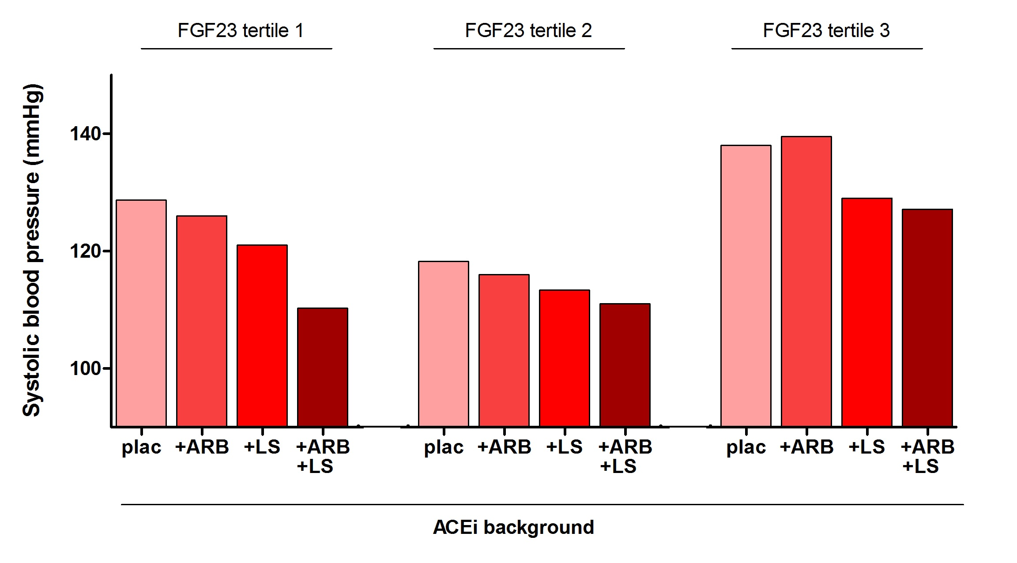
Antihypertensive response per tertile of FGF23

Slide 11
Baseline parameters per baseline tertile of FGF23
 | unit | Tertile 1 80-131 RU/mL | Tertile 2 134-183 RU/mL | Tertile 3 211-556 RU/mL | p-value (Kruskal Wallis)
n |  | 15 | 16 | 16
age |  | 40 [34-54] | 47 [44-57] | 57 [48-67] | 0.007
BMI | kg/m² | 24 [22-30] | 27 [24-31] | 28 [26-33] | 0.079
SBP | mmHg | 129 [118-145] | 118 [114-127] | 134 [128-150] | 0.026
DBP | mmHg | 77 [71-88] | 75 [68-86] | 83 [75-94] | 0.270
uNaV | mmol/d | 196 [167-243] | 160 [150-197] | 161 [146-197] | 0.110
UP | g/d | 1.8 [0.7-2.8] | 1.9 [0.7-3.4] | 1.8 [0.9-3.2] | 0.754
CrCl | mL/min | 119 [76-165] | 67 [51-100] | 49 [36-68] | <0.001
Notes:
Substantial differences in age, crcl as can be expected in the highest FGF23 tertile, and bit higher blood pressure. However, no significant diferences in sodium excretion.

Slide 12
Baseline parameters per baseline tertile of FGF23
 |  | Tertile 1 80-131 RU/mL | Tertile 2 134-183 RU/mL | Tertile 3 211-556 RU/mL | p-value (Kruskal Wallis)
n |  | 15 | 16 | 16
sPi | mg/dL | 3.1 [2.8-3.3] | 3.3 [2.9-3.9] | 3.4 [3.0-4.1] | 0.238
UPiV | mg/dL | 1032 [888-1252] | 875 [630-1056] | 906 [681-1266] | 0.181
1,25D | pg/mL | 41 [26-46] | 29 [23-41] | 33 [22-39] | 0.288
PTH | pg/mL | 37 [26-50] | 41 [32-53] | 76 [49-113] | 0.004
Notes:
Benoem PTH. As covariates differed among tertiles, we perfomred a multivariate regression analysis to account for these differences.

Slide 13
Multivariate Regression analysis
Baseline determinants of proteinuria under maximum therapy
Excluded: systolic and diastolic blood pressure, serum phosphate, phosphate excretion, 1,25(OH)₂-vitamin D, PTH, NT-proBNP, BMI, age and gender.
Model |  | Standardized Beta | Sig. | R²
1 | UP | .741 | .000 | .55
2 | UP | .669 | .000 | .70
 | FGF23 | .391 | .000
3 | UP | .671 | .000 | .76
 | FGF23 | .241 | .016
 | CrCl | -.288 | .004

Slide 14
Discussion
Higher FGF23 level is independently associated with an impaired response to intensification of antiproteinuric therapy
Mechanism?
FGF23 stimulates the RAAS by inhibiting 1,25(OH)₂ -vitamin D and thus increasing renin
Prevalent renal damage associated with impaired antiproteinuric response, FGF23 as marker?
Other?

Slide 15
Implications
Modulation of FGF23/Pi as sensitizer for RAASi?
Protein restriction potentiates RAASi
High serum Pi blunts RAASi
Optimization of FGF23/phosphorus status

Slide 16
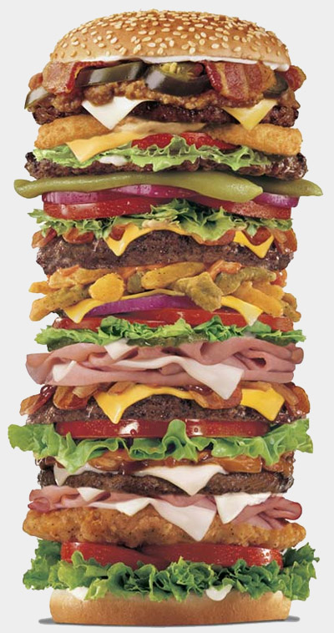
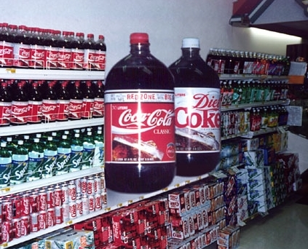
One does not simply inhibit the RAAS.
For optimal efficacy of RAAS blockade lifestyle change is mandatory!!!

Slide 17
Acknowledgements
UMC Groningen, Department of Nephrology: NIGRAM consortium (Dutch Kidney
Foundation):
Vitamin D/FGF23/Klotho research group
PhD students: VU Medical Center Amsterdam:
Carolien Doorenbos, Katarina Mirkovic, Marc Vervloet
Leandro da Cunha Baia, Charlotte Keyzer Piet ter Wee
Technician: Wendy Dam
Nephrology (former) PhD students Radboud UMC Nijmegen:
Arjan Kwakernaak, Femke Waanders, Joost Hoenderop
Maartje Slagman René Bindels
Co-supervisor: Martin de Borst
UMC Groningen:
Gerjan Navis
Jan-Luuk Hillebrands

Slide 18
Questions?

