Slide 1
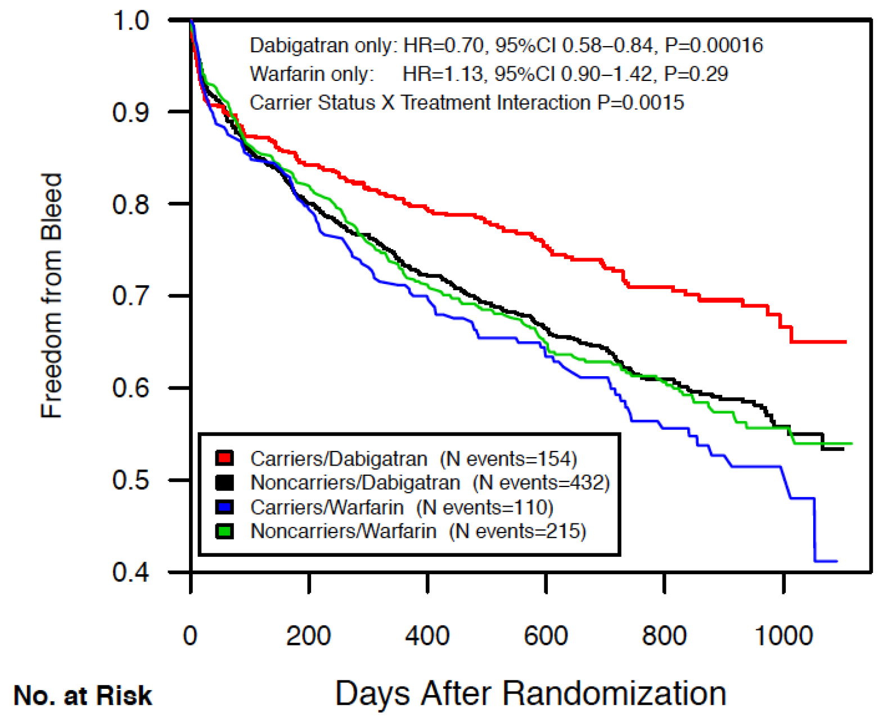
Survival Analysis
Freedom from bleed according to rs2244613 carrier status
ESC Clinical Trial & Registry Update III: Updates on Atrial Fibrillation and Valves
Woensdag 29 augustus 2012

