Slide 1
Prasugrel vs. Clopidogrel for Acute Coronary Syndromes Patients Managed without Revascularization — the TRILOGY ACS trial On behalf of the TRILOGY ACS Investigators
www.clinicaltrials.gov Identifier: NCT00699998
ESC 2012 Hot Line I: Late Breaking Trials on Prevention to Heart Failure

Slide 2
TRILOGY ACS Background
The proportion of ACS (UA/NSTEMI) patients world-wide who are managed medically without revascularization (PCI or CABG) is 40-60%
Medically managed ACS patients have a two-fold increase in ischemic events, but have been under-represented in contemporary ACS trials
Prasugrel, a thienopyridine P2Y₁₂ inhibitor, was shown to improve outcomes compared with clopidogrel in ACS patients undergoing PCI in the TRITON trial, with an increase in major bleeding
ESC 2012 Hot Line I: Late Breaking Trials on Prevention to Heart Failure
Notes:
2

Slide 3
TRILOGY ACS — Inclusion Criteria
Randomization within 10 days of a UA/NSTEMI event
NSTEMI: CK-MB or Troponin > ULN
UA: ST depression > 1 mm in 2 or more leads
“Reasonable certainty” for a medical management strategy decision determined
Angiography not required, but if performed, had to be done before randomization, and evidence of coronary disease had to be seen (1 lesion > 30% or prior PCI/CABG)
At least 1 of 4 enrichment criteria:
Age > 60 years
Diabetes Mellitus
Prior MI
Prior Revascularization (PCI or CABG)
ESC 2012 Hot Line I: Late Breaking Trials on Prevention to Heart Failure

Slide 4
TRILOGY ACS Study Design
Medically Managed UA/NSTEMI Patients
Randomization Stratified by:
Age, Country, Prior Clopidogrel Treatment
(Primary analysis cohort — Age < 75 years)
Median Time to Enrollment = 4.5 Days
Medical Management Decision ≤72 hrs
(No prior clopidogrel given) — 4% of total
Medical Management Decision ≤ 10 days
(Clopidogrel started ≤ 72 hrs in-hospital OR
on chronic clopidogrel) — 96% of total
Clopidogrel¹ 300 mg LD
+
75 mg MD
Prasugrel¹ 30 mg LD
+
5 or 10 mg MD
Clopidogrel¹
75 mg MD
Prasugrel¹ 5 or 10 mg MD
Minimum Rx Duration: 6 months; Maximum Rx Duration: 30 months
Primary Efficacy Endpoint: CV Death, MI, Stroke
All patients were on aspirin and low-dose aspirin (< 100 mg) was strongly recommended. For patients <60 kg or ≥75 years, 5 mg MD of prasugrel was given. Adapted from Chin CT et al. Am Heart J 2010;160:16-22.e1.
Notes:
Source: Q113, Q111, Q331
[Source: Figure 1 on page 19]
Reference:
Chin CT, Roe MT, Fox KA, Prabhakaran D, Marshall DA, Petitjean H, Lokhnygina Y, Brown E, Armstrong PW, White HD, Ohman EM; TRILOGY ACS Steering Committee. Study design and rationale of a comparison of prasugrel and clopidogrel in medically managed patients with unstable angina/non-ST-segment elevation myocardial infarction: the TaRgeted platelet Inhibition to cLarify the Optimal strateGy to medicallY manage Acute Coronary Syndromes (TRILOGY ACS) trial. Am Heart J 2010;160(1):16-22.e1.
Pras00045111

Slide 5
Statistical Considerations
Event-driven trial, powered for efficacy in the primary cohort of patients < 75 yrs of age (688 events planned for 90% power for 22% RRR, 761 events accrued)
Exploratory analysis in the elderly (age ≥ 75 yrs) with a minimum of 2,000 patients
Testing strategy specified first testing the primary endpoint (CV death, MI, or stroke) in patients < 75 yrs
Conditional on successfully establishing superiority of prasugrel over clopidogrel in this group, treatment groups would be compared in the overall population (including the elderly patients)
ESC 2012 Hot Line I: Late Breaking Trials on Prevention to Heart Failure
Notes:
5

Slide 6
Baseline Characteristics
 | Age < 75 Years (N = 7243) |  | Overall Population (N = 9326)
 | Prasugrel (N = 3620) | Clopidogrel (N = 3623) | Prasugrel (N = 4663) | Clopidogrel (N = 4663)
Age—yr | 62 (56–68) | 62 (56–68) | 66 (58–74) | 66 (59–73)
Female sex—% | 36.2 | 35.6 | 39.2 | 39.1
Body weight < 60 kg—% | 13.1 | 12.8 | 15.2 | 14.9
Disease classification—%
NSTEMI | 67.8 | 67.2 | 70.4 | 69.4
Unstable angina | 32.2 | 32.8 | 29.6 | 30.6
Medical History—%
Diabetes mellitus | 38.5 | 39.3 | 37.7 | 38.3
Current/recent smoking | 23.3 | 23.6 | 19.7 | 20.2
Prior myocardial infarction | 43.3 | 44.8 | 42.9 | 43.3
Prior PCI | 27.0 | 29.1 | 25.6 | 26.7
Prior CABG | 14.6 | 16.3 | 15.2 | 16.1
Baseline risk assessment
GRACE risk score | 114 (101–128) | 115 (102–128) | 122 (105–140) | 121 (106–138)
Creatinine clearance—mL/min | 81 (63–104) | 81 (63–102) | 73 (54–97) | 73 (54–96)
Angiography performed pre-randomization—% | 42.1 | 43.1 | 41.2 | 41.4
Post-randomization revascularization performed in 7.5% of patients

Slide 7
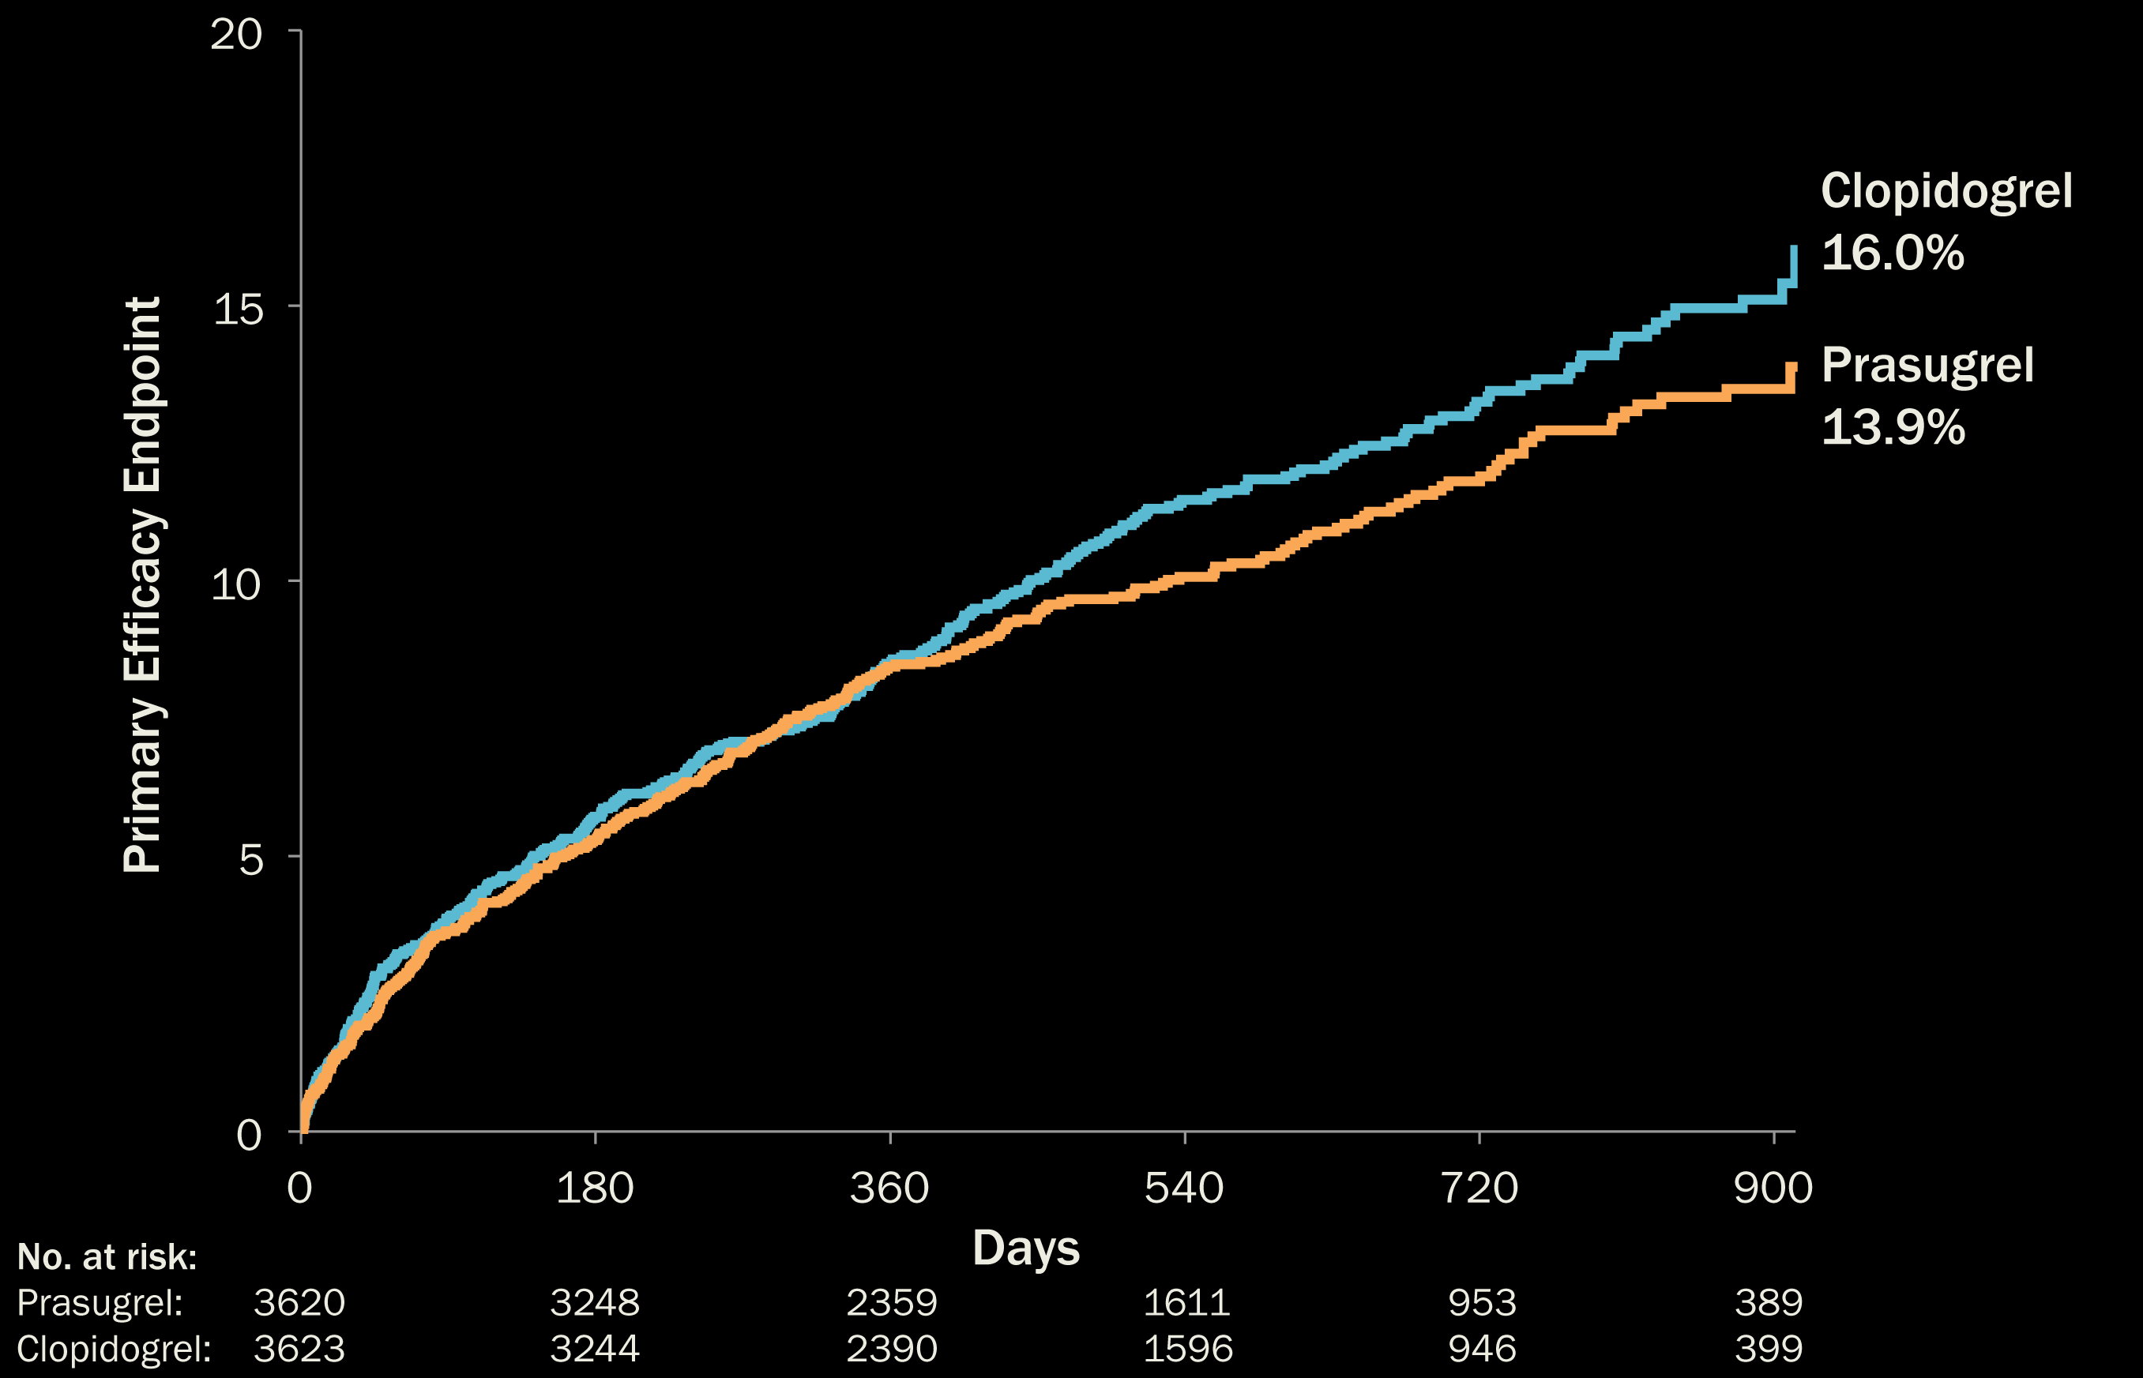
Primary Efficacy Endpoint to 30 Months (Age < 75 years)
HR (95% CI) ≤ 1 Year:
0.99 (0.84, 1.16)
HR (95% CI) > 1 Year:
0.72 (0.54, 0.97)
HR (95% CI):
0.91 (0.79, 1.05)
P = 0.21
Interaction P = 0.07
ESC 2012 Hot Line I: Late Breaking Trials on Prevention to Heart Failure

Slide 8
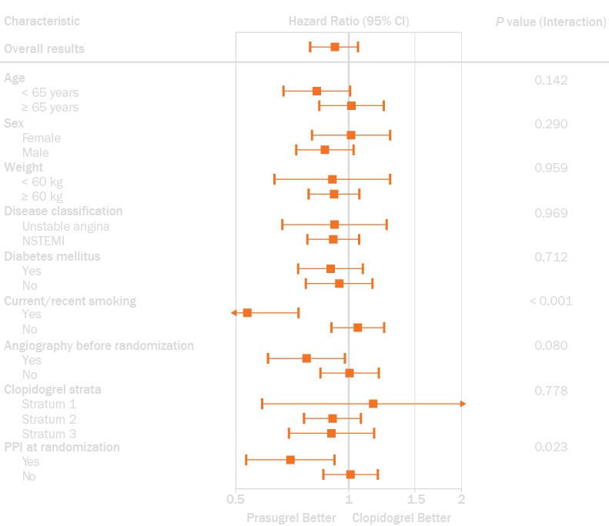
Primary Endpoint - Pre-Specified Sub-Groups (Age < 75 years)
ESC 2012 Hot Line I: Late Breaking Trials on Prevention to Heart Failure

Slide 9
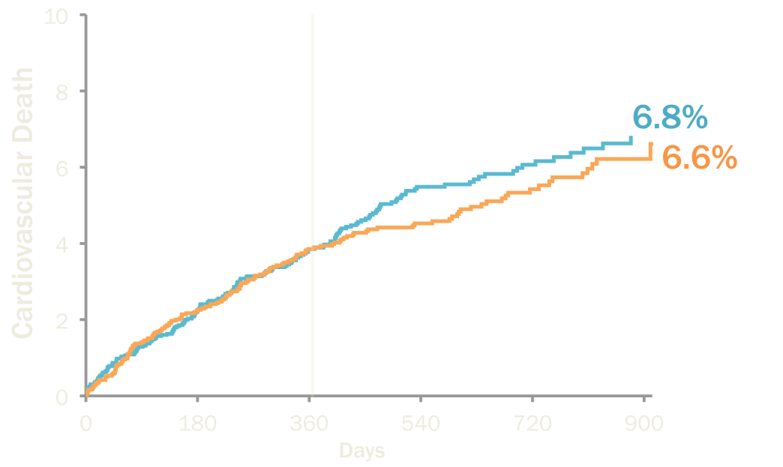
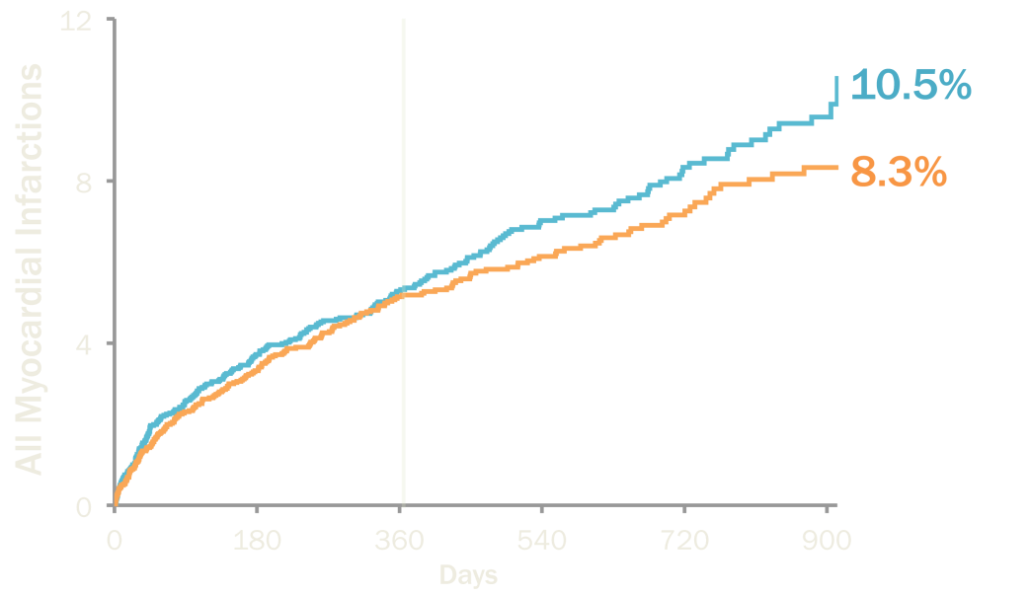
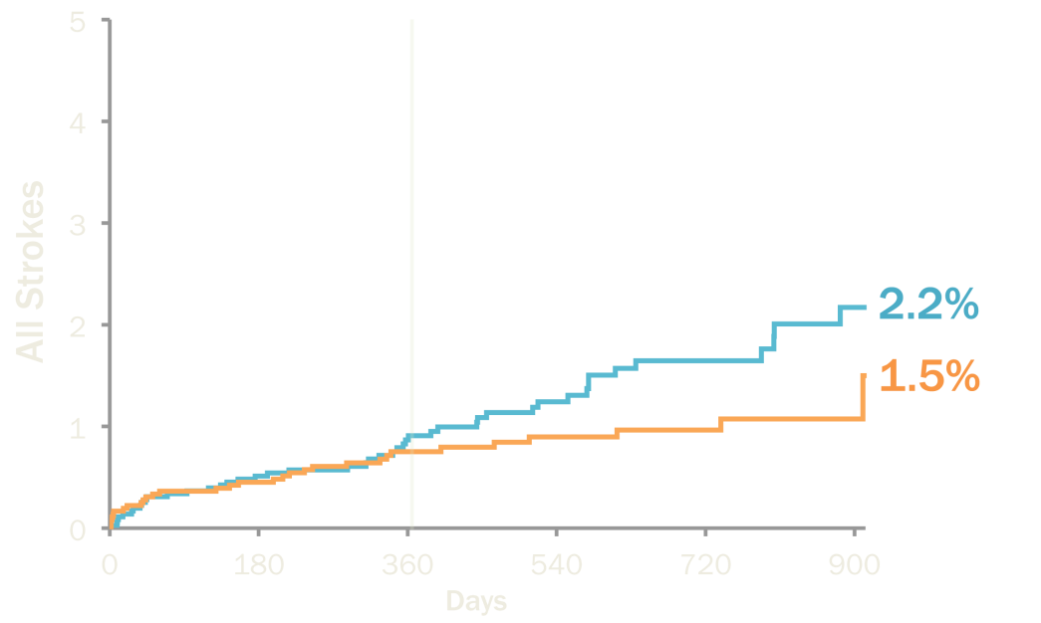
Efficacy Component Endpoints to 30 Months (Age < 75 years)
CV Death
All MI
HR: 0.93 (0.75-1.15)
HR: 0.89 (0.74-1.07)
 | HR (95% CI) ≤ 1 Year | HR (95% CI) > 1 Year
CV Death | 1.00 (0.78, 1.28) | 0.75 (0.49, 1.14)
All MI | 0.97 (0.78, 1.19) | 0.68 (0.46, 0.99)
All Stroke | 0.86 (0.50, 1.47) | 0.35 (0.14, 0.88)
All Stroke
HR: 0.67 (0.42-1.06)
ESC 2012 Hot Line I: Late Breaking Trials on Prevention to Heart Failure

Slide 10
Evaluation of All Ischemic Events Over Time* (Age < 75 years)
Lower risk multiple recurrent ischemic events suggested with prasugrel using the pre-specified Andersen-Gill model (HR = 0.85, 95% CI: 0.72–1.00, P=0.04)
Significant interaction with treatment and time (HR for > 12 mos = 0.64, 95% CI: 0.48–0.86, Interaction P=0.02)
 | Prasugrel | Clopidogrel
≥ 1 event | 364 | 397
≥ 2 events | 77 | 109
3–7 events | 18 | 24
* Pre-specified evaluation of all CV death, MI, or stroke events by treatment
ESC 2012 Hot Line I: Late Breaking Trials on Prevention to Heart Failure

Slide 11
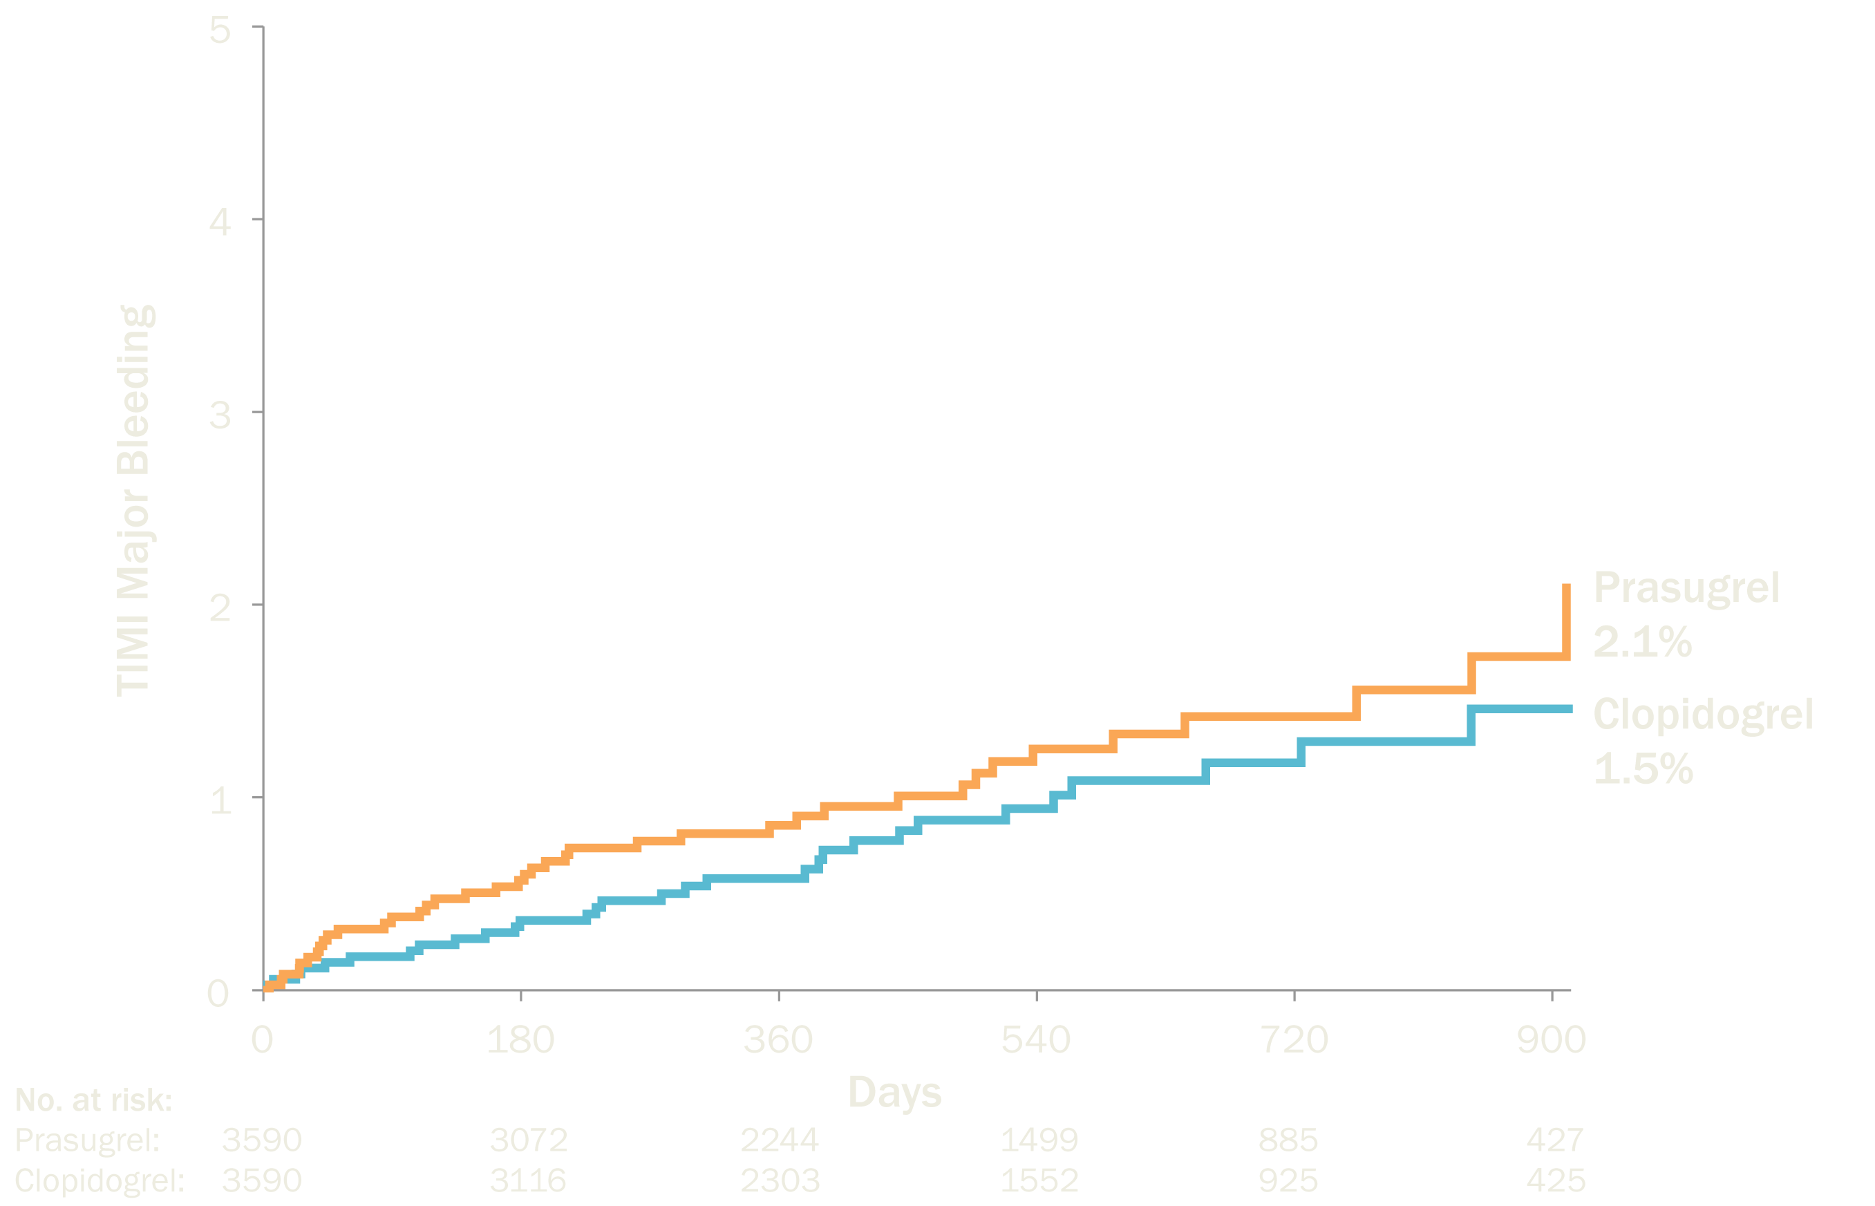
TIMI Major Bleeding to 30 Months (Age < 75 years)
HR (95% CI):
1.31 (0.81, 2.11)
P = 0.27
ESC 2012 Hot Line I: Late Breaking Trials on Prevention to Heart Failure

Slide 12
Primary Efficacy Endpoint and TIMI Major Bleeding Through 30 Months (Overall population)
HR (95% CI):
0.96 (0.86, 1.07)
P = 0.45
HR (95% CI):
1.23 (0.84, 1.81)
P = 0.29
ESC 2012 Hot Line I: Late Breaking Trials on Prevention to Heart Failure

Slide 13
Incidence of Key Safety Outcomes (Overall Population)
 | Prasugrel | Clopidogrel | Hazard Ratio (95% CI) | P Value
Bleeding | (N = 4623) | (N = 4617)
GUSTO Severe/life-threatening bleeding | 22 (0.5%) | 27 (0.6%) | 0.83 (0.48–1.46) | 0.53
TIMI Fatal Bleeding | 7 (0.2%) | 9 (0.2%) | 0.80 (0.30–2.14) | 0.68
Intracranial Hemorrhage | 14 (0.3%) | 19 (0.4%) | 0.76 (0.38–1.51) | 0.42
Neoplasm
New, non-benign neoplasms* | 82 (1.8%) | 78 (1.7%) | 1.05 (0.77-1.43) | 0.79
Mortality | (N = 4663) | (N = 4663)
All-cause death | 385 (8.3%) | 409 (8.8%) | 0.94 (0.82–1.08) | 0.40
*Among patients with no prior history of malignancy or prior malignancy treated with curative therapy
ESC 2012 Hot Line I: Late Breaking Trials on Prevention to Heart Failure

Slide 14
Conclusions
In the largest trial to date of ACS patients managed medically without revascularization, prasugrel was not statistically different from clopidogrel during 2.5 years of follow-up among patients < 75 years of age
Further analyses of the primary endpoint yielded several important findings favoring prasugrel treatment
Trend for a time-dependent benefit after 1 year
Fewer total recurrent ischemic events, particularly after 1 year
No statistical differences in major, life-threatening, or fatal bleeding with prasugrel vs. clopidogrel
ESC 2012 Hot Line I: Late Breaking Trials on Prevention to Heart Failure
Notes:
14

