Slide 1
Type 1 Diabetes:
An Overview

Slide 2


Type 1 Diabetes: Before and After Insulin
1. The Case for Serendipity. Available at: http://www.mc.vanderbilt.edu/lens/article/?id=221&pg=999. Accessed April 6, 2010.
2. Westman et al. Perspectives in Biology and Medicine. 2006;49:77-83.
Notes:
KEY POINTS
The images represent a diabetic patient before and after insulin therapy– 1922¹
Discovery of insulin in the early 1920s ushered a new era in the treatment of diabetes²
Insulin helped emaciated patients gain weight and reduced the occurrence of
diabetic glycosuria
REFERENCES
The Case for Serendipity. Available at: http://www.mc.vanderbilt.edu/lens/article/?id=221&pg=999. Accessed 6 April, 2010.
Westman EC, Yancy Jr. WS, Humphreys M. Dietary Treatment of diabetes mellitus in the pre-insulin era (1914–1922). Perspectives in Biology and Medicine. 2006;49:77-83.

Slide 3

Discovery of Insulin
Insulin discovered by Banting and Best in 1921
Discovery of Insulin. Available at: http://www.discoveryofinsulin.com/Home.htm. Accessed April 6, 2010.
Notes:
KEY POINTS
Insulin was discovered by Banting and Best in the year 1921.
They successfully treated a diabetic dog using insulin.
REFERENCE
Discovery of Insulin. Available at: http://www.discoveryofinsulin.com/Home.htm. Accessed 6 April, 2010.

Slide 4
Diabetes Mellitus: Type 1 Versus Type 2
 | Type 1 | Type 2
Age | Develops at any age, but usually before 30² | Can develop at any age, but usually after 30¹
Body constitution | Frequently lean² | 90% overweight¹
Pathogenesis | Autoimmune destruction of the beta cells¹ | Insulin resistance is usually present¹
Insulin deficiency | Absolute insulin deficiency¹ Dependent on exogenous insulin for life Strong tendency for ketoacidosis Greater glucose variability | Relative insulin deficiency¹ Endogenous insulin levels may be low, normal, or high Not prone to ketosis
1. American Association of Clinical Endocrinologists. Endocr Prac. 2007;13:1-68.
2. Frier BM et al. Davidson's Principles and Practice of Medicine, 20th ed. 2006;805-847.
Notes:
KEY POINTS
Type 1 Diabetes
The condition develops usually before the age of 30.²
The patients are usually lean.²
It occurs due to autoimmune destruction of the beta cells of the pancreas.¹
Absolute insulin deficiency is seen resulting in the patients’ dependence on exogenous insulin for life.¹
These patients have greater blood glucose variability and are prone to develop ketoacidosis.²
Type 2 diabetes
The condition usually develops after the age of 30.¹
Most patients are usually obese.¹
Variable degrees of insulin resistance are often present.¹
These patients present with relative insulin deficiency with low, normal, or high endogenous insulin levels.
These patients are not prone to develop ketoacidosis.
REFERENCES
American Association of Clinical Endocrinologists Medical Guidelines for Clinical Practice for the Management of Diabetes Mellitus. Endocr Prac. 2007;13 (Suppl 1):1-68.
Frier BM, Fisher M. Diabetes mellitus. Davidson's Principles and Practice of Medicine, 20th ed. Edinburgh: Churchill Livingstone;2006:805-847.

Slide 5
T1DM: Unmet Needs
A1c control – difficult to reach goal
Multiple insulin injections – negative impact on activities of daily living
Multiple glucose self-tests – negative impact on activities of daily living
Hypoglycemia – major concern for both patients and their caregivers; can be life-threatening
Hyperglycemia/diabetic ketoacidosis – can be life-threatening
Chronic complications – nephropathy (dialysis), retinopathy (vision loss), neuropathy (amputations), macrovascular disease (MI/stroke)
Frier BM et al. Diabetes mellitus. Davidson's Principles and Practice of Medicine, 20th ed. 2006:805-847.
Notes:
KEY POINTS
The unmet needs of type 1 diabetes are:
A1c control – difficult to reach goal
Multiple insulin injections – negative impact on activities of daily living
Multiple glucose self-tests – negative impact on activities of daily living
Hypoglycemia – major concern for both patients and their caregivers – can be life-threatening¹
Hyperglycemia/diabetic ketoacidosis – can be life-threatening¹
Chronic complications – nephropathy (dialysis), retinopathy (vision loss), neuropathy (amputations), macrovascular disease (MI/stroke)¹
REFERENCE
Frier BM, Fisher M. Diabetes mellitus. Davidson's Principles and Practice of Medicine, 20th ed. Edinburgh: Churchill Livingstone;2006:805-847.

Slide 6

T1DM: Psychosocial Impact on the Patient
“Life with type 1 diabetes poses challenges for every member of the family. A new diagnosis of type 1 diabetes can spark a range of reactions, including anger, sadness, and guilt.”
“As time goes by, everyone will gain knowledge and confidence, and be able to celebrate successes, learn from mistakes, and move away from the intense feelings common after diagnosis.”
Newly diagnosed. Available at: http://www.jdrf.org/index.cfm?page_id=103432. Accessed 8 April, 2010.
Image courtesy of Michelle Meiklejohn / FreeDigitalPhotos.net.
Notes:
KEY POINT
JDRF has one mission – to find a cure for diabetes and its complications through the support of research.
REFERENCE
Newly diagnosed. Available at: http://www.jdrf.org/index.cfm?page_id=103432. Accessed 8 April, 2010.

Slide 7
T1DM Epidemiology: Prevalence
Prevalence of Type 1 diabetes in US¹
Approximately 1 million individuals have type 1 diabetes
Overall prevalence of diabetes has been increasing steadily
Lifetime prevalence of type 1 diabetes²
  United States: ~ 0.4%
  High-incidence countries such as Finland and Sweden:1%
1. Skyler et al. Diabetes Metab Res Rev 2002;18:S21–S26.
2. Unger et al. Prim Care Clin Office Pract 2007;34:791–808.
Notes:
KEY POINTS
Prevalence of Type 1 diabetes in US¹
Approximately 1 million individuals have type 1 diabetes
Overall prevalence of diabetes has been increasing steadily
In the United States, the lifetime prevalence approaches 0.4%, but in high-incidence countries such as Finland and Sweden, it may be as high as 1%²
REFERENCES
Skyler JS, Oddo C. Diabetes trends in the USA. Diabetes Metab Res Rev. 2002;18:S21–S26.
Unger J. Management of Type 1 Diabetes. Prim Care Clin Office Pract. 2007;34:791–808.

Slide 8
T1DM - Epidemiology: Incidence
Overall Age-standardized Incidence of Type I DM in Children Ages 0-14, 1990-1999
DIAMOND Project Group. Diabet Med 2006;23:857-866.
Notes:
KEY POINTS
DIAMOND is a Multinational Project for Childhood Diabetes funded by the WHO
The study included 43,013 children ≤14 years of age diagnosed with Type 1 DM between the years 1990 and 1999.
The incidence of Type 1 DM has been found to be very high in Finland, United Kingdom, Canada, and the United State; it is low in Italy and France, and very low in Japan.
REFERENCE
DIAMOND Project Group. Incidence and trends of childhood Type 1 diabetes worldwide 1990-1999.
Diabet Med. 2006;23:857-866.

Slide 9
T1DM –
Epidemiology: Incidence (cont’d)
Incidence of Type I DM per 100,000 Person-years Among Swedish Men and Women 0–34 Years of Age, 1983–1998
50
40
30
Incidence per 100,000 Person-Years
20
Men
10
Women
0
2
4
6
8
10
12
14
16
18
20
22
24
26
28
30
32
34
Age at Diagnosis (years)
Pundziute-Lyckå et al. Diabetologia 2002;45:783–791.
Notes:
KEY POINTS
Incidence and cumulative incidence of Type I DM per 100,000 person-years was carried out using 11,751 cases from two nationwide prospective registers in Sweden 1983-1998.
Incidence was 21.4% (95% CI, 20.8-21.9) in men and 17.1% (95% CI, 16.6-17.5) in women 0-34 years of age.
In boys 0-14 years of age, and girls 0-12 years of age, the incidence increased over time but tended to decrease at older age groups – especially in men.
Average cumulative incidence was 748 in men and 598 in women.
During the 16-year period investigated, the incidence of Type I DM did not increase in the 0-34–year age group in Sweden; however, median age at diagnosis decreased.
REFERENCE
Pundziute-Lyckå A, Dahlquist G, Nyström L, et al. and the Swedish Childhood Diabetes Study Group. The incidence of Type I diabetes has not increased but shifted to a younger age at diagnosis in the 0–34 years group in Sweden 1983 to 1998. Diabetologia. 2002;45:783–791.

Slide 10
T1DM - Epidemiology: Increasing Incidence
20
Boys
Trends in childhood diabetes incidence in Europe between 1989
and 1994 by age group and sex
18
16
14
Rate per 100,000
12
Incidence of type 1 diabetes is increasing
  An average of 3.4% increase per year
  No difference in trends between boys and girls
  No known explanation for this increasing incidence
10
8
Age
6
10-14
5-9
4
0-4
20
Girls
18
16
14
Rate per 100,000
12
10
8
6
4
1989
1990
1991
Year
1992
1993
1994
EURODIAB ACE Study Group. Lancet 2000; 355:873-876.
Notes:
KEY POINTS
The EURODIAB collaborative group was established in 1988.
It is a prospective geographically defined registry of new cases diagnosed under 15 years of age.
The risk of Type 1 Diabetes is increasing rapidly.
An average 3.4% (2.5%-4.4%) increase in incidence per year as reported by the EURODIAB ACE Study Group.
No evidence of a difference in trends between boys and girls.
No evidence of difference in trends between age-groups between boys and girls.
There is no known explanation for this increasing incidence.
REFERENCE
EURODIAB ACE Study Group. Variation and trends in incidence of childhood diabetes in Europe. Lancet. 2000;355:873-876.

Slide 11
Type 1 Diabetes Pathophysiology

Slide 12
T1DM - Risk Factors: Genetic
Genetic Factors | Details | Impact
Family History | Increased lifetime risks among relatives First-degree relative: 5%; identical twin: 50% | é
Major Histocompatibility Complex (MHC) Genes (in HLA region) | Genotypes HLA-DR3,DQ2 and HLA-DR4,DQ8 have increased susceptibility > 90% of T1D have 1 haplotype, | é
Non-MHC Genes | Changes in the insulin gene (IDDM2), and cytotoxic T-lymphocyte-associated antigen-4 gene (CTLA-4) have been associated with risk, but the association is much less strong than the association with HLA | é
Devendra et al. BMJ 2004;328:750-754.
Notes:
KEY POINTS
Specific genes have been linked to type 1 diabetes.
The concordance for type 1 diabetes is approximately 50% for monozygotic twins, and the risk to a first degree relative is approximately 5%.
More than 90% of patients who develop type 1 diabetes have either DR3, DQ2 or DR4, DQ8 haplotypes, whereas fewer than 40% of normal controls have these haplotypes.
Changes in the insulin gene (IDDM2), and cytotoxic T-lymphocyte-associated antigen-4 gene (CTLA-4) have been associated with risk; but the association is much less strong than the association with human leukocyte antigen (HLA).
REFERENCE
Devendra D, Liu E, Eisenbarth GS. Type 1 diabetes: recent developments. BMJ. 2004;328:750-754.

Slide 13
T1DM - Risk Factors: Environmental
Environmental Factors | Details | Impact
Viruses | May cause diabetes by infecting beta cells or by inducing an autoimmune attack (including enterovirus, Coxsackie, rubella)^{1,2} However, some believe that viruses have a protective effect¹ | é⬇
Dietary | Early introduction to cow’s milk has been investigated as a potential etiologic factor, but conflicting results have been obtained¹ Early introduction to cereal¹ and nitrates³ have been suggested as risk factors Vitamin D supplements might be protective¹ | é/? é ⬇
1. Knip et al. Diabetes 2005;54:S125-S136.
2. Gillespie et al. CMAJ 2006;175(2):165-170.
3. Devendra et al. BMJ 2004;328:750-754.
Notes:
KEY POINTS
Less than 10% of genetically susceptible individuals progress to clinical disease implying the role of additional factors that trigger and drive beta-cell destruction in genetically predisposed subjects.¹
There are several hypotheses on relevant environmental triggers.^{1,2,3}
Viruses such as rotavirus, enterovirus, and rubella may cause diabetes by infecting beta cells or by inducing an autoimmune attack. However, some believe that viruses have a protective effect.
Dietary interventions such as early introduction to cow’s milk (specifically, albumin and beta-casein proteins) has been studied with conflicting results. Early introduction to cereal (gluten) and nitrates in drinking water concentration have been suggested as risk factors. Vitamin D supplements might
be protective.
REFERENCES
Knip M, Veijola R, Virtanen SM, et al. Environmental triggers and determinants of type 1 diabetes. Diabetes. 2005;54:S125-S136.
Gillespie KM. Type 1 diabetes: pathogenesis and prevention. CMAJ. 2006;175(2):165-170.
Devendra D, Liu E, Eisenbarth GS. Type 1 diabetes: recent developments. BMJ. 2004;328:750-754.

Slide 14
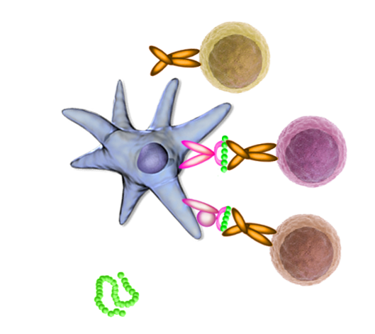
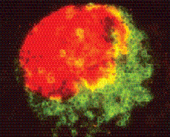
T1DM Disease Pathway:
Cellular Mechanism of Beta Cell Destruction
Autoimmune disease resulting from specific destruction of beta cells in pancreatic islet cells¹
Primarily, a T-cell mediated disease²
Evidence of innate immune system involvement³
CD4
Treg
HLA II
TCR
CD4
T-cell
APC
HLA I
Epitope
CD8
T-cell
Trimolecular complex
Islet autoantigen
Insulitis
A pancreatic islet (insulin in red) being invaded by T lymphocytes (green)⁴
1. Gillespie et al. CMAJ 2006;175(2):165-170. 3. Notkins et al. J Clin. Invest 2001;108:1247-1252.
2. Kim et al. Horm Res 2005;64:180-188. 4. Narendran et al. Q J Med 2005; 98:547-556.
Notes:
KEY POINTS
Autoimmune destruction of insulin-producing beta cells in the pancreas by CD4⁺ and CD8⁺ T cells and macrophages is responsible for the development of type 1 diabetes.¹
B cells produce autoantibodies to beta-cell antigens. These present as self-antigens and activate the T cells.²
The infiltrating inflammatory cells may themselves express cytokines that lead to cellular cytotoxicity or autoantibody formation.³
Insulitis, an inflammatory infiltrate containing large numbers of mononuclear cells and CD8⁺ T cells, typically occurs around or within individual islets.^{3, 4}
REFERENCES
Gillespie KM. Type 1 diabetes: pathogenesis and prevention. CMAJ. 2006;175(2):165-170.
Kim MS. Immunogenetics of type 1 diabetes. Horm Res. 2005;64:180-188.
Notkins AL, Lernmark A. Autoimmune type 1 diabetes: resolved and unresolved issues. J Clin Invest. 2001;108:1247-1252.
Narendran P, et al. Immunology of type 1 diabetes. Q J Med. 2005; 98:547-556.

Slide 15
T1DM Autoimmunity: Evidence
Association of HLA genes with disease risk or protection
Immune cell infiltrates in the pancreatic beta cells
Reduced disease incidence with immunosuppressive drugs
Established autoimmune disease cluster with type 1 diabetes
1. Notkins et al. J Clin. Invest 2001;108:1247-1252.
2. Narendran et al. Q J Med 2005; 98:547-556.
Notes:
KEY POINTS
Two discoveries in 1970 provided evidence of the role of autoimmunity in the pathogenesis of type 1 diabetes:¹
Human leukocyte antigen (HLA)
A strong linkage of type 1 diabetes to the highly polymorphic HLA class II: only 45% of the population in the United States express DR3 or DR4, whereas 95% of those who develop type 1 diabetes express these haplotypes
Known role of HLA molecules in antigen presentation supported the hypothesis that type 1 diabetes has an autoimmune component
Antibodies
The sera from type 1 diabetic patients with polyendocrine disease were found, by immunofluorescence, to stain pancreatic islets
These antibodies, which came to be known as islet cell antibodies, have been widely used to study the clinical course and pathogenesis of type 1 diabetes
The presence of pancreatic infiltrates
Response to immunosuppressive agents
Identification of autoantigens recognized by islet cell antibodies in the 1980s and early 1990s¹
Presence of other autoimmune disease further strengthened the autoimmune hypothesis²
REFERENCES
Notkins AL, Lernmark A. Autoimmune type 1 diabetes: resolved and unresolved issues. J Clin Invest. 2001;108:1247–1252.
Narendran P, et al. Immunology of type 1 diabetes. Q J Med. 2005; 98:547–556.

Slide 16
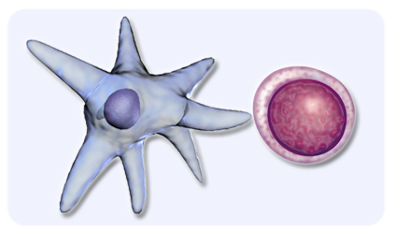

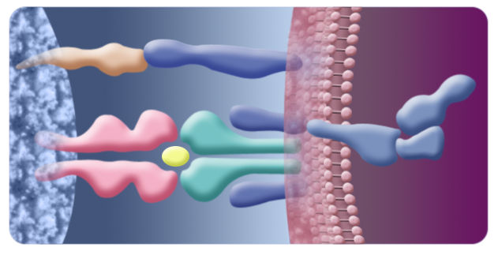
Autoimmunity: Mechanism
Imbalance between effector
T cells and regulatory T cells leads to dysregulation of immunity¹
Four major islet cell autoantigens have been identified²
These antigens are presented to T cells by HLA class II molecules on the antigen-presenting cell²
This results in T-cell activation, leading to beta cell destruction²
Antigen presenting cell
CD4+ T-cell
B7
CTLA-4
CD3
LYP
MHC
Class II
TCR
LYK
FYN
CSK
CD3
Islet autoantigen
(proinsulin)
1. Kim et al. Horm Res 2005;64:180-188.
2. Gillespie et al. CMAJ 2006;175(2):165-170.
Notes:
KEY POINTS
Imbalance between effector T cells and regulatory T cells leads to dysregulation of immunity.¹
Four major islet cell autoantigens have been identified.
These antigens are presented to T cells By HLA class II molecules on the antigen-presenting cell.
This results in T cell activation leading to beta cell destruction.²
REFERENCES
Kim MS. Immunogenetics of type 1 diabetes. Horm Res. 2005;64:180-188.
Gillespie KM. Type 1 diabetes: pathogenesis and prevention. CMAJ. 2006;175(2):165-170.

Slide 17
Islet Autoantigens
Islet cell antigen (ICA) | The first islet 'autoantigen' to be described. Now known to be a complex of auto antigens. Antibodies to ICA are present in 90% of type 1 diabetes patients at the time of diagnosis.
Insulin and pro-insulin | Antibodies to insulin and pro-insulin, the biochemical precursor to insulin, are present at diagnosis in 23% and 34% of type 1 diabetes patients, respectively.
Glutamic acid decarboxylase (GAD) | A constituent of the ICA antigen complex. Present in the 65 kDA form in the human islet. Also present in the central nervous system. GAD antibodies are present in 73% of type 1 diabetes patients at diagnosis.
Protein tyrosine phosphatase (IA-2) | A transmembrane protein from the insulin secretory granule. Also present in central nervous tissue. IA-2 antibodies are present in 75% of type 1 diabetes patients at diagnosis.
1. Narendran et al. Q J Med 2005; 98:547-556.
2 . Notkins et al. J Clin. Invest 2001;108:1247-1252.
Notes:
KEY POINTS
As discussed, type 1 diabetes is characterized by the presence of antibody (humoral) and T-cell (cellular) responses to islet proteins (antigens).¹
Many patients have antibodies to candidate auto-antigens long before they develop disease; maybe as early as in utero.¹
The antibodies are:^{1,2}
Islet cell antigen (ICA): first to be described; antibodies to ICA are seen in 90% of patients at the time of diagnosis.
Insulin and pro-insulin: first to appear; present in 23% and 34% of patients at the time of diagnosis, respectively; not useful for confirming the classification of diabetes after insulin replacement as the patients develop antibodies to exogenous insulin.
Glutamic acid decarboxylase: present in 73% of patients at the time of diagnosis; involved in the conversion of glutamic acid to gamma-aminobutyric acid (GABA)— a major inhibitory neurotransmitter.
Protein tyrosine phosphatase: present in 75% of patients at the time of diagnosis; lacks enzymatic activity.
REFERENCES
Narendran P, et al. Immunology of type 1 diabetes. Q J Med. 2005; 98:547-556.
Notkins AL, Lernmark A. Autoimmune type 1 diabetes: resolved and unresolved issues. J Clin Invest. 2001;108:1247-1252.

Slide 18
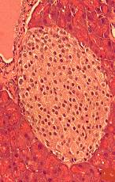
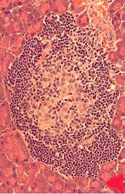
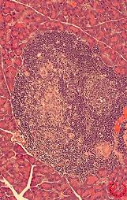
T1DM - Disease Progression
Patients probably have a genetic predisposition to the disease, but one or more environmental triggers are required to trigger the disease
Process is gradual; symptoms may not develop for several years after physiologic changes
Overt disease results in symptoms of hyperglycemia hunger, weight loss, and fatigue
Treatment is chronic insulin replacement therapy
At risk
Environmental trigger
Progressive loss of insulin release
Genetic predisposition
Antibodies
New onset diabetes
Overt diabetes
Beta cell mass
Glucose normal
C-Peptide present
Variable insulitis
Beta cell injury
Multiple beta
cell antibodies
Loss of first phase insulin response
C-Peptide absent (?)
Time
Adapted from Devendra et al. BMJ 2004;328:750-754.
Notes:
KEY POINTS
Current view is that patients probably have a genetic predisposition to the disease, but one or more environmental triggers are required to trigger the disease.
Process is gradual, and symptoms may not develop for several years after physiologic changes.
Overt disease results in symptoms of hyperglycemia.
Treatment is chronic insulin replacement therapy.
REFERENCE
Devendra D, Liu E, Eisenbarth GS. Type 1 diabetes: recent developments. BMJ. 2004;328:750-754.

Slide 19
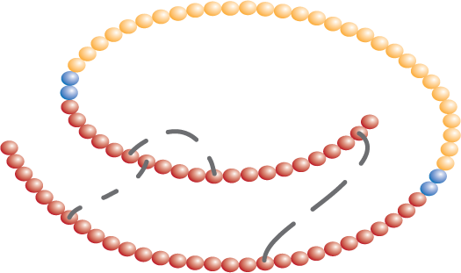
Assessment of Endogenous Insulin Secretion: C-Peptide
Proinsulin
C-peptide is a peptide that is proteolytically cleaved out of the proinsulin molecule during processing to mature insulin. C-peptide is released along with insulin from beta cell secretory granules in response to increases in circulating glucose levels.
C-peptide
-COOH
-NH₂
S
S
S
S
S
A-chain
S
B-chain
Measuring C-peptide can help assess the residual beta cell function in patients treated with insulin and distinguish between type 1 and type 2 diabetes.
C-Peptide: Biology. Available at: http://www.cebix.com/index.php/research/Accessed 6 April, 2010.
Notes:
KEY POINTS
C-peptide is a peptide that is proteolytically cleaved out of the proinsulin molecule during processing to mature insulin.
It is released along with insulin from beta cell secretory granules in response to increases in circulating glucose levels.
Measuring C-peptide can help assess the residual beta cell function in patients treated with insulin and distinguish between type 1 and type 2 diabetes.
REFERENCE
C-Peptide: Biology. Available at: http://www.cebix.com/index.php/research/. Accessed 5 October, 2009.

Slide 20
Type 1 Diabetes Complications

Slide 21
Acute Versus Chronic Complications
Acute complications include hypoglycemia (including severe hypoglycemia) and hyperglycemia/diabetic ketoacidosis
Chronic complications are vascular
  Microvascular complications – retinopathy, nephropathy, and neuropathy
  Macrovascular complications – cardiac and peripheral vascular disease
Frier et al. Davidson's Principles and Practice of Medicine. 20th ed. 2006:805-847.
Notes:
KEY POINTS
Acute versus Chronic Complications
Patients with diabetes may develop hypoglycemia as a result of treatment with insulin.¹
Many patients with diabetes also present with hyperglycemia/ketoacidosis at the time of diagnosis.¹
The long-term complications of diabetes include:
Microvascular complications such as retinopathy, nephropathy, and neuropathy¹
Macrovascular complications such as cardiac and peripheral vascular disease¹
REFERENCE
Frier BM, Fisher M. Diabetes mellitus. In: Davidson's Principles and Practice of Medicine, 20th ed. Edinburgh: Churchill Livingstone;2006:805-847.

Slide 22
Hypoglycemia:
Economic Burden
Hypoglycemia (<70 mg/dL)¹
  2% to 4% of deaths in T1DM occur under hypoglycemic conditions²
  Incidence in T1DM³
    Reported incidence of severe hypoglycemia — 4 to 65 episodes per 100 patient-years
American Diabetes Association. Diabetes Care 2009;32(suppl 1):S13-S61.
Galan et al. The Netherlands Journal of Medicine 2006;64(6):269-276.
The DCCT Research Group. Am J Med 1991;90:450-459.
Notes:
KEY POINTS
Plasma glucose less than 70 mg/dL signifies hypoglycemia.¹
Hypoglycemia is common in type 1 diabetes with 2% to 4% of deaths occurring in this condition.²
Reported incidence of severe hypoglycemia ranged from 4 to 65 episodes per 100 patient-years.³
REFERENCES
American Diabetes Association. Standards of medical care in diabetes. Diabetes Care. 2009;32(suppl 1):S13-S61.
Galan BE, Schouwenberg BJ, Tack CJ, Smits P. Pathophysiology and management of recurrent hypoglycaemia and hypoglycaemia unawareness in diabetes. The Netherlands Journal of Medicine. 2006;64(6):269-276.
3. The DCCT Research Group. Epidemiology of severe hypoglycemia in the Diabetes Control and Complications Trial. Am J Med. 1991;90:450-459.

Slide 23
Hypoglycemia: HbA1c
Although maintaining strict control of HbA1c levels with intensive insulin therapy is beneficial, it significantly increases the risk of hypoglycemic events.
120
95% CI
100
Log of mean HbA1c
80
Rate of Severe Hypoglycemia
(per 100 patient-years)
60
40
20
0
5.0
5.5
6.0
6.5
7.0
7.5
8.0
8.5
9.0
9.5
10.0
10.5
Glycosylated Hemoglobin (%)
Relationship between rate of severe hypoglycemia and level of glycemic control
Adapted from: The Diabetes Control and Complications Trial Research Group. N Engl J Med 1993;329:977–986.
Notes:
KEY POINT
Although maintaining strict control of HbA1c levels with intensive insulin therapy is beneficial, it significantly increases the risk of hypoglycemic events.
REFERENCE
The Effect of Intensive Treatment of Diabetes on the Development and Progression of Long-Term Complications in Insulin-Dependent Diabetes Mellitus. The Diabetes Control and Complications Trial Research Group. N Engl J Med. 1993;329:977–986.

Slide 24
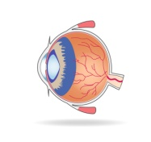
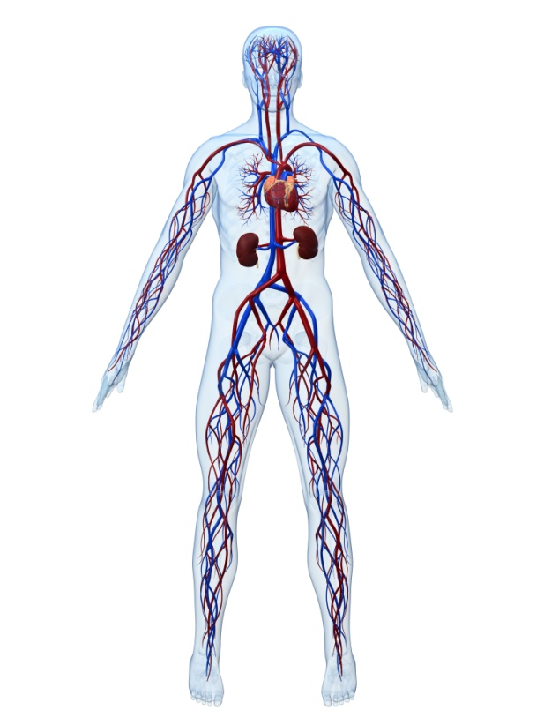



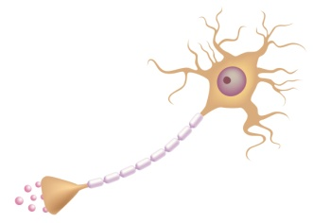
Diabetes: Magnitude of Chronic Complications
Diabetic Retinopathy
Leading cause
of blindness in working age adults
Stroke
2- to 4-fold increase in cardiovascular
mortality and stroke
Diabetic Nephropathy
Leading cause of
end-stage renal disease
Cardiovascular Disease
Diabetic Neuropathy
Leading cause
of nontraumatic
lower-extremity amputations
National Diabetes Information Clearinghouse. Available at: http://diabetes.niddk.nih.gov/dm/pubs/statistics/index.htm#complications.
Accessed 8 April, 2010.
Notes:
KEY POINTS
Diabetic microvascular complications most commonly manifest in the eyes, kidneys, and nerves. Some of the complications are as follows:
Diabetic retinopathy and diabetic macular edema: Diabetes is the leading cause of new cases of blindness in adults aged between 20 and 74 years
Diabetic nephropathy: Diabetes is the leading cause of kidney failure, accounting for 44% of new cases in 2005. People with diabetes constitute the fastest-growing group of renal dialysis and transplant recipients.
Diabetic neuropathy and amputations: Diabetes is the leading cause of nontraumatic lower-extremity amputations, accounting for more than 60% of amputations in the United States. About 60% to 70% of people with diabetes have some degree of diabetic nerve damage.
There is also a high frequency of atherosclerosis (macrovascular disease) leading to increased risk of stroke and/or heart attack.
Cardiovascular disease: People with diabetes are 2 to 4 times more likely to die from heart disease than people without diabetes. Cardiovascular disease is responsible for 50% of diabetes-related deaths.
Stroke: A person with diabetes is 2 to 4 times more likely to suffer a stroke than a person without diabetes.
REFERENCE
National Diabetes Information Clearinghouse. National Diabetes Statistics; 2007 – Complications of Diabetes. Available at: http://diabetes.niddk.nih.gov/dm/pubs/statistics/index.htm#complications. Accessed 8 April, 2010.
Diabetes mellitus is associated with a wide variety of microvascular and macrovascular complications.

Slide 25
Glycemic Control and Complications
Risk Reduction in Primary Prevention Cohort of DCCT
[Intensive therapy (mean HbA1c = 7.2%) vs. conventional therapy (mean HbA1c = 9.1%)]
The Diabetes Control and Complications Trial Research Group. N Engl J Med 1993;329:977–986.
Notes:
KEY POINT
Intensive insulin therapy reduces the adjusted mean risk of macrovascular complications such as retinopathy, neuropathy and nephropathy.
REFERENCE
The Diabetes Control and Complications Trial Research Group. The Effect of Intensive Treatment of Diabetes on the Development and Progression of Long-term Complications in Insulin-dependent Diabetes Mellitus. N Engl J Med. 1993;329:977–986.

Slide 26
Relationship Between Hyperglycemia and Complications
Continuous relationship
between HbA1c
and complication risk
No threshold effect
16
12
Microvascular complications
Rate per 100 patient years
8
4
0
5
6
7
8
9
10
11
12
Glycosylated hemoglobin (%)
The Diabetes Control and Complications Trial Research Group. Diabetes 1996;45:1289-1298.
Notes:
KEY POINT
For every 10% reduction in HbA1c, a 39% reduction in the risk of macrovascular complications such as retinopathy is seen.
REFERENCE
The Diabetes Control and Complications Trial Research Group. The absence of a glycemic threshold for the development of long-term complications: The perspective of the Diabetes Control and Complications Trial. Diabetes. 1996;45:1289-1298.

Slide 27
DCCT Extension Trial (EDIC)
A1c convergence following DCCT
11
Conventional therapy
Intensive therapy
10
9
8
Glycosylated Hemoglobin (%)
7
6
p<.001
p<.001
p<.001
p=.005
p=.07
p<.001
0
1
2
3
4
Years 1-4 (average)
End of DCCT
EDIC Year
DCCT=Diabetes Control and Complications Trial; EDIC=Epidemiology of Diabetes Interventions and Complications Research Group
Used with permission. The Diabetes Control And Complications Trial/Epidemiology Of Diabetes Interventions And Complications Research Group. N Engl J Med 2000;342:381-389.
Notes:
KEY POINTS
Distribution of glycosylated hemoglobin values at the end of the DCCT and EDIC studies for the 1208 patients who had an eye evaluation during year 4 of the EDIC study.
Mean glycosylated hemoglobin value in each group at the time of enrollment in DCCT was
about 9%.
Over 6.5 years of follow-up in the DCCT study, the median glycosylated hemoglobin value was 7.2% in the intensive therapy group and 9.1% in the conventional therapy group.
By the end of 1 year in the EDIC study, the glycosylated hemoglobin values in both the groups had almost converged; the median value was 8.1% in the conventional therapy group and 7.7% in the intensive therapy group.
During the 4-year follow-up period in the EDIC study, the median glycosylated hemoglobin values were 8.2% in the conventional therapy group and 7.9% in the intensive therapy group (p<.001).
REFERENCE
Retinopathy and nephropathy in patients with type 1 diabetes four years after a trial of intensive therapy. The Diabetes Control And Complications Trial/Epidemiology Of Diabetes Interventions And Complications Research Group. N Engl J Med. 2000;342:381-389.

Slide 28
Diabetic Retinopathy Progression in EDIC: Persistent Differences Between Groups Despite A1c Convergence
24
22
20
Conventional therapy
18
16
14
12
Cumulative Incidence (%)
10
8
Intensive therapy
6
4
2
0
0.0
0.5
1.0
1.5
2.0
2.5
3.0
3.5
4.0
EDIC Year
Cumulative Incidence of Further Progression of Retinopathy (an Increase of at Least Three Steps from the Level at the End of the Diabetes Control and Complications Trial [DCCT] in the Former Conventional-Therapy and Intensive-Therapy Groups.
The Diabetes Control And Complications Trial/Epidemiology Of Diabetes Interventions And Complications Research Group. N Engl J Med 2000;342:381-389.
Notes:
KEY POINT
By year 4, the cumulative incidence of progressive retinopathy in the prior intensive-therapy group was significantly (70%) lower than that in the prior conventional-therapy group (95% confidence interval, 58% to 78%; p<.001) despite A1cs that were very similar between the
2 groups.
REFERENCE
Retinopathy and nephropathy in patients with type 1 diabetes four years after a trial of intensive therapy. The Diabetes Control And Complications Trial/Epidemiology Of Diabetes Interventions And Complications Research Group. N Engl J Med. 2000;342:381-389.

Slide 29
Summary of DCCT/EDIC Findings
In summary, the DCCT/EDIC Research Group has established the following:
  Intensive therapy aimed at achieving glycemic levels as close to the non-diabetic range as safely possible reduces complications by as much as 76%.
  Intensive intervention is most effective when implemented early in the course of diabetes.
  Effects of a 6.5-year mean period of intensive therapy persist for at least 10 years after differences in glycemia between the original intensive and conventional therapy groups have disappeared (metabolic memory).
  Chronic glycemia and duration of diabetes are the major factors in the pathogenesis of microvascular complications.

Slide 30
Loss of Endogenous Insulin Secretion Over Time
Residual Beta Cell Function
(Stimulated C-peptide >0.2)
0.6
Intensive therapy
0.5
Conventional therapy
0.4
0.3
Stimulated C-Peptide Level, pmol/mL
0.2
0.1
0
Eligibility
Year 1
Year 2
Year 3
Year 4
Year 5
Year 6
The Diabetes Control and Complications Trial Research Group. Ann Int Med 1998;128:517-523.
Notes:
KEY POINTS
DCCT
Despite similar stimulated C-peptide levels at entry, the responders randomly assigned to intensive therapy had higher stimulated C-peptide levels during the first 5 years of the study than the responders randomly assigned to conventional therapy (p< .001).
Intensive therapy reduced the adjusted mean risk for loss of C-peptide response (that is,
<0.20 pmol/mL) by 57% (95% CI, 39% to 71%; p< .001) over the mean 6.5 years of study.
REFERENCE
The Diabetes Control and Complications Trial Research Group. Effect of intensive therapy on residual β-cell function in patients with type 1 diabetes in the diabetes control and complications trial. A randomized, controlled trial. Ann Int Med. 1998;128:517-523.

Slide 31
Type 1 Diabetes Treatment

Slide 32
Treatment Goals: Juveniles
Plasma blood glucose and HbA1C goals by age group
 | Plasma blood glucose goal range (mg/dL) Before Meals Bedtime/Overnight |  | HbA1c | Rationale
Toddlers and Preschoolers <6 years | 100-180 | 110-200 | <8.5% (>7.5%) | High risk and vulnerable to hypoglycemia
School Age 6 to12 years | 90-180 | 100-180 | <8% | Risk of hypoglycemia and relatively low risk of complication before puberty
Adolescents and Young Adults 13 to19 years | 90-130 | 90-150 | <7.5% | Risk of hypoglycemia. Developmental and psychological issues
Silverstein et al. Diabetes Care 2005;28:186-205. Reprinted with permission from the American Diabetes Association.
Notes:
KEY POINT
In addition to educational and clinical goals, it may be necessary to individualize glycemic goals depending on the patient. It is desirable to aim for near-normalization of blood glucose, if it can be achieved without serious side effects.
REFERENCE
Silverstein J, Klingensmith G, Clark N, et al. Care of Children and Adolescents with Type 1 Diabetes: A Statement Of the American Diabetes Association. Diabetes Care. 2005;28:186-205.

Slide 33
Treatment Goals: Adults
 | Definition | ADA Guidelines | AACE Guidelines
HbA1c | Measures the amount of glycosylated hemoglobin in the patient’s blood Estimates how well diabetes is managed over time Tested every 3-6 months | <7.0%* Note: Targets may be higher for younger patients to minimize hypos | <6.5%† Note: Targets may be higher for younger patients to minimize hypos
Pre-prandial Glucose | Blood glucose level taken before a meal | 70-130 mg/dL (3.9-7.2 mmol/L) | <110 mg/dL
Post-prandial Glucose | Blood glucose level taken 1 to 2 hours after a meal | <180 mg/dL (<10.0 mmol/L) | <140 mg/dL
Blood pressure |  | <130/80 mm Hg | <130/80 mm Hg
*Guideline for patients in general, individual patients should target normal (<6%) HbA1c without significant hypoglycemia. Higher targets might be necessary for some patients, including young children.
† Secondary target, primary target is as close to normal as possible without significant hypoglycemia.
1. American Diabetes Association. Diab Care 2009;32(suppl 1)S13-S61.
2. Rodbard et al. Endocr Pract 2007;13 Suppl 1:1-68.
Notes:
KEY POINT
Physicians typically refer to American Diabetes Association (ADA) and American Association of Clinical Endocrinologists (AACE) guidelines in setting their own treatment goals for their patients. Ultimately, physicians hope to optimize glycemic control and minimize complications.^{1,2}
REFERENCES
American Diabetes Association. Standards of medical care in diabetes. Diabetes Care. 2009;32(suppl 1):S13-S61.
Rodbard HW et al. American Association of Clinical Endocrinologists medical guidelines for clinical practice for the management of diabetes mellitus. Endocr Pract. 2007;13(suppl 1):1-68.

Slide 34
Treatment Goals: Outside US
 | Definition | NICE Guidelines
HbA1c | Measures the amount of glycosylated hemoglobin in the patient’s blood Estimates how well diabetes is managed over time Tested every 3-6 months | <7.5%
Pre-prandial Glucose | Blood glucose level taken before a meal | 4.0-7.0 mmol/L (adults) 4.0-8.0 mmol/L (children)
Post-prandial Glucose | Blood glucose level taken 1 to 2 hours after a meal | <9.0 mmol/L (adults) <10.0 mmol/L (children)
Blood Pressure |  | <130/80 mm Hg (if abnormal albumin excretion)
National Institute for Clinical Excellence. Type 1 diabetes. Available at: http://www.nice.org.uk/CG015NICEguideline.
Accessed 8 April, 2010.
Notes:
KEY POINTS
Treatment Goals: Outside US
Although guidelines are also written by national authorities and medical groups outside the United States, many physicians still reference the ADA.
REFERENCE
National Institute for Clinical Excellence. Type 1 diabetes: diagnosis and management of type 1 diabetes in children, young people and adults. Available at: http://www.nice.org.uk/CG015NICEguideline. Accessed 8 April, 2010.

Slide 35
The Patient: Treatment Issues by Age
 | Diabetes Management Priorities | Family Issues in Management
 | Preventing and treating hypoglycemia Avoiding extreme fluctuations in blood glucose levels | Coping with stress Sharing the “burden of care” to avoid parent burnout
 | Preventing and treating hypoglycemia Avoiding extreme fluctuations in blood glucose levels | Establishing a schedule Coping with toddler lack of cooperation with regimen Sharing the burden of care
 | Preventing and treating hypoglycemia Unpredictable appetite activity Positive reinforcement for cooperation with regimen | Reassuring the child that diabetes is no one’s fault Balancing caregiver responsibilities such as getting up at night to balance blood sugar
Infancy
(0-12 months)
Toddler
(13-36 months)
Preschooler and Early Elementary (3-7 years)
Silverstein et al. Diabetes Care 2005;28:186-212. Reprinted with permission from the American Diabetes Association.
Notes:
KEY POINT
Issues in diabetes management evolve depending on the age of the type 1 diabetic patient.
REFERENCE
Silverstein J, et al. Care of children and adolescents with type 1 diabetes. Diabetes Care. 2005;28:186-212.

Slide 36
The Patient: Treatment Issues by Age (Cont’d)
 | Diabetes Management Priorities | Family Issues in Management
 | Making diabetes regimen flexible to allow for participation in school/peer activities Learning short- and long-term benefits of optimal control | Maintaining parental involvement in insulin and blood glucose monitoring tasks while allowing for independence Allowing patient to live normal life
 | Managing increased insulin requirements during puberty Diabetes management and blood glucose control become more difficult Weight and body image concerns | Renegotiating parents and teen’s roles in management Monitoring for signs of depression, eating disorders, and risky behaviors Maintaining control while allowing the patient to live a normal life
 | Begin discussion of transition to a new diabetes team Integrating diabetes into new lifestyle | Support transition to independence Monitoring for signs of depression, eating disorders, and risky behaviors
Older Elementary School (8-11 years)
Early Adolescence (12-15 years)
Later Adolescence (16-19 years)
Silverstein et al. Diabetes Care 2005;28:186-212. Reprinted with permission from the American Diabetes Association.
Notes:
KEY POINT
Children attending older elementary school maybe involved in insulin and blood glucose monitoring tasks under parental supervision. Adolescents maybe able to perform insulin administration and blood glucose monitoring all by themselves but parental involvement in insulin dose adjustments helps achieve better control of diabetes.
REFERENCE
Silverstein J, et al. Care of children and adolescents with type 1 diabetes. Diabetes Care. 2005;28:186-212.

Slide 37
Current Treatment: Insulin Replacement Therapy
Goal – mimic normal insulin response to hyperglycemia
More physiological replacement regimens
  Insulin pump therapy
  Basal plus bolus insulin preparations and premixed insulin analogs
Less physiological replacement regimens
  NPH, with or without a rapid-acting insulin, and a single dose of analog basal insulin once or twice daily
Unger et al. Prim Care Clin Office Pract 2007;34:791-808.
Notes:
KEY POINTS
The ultimate goal of insulin replacement therapy is to mimic the normal insulin response to hyperglycemia in both the fasting and postprandial states.
More physiologic insulin replacement regimens include the use of insulin pumps, basal plus bolus insulin preparations, and premixed insulin analogs. Less physiologic regimens include NPH, with or without a rapid-acting insulin, and a single dose of analog basal insulin once or twice daily.
Analog basal insulins include glargine and detemir.
The rapid-acting insulin analogs (lispro, aspart, and glulisine) begin to exhibit their glucose-lowering effects within 10 to 15 minutes following an injection.
REFERENCE
Unger J. Management of Type 1 Diabetes. Prim Care Clin Office Pract. 2007;34:791-808.

Slide 38
Types of Injectable Insulin
Illustrative Graph of Insulin Profiles
8
 | Key Products
Rapid-acting analog | Humalog Novolog Apidra
Human regular | Humulin R Novolin R
NPH | Humulin N Novolin N
24-hour basal | Lantus Levemir
Insulin Iispro, aspart, gulisine
7
6
Regular
5
Inhaled insulin
Glucose infusion rate (mg/kg/min)
NPH
4
3
2
Insulin detemir
Insulin glargine
1
1
2
3
4
5
7
8
10
11
12
13
14
15
16
17
18
19
20
6
9
21
22
24
23
*Note that the y-axis is dose-dependent and may not be comparable between short and long-acting insulins.
Katzung et al. Basic & Clinical Pharmacology. 10th ed. 2007.
Notes:
KEY POINT
The most recent generation of basal and bolus insulin formulations more closely mimic the secretion patterns of native insulin.
REFERENCE
Katzung BG. Basic & Clinical Pharmacology. 10th ed. New York, NY: Lange Medical Books/McGraw Hill; 2007.

Slide 39




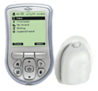
Insulin Delivery Devices
 | Product Options | Advantages/Disadvantages
Vial and Syringe | Medical supply companies (e.g. BD) | Difficult to handle and administer, especially for patients with visual and dexterity issues Hard to transport
Prefilled Pens | Lilly Novo Nordisk Sanofi Aventis | Very portable and relatively discreet Minimal needle handling required
Reusable Pens | Lilly Novo Nordisk Sanofi Aventis | Very portable and relatively discreet Requires needle changing and disposal “Green” or environment friendly
Insulin Pumps | Medtronic Insulet Roche J&J Smiths | Need to be “tethered,” unless using OmniPod Continuous basal infusion may offer better long-term glycemic control
Least Expensive
Most Expensive
BD Getting StartedTM.Insulin Delivery Devices. Available at: www.bddiabetes.com/us. Accessed 8 April, 2010.
Notes:
KEY POINTS
Insulin Delivery Devices
The different insulin delivery devices are syringe, prefilled pens, reusable pens and insulin pumps.
REFERENCE
BD Getting StartedTM.Insulin Delivery Devices. Available at: www.bddiabetes.com/us. Accessed 8 April, 2010.

Slide 40
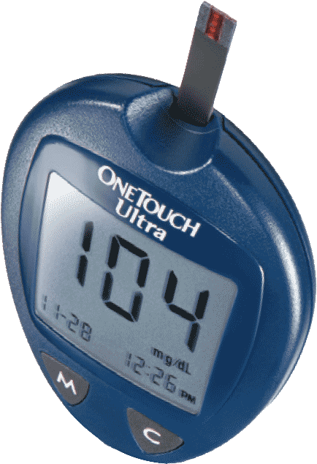
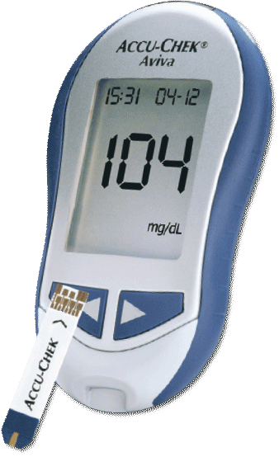
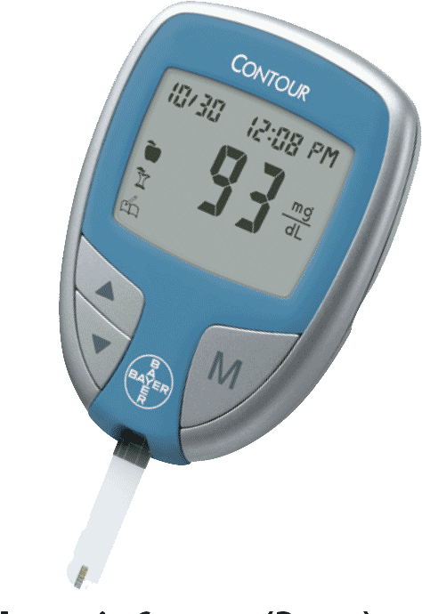
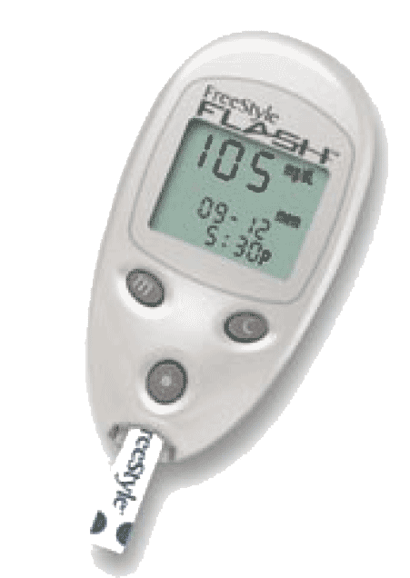
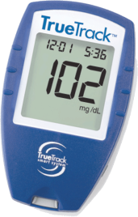
Glucose Monitoring Devices
 |  | Lifescan (J&J) | Roche Diagnostics | Bayer | Thera/ MediSense (Abbott) | Home Diagnostics
 | Key Characteristics
 |  | OneTouch Ultra^{®1} | Accu-Chek Aviva^{®2} | Ascencia Contour^{®3} | FreeStyle Flash^{®4} | HDI TrueTrack^{®5}
 | Test Time | 5 sec | 5 sec | 15 sec | 7 sec | 10 sec
 | Sample Required | 1.0 µL | 0.6 µL | 0.6 µL | 0.3 µL | 1.0 µL
 | Memory | 150 | 500 | 240 | 250 | 365
 | Calibration Method | Code | Code Chip | Auto | Code | Code Chip
 | Hematocrit Range | 30%-55% | 20%-70% | 20%-60% | 15%-65% | 30%-55%
 | Insulin Pump Affiliation | Animas | Disetronic |  | OmniPod Cozmo
One Touch® UltraTM System Owner’s Booklet. Accessed October 8,2009. 4. Freestyle® Blood Glucose Monitoring. Accessed October 8,2009.
2. Accu-Check®. Accessed October 8, 2009. 5. TRUEtrack® Quality Assurance/Quality Control Manual. Accessed October 8, 2009.
3. Ascensia® ContourTM. Blood Glucose Monitoring System. Accessed October 8, 2009.
Notes:
KEY POINT
Differentiating features of glucose-monitoring products include size, the availability of alternate site testing, ease of use, memory, and required blood sample.
REFERENCES
One Touch® UltraTM System Owner’s Booklet. Available at: http://ww2.lifescan.com/mea/products/pdfs/AW061-658-01A.pdf. Accessed October 8,2009.
Accu-Check®. Available at: http://www.poc.roche.com/en_US/pdf/SHR-ART-04473345006WEB.pdf. Accessed October 8, 2009.
Ascensia® ContourTM. Blood Glucose Monitoring System. Available at: http://www.bayerdiabetes.ch/pub/de/produkte/documents/Contour_e.pdf. Accessed October 8, 2009.
Freestyle® Blood Glucose Monitoring. Available at: http://www.abbottdiabetescare.com/static/content/document/ART03978-Rev-A.pdf. Accessed October 8,2009.
TRUEtrack® Quality Assurance/Quality Control Manual. Available at: http://www.prestigesmartsystem.com/our_products/downloads/bgm_true_track/true_track_QA.pdf. Accessed October 8, 2009.

Slide 41
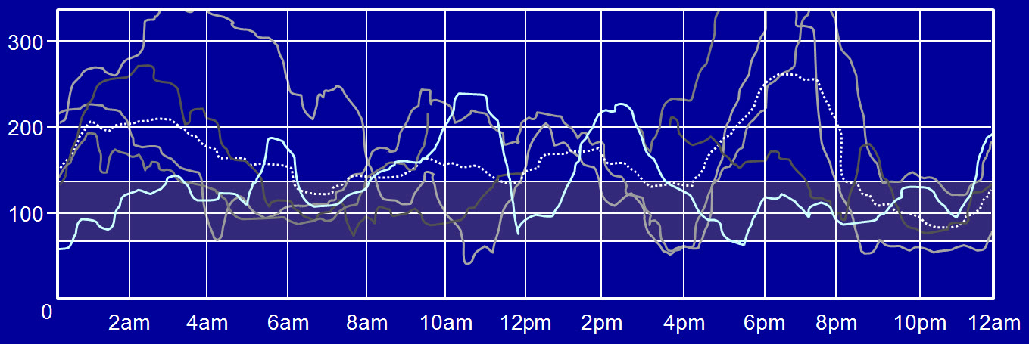
Achieving Blood Glucose Targets Is a Daily Challenge for People With T1DM
Lack of Improvement of Glycemic Control Despite Increased Intensity of Insulin Treatment¹
 | 1992 | 2003
On 4 injections or insulin pump | 27.8% | 74.6%
Median A1c 18,403 German children¹ | 8.2% | 8.2%
Day-to-Day Variability in Blood Glucose in T1DM as Assessed by Continuous Glucose Monitoring²
[Glucose] (mg/dL)
Time
1. Hecker et al: ADA 2004; abstract 1771-P
2. Fabiato et al. Diabetes Tech Ther 2007;11 (Suppl 1):S93-S103
Notes:
KEY POINTS
Increased used of intensified insulin therapy alone is not sufficient enough to improve
metabolic control.¹
As an integrated measure of fasting, preprandial, and postprandial glucose levels, HbA1c may not completely represent the risks that patients with diabetes are exposed to on a daily basis. Although it provides a quantitative measure of mean glucose exposure over an extended period, HbA1c alone does not indicate the degree of glycemic variability (the frequency and magnitude of glucose excursions) that a patient may experience during a given day.²
REFERENCES
Hecker W, Vogel C, Rösel M, et al. Gender and age-specific longterm effects of the DCCT in the management of children and adolescents with type-1—diabetes mellitus (T1DM) in Germany. 2004 ADA, abstract 1771-P.
Fabiato K, Buse J, Duclos M, et al. Clinical Experience with Continuous Glucose Monitoring in Adults. Diabetes Tech Ther. 2007;11(Suppl 1):S93-S103.

Slide 42
Risk of Hypoglycemia is a Significant Barrier to Achieving Aggressive Blood Glucose Targets in T1DM
1.0
0.9
0.8
0.7
0.6
Proportion with Hypoglycemia
0.5
Intensive
0.4
0.3
0.2
Conventional
0.1
0.0
0
4
8
12
16
20
24
28
32
36
Months of Treatment
The DCCT Research Group. Am J Med 1991;90:450-459.
Notes:
KEY POINTS
Risk of hypoglycemia is higher with intensive insulin therapy as observed in the DCCT trial
77% of total hypoglycemia were in the intensive group
REFERENCE
The DCCT Research Group. Epidemiology of severe hypoglycemia in the Diabetes Control and Complications Trial. Am J Med. 1991;90:450-459.

Slide 43
Barriers to Achieving Glycemic Targets: Severe Hypoglycemia
100
80
Intensified regimens result in
3- to 4-fold higher severe hypoglycemia event rates
than conventional regimens
60
Rate of Severe Hypoglycemia per 100 patient years
Intensified
40
20
Conventional
0
5
6
7
8
9
10
11
12
13
14
HbA1c (%) during study
DCCT Research Group. Diabetes 1997;46:271-286.
Notes:
KEY POINT
Intensified regimens result in 3- to 4-fold higher severe hypoglycemia event rates than conventional regimens.
REFERENCE
DCCT Research Group. Hypoglycemia in the Diabetes Control and Complication Trial. Diabetes,
1997;46:271-286.

Slide 44
Barriers to Achieving Glycemic Targets: Weight Gain
Intensive therapy
Conventional therapy
50
50
40
40
30
30
Major weight gain (percent of subjects)
Major weight gain (percent of subjects)
20
20
10
10
0
1
2
3
4
5
6
7
8
9
0
1
2
3
4
5
6
7
8
9
Follow-up (years)
Follow-up (years)
Adult Men
Adult Women
The DCCT Research Group. Diabetes Care 2001;24:1711-1721. Reprinted with permission from the American Diabetes Association.
Notes:
KEY POINT
The annual prevalence of major weight gain was consistently higher in the intensive treatment group compared to the conventional treatment group. This persisted throughout the follow-up period, and was statistically significant for both sexes.
REFERENCE
The DCCT Research Group. Influence of Intensive Diabetes Treatment on Body Weight and Composition of Adults With Type 1 Diabetes in the Diabetes Control and Complications Trial. Diabetes Care. 2001;24:1711-1721.

Slide 45
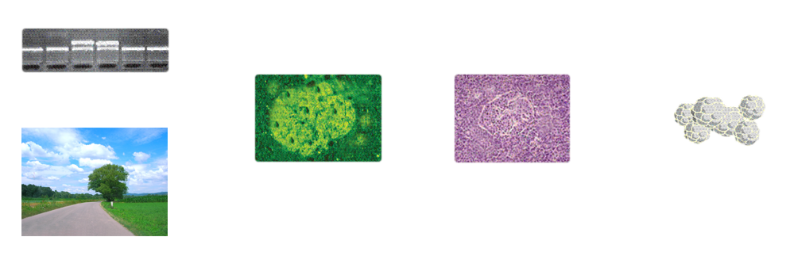
Potential Treatment/Prevention Targets
Genetic susceptibility
Diagnosis of type 1 diabetes (<20%
β cells remaining)
Appearance of islet autoantibodies
+
Environmental factors
β-cell regeneration
Renewable sources
of islets
Prevention
Identify and remove environmental insult
Reversal
Anti T-cell strategies
Induction of tolerance
T-cell regulation
Islet transplantation
Gene therapy to generate "super islets"
Gillespie et al. CMAJ 2006;175(2):165-170.
Notes:
KEY POINT
Two strategies are open to physicians who have patients with type 1 diabetes: the first is to prevent initiation of autoimmunity; the second is to reverse the effects of ongoing autoimmunity coupled with beta cell regeneration.
REFERENCE
Gillespie KM. Type 1 diabetes: pathogenesis and prevention. CMAJ. 2006;175(2):165-170.

Slide 46
Treatment: Additional Aspects of Care
 | Aspects of Diabetes Care
Diagnostics | A1c Lipid profiling Neuropathy Retinopathy Protein albumin
Therapeutics | Hypertensive agents Cholesterol lowering agents Oral diabetes meds Insulin Pumps
Monitoring | Blood pressure Glucose monitoring
Patient Support | Disease management Endocrinologist/PCP Nurse educator Dietician/exercise physiologist
American Diabetes Association. Diab Care 2009;32(suppl 1): S13-S61.
Rodbard et al. Endocr Pract 2007;13 Suppl 1:1-68.
Notes:
KEY POINT
Type 1 diabetes care also involves frequent monitoring of glucose levels and potential complications. In addition, appropriate drug compliance and patient support goes a long way in controlling diabetes and preventing complications.
REFERENCES
1. American Diabetes Association. Standards of medical care in diabetes. Diabetes Care. 2009;32(suppl 1):S13-S61.
2. Rodbard HW et al. American Association of Clinical Endocrinologists medical guidelines for clinical practice for the management of diabetes mellitus. Endocr Pract. 2007;13(suppl 1):1-68.

Slide 47
Type 1 Diabetes
New Therapeutic Directions

Slide 48
Preserving Residual Beta Cell Function Is Likely to Produce Important Clinical Benefits
 | Incidence (rate per 100 patient-years) |  | Relative Risk Reduction
 | C-peptide Responders† | C-peptide Non-Responders
Severe Hypoglycemia (resulting in coma or seizure) | 6.6 | 17.3 | 65%*
Retinopathy (3-step progression) | 2.0 | 4.7 | 50%*
Nephropathy (≥40 mg/day urine albumin) | 1.4 | 2.5 | 23%
†Responders had stimulated C-peptide levels > 0.2 pmol/mL
*p<.01
The Diabetes Control and Complications Trial Research Group. Ann Int Med 1998;128:517-523.
Notes:
KEY POINTS
Diabetes Control and Complications Trial (DCCT)
Intensively treated responders had reduced risks for development and progression of retinopathy and microalbuminuria.
Differences were seen within the intensive therapy group that were based on baseline C-peptide status.
Despite lower hemoglobin A1c values in intensively treated responders, the risk for severe hypoglycemia with seizure or coma was 65% (CI, 53% to 74%) less in this group than in intensively treated nonresponders.
A 50% reduced risk for retinopathy progression (CI, 12% to 72%) was observed in
C-peptide responders.
Similar trend was seen with a lower risk for the development of microalbuminuria.
REFERENCE
The Diabetes Control and Complications Trial Research Group. Effect of intensive therapy on residual β-cell function in patients with type 1 diabetes in the diabetes control and complications trial. A randomized, controlled trial. Ann Int Med. 1998;128:517-523.

Slide 49
Islet Cell Transplantation
Description
Following the introduction of the Edmonton transplant protocol in 1999, developed at the University of Alberta in Canada, major islet transplant centers have developed and refined new procedures There are sufficient data to conclude that there is a high rate of technical success for islet-alone transplantation Recent clinical trials have demonstrated that 50% to 90% of patients are free from insulin after 1 year Side effects (from long-term immunosuppression) include mouth ulcers, diarrhea, and neutropenia
Limitations
Need for chronic immunosuppression will limit transplantation to only the most brittle patients Organ availability will limit the number of procedures performed Each transplant requires at least 2 pancreases For 2002, the Organ Procurement and Transplantation Network reported 6,187 total deceased organ donors, 1,870 pancreas organs recovered, and 1,461 pancreas organs transplanted
Islet transplantation in patients with type 1 diabetes mellitus. Available at: http://www.ahrq.gov/clinic/epcsums/isletsum.htm. Accessed on 8 April, 2010.
Notes:
KEY POINT
Islet cell transplantation could one day provide an important therapeutic option for reversal of T1DM. However, there are significant limitations on the number of available organs for transplant at the current time, and current immunosuppressive regimens are not well-tolerated during chronic use.
REFERENCE
Islet transplantation in patients with type 1 diabetes mellitus. Available at: http://www.ahrq.gov/clinic/epcsums/isletsum.htm. Accessed on 8 April, 2010.

Slide 50
Immunosuppression
Immunosuppression with cyclosporin enhances beta-cell function but lacks tolerability and safety
1.0
0.8
CP pmol/mL
0.6
0.4
0.2
0.8
0.6
Insulin u/k/d
0.4
Plasma glucagon-stimulated C-peptide (CP) levels, insulin dosage, and glycosylated hemoglobin (GHb) during 1st yr (Canadian open study). Mean values for patients taking cyclosporin at times indicated ( ; n = 46-81); patients who were in remission as defined at 365 days ( ; n = 31); and patients classed as "no apparent benefit" who discontinued cyclosporin at intervals after 6 mo
( ; n = 22)
0.2
0.0
12.0
%GHb
10.0
8.0
6.0
0
3
6
9
12
Months Since Entry
Dupre et al. Diab Care 1988;1:37-44. Reprinted with permission from the American Diabetes Association.
Notes:
KEY POINTS
All studies demonstrated an enhanced beta-cell function upon immune intervention with cyclosporin.
Canada Open Study
It was an open trial that enrolled 81 subjects.
10 mg/kg per day of cyclosporin was administered in 2 divided doses 12 hours apart.
Clinical remission rate at 1 year was 46%; out of this, 84% were not receiving insulin.
Recovery of plasma glucagon-stimulated C-peptide indicated a recovery of beta-cell function.
However, a relapse was observed within weeks after discontinuation of cyclosporin.
French Study
It was a randomized, double-blind, controlled trial on 122 patients.
Complete remission was seen in 37.5% in whom the cyclosporin blood trough level in the first 3 months was ~300 ng/mL; the remission was maintained over a 1-year study period.
Canadian-European Study
It was a randomized, double-blind, controlled trial.
Clinical remission with cyclosporine was greater in patients with < 6 week symptomatic diabetes and with 2 weeks of initiation of insulin therapy.
A lack of tolerability/safety of chronic immunosuppression was observed in these studies, with nephrotoxicity being a major concern.
REFERENCE
Dupre J, Stiller CR, Gent M, et al. Clinical trials of cyclosporine in IDDM. Diab Care. 1988;1:37-44.

Slide 51
Immunomodulation
160
C-peptide responses to a mixed-meal tolerance test (MMTT) in the control and anti-CD 3 antibody groups. The total AUC of the C-peptide during a 4-h MMTT is shown for the drug-treated and control groups (means ± SE)
**p< .02
Drug
140
Control
**
**
**
120
100
AUC (pmol/mL/240 min)
80
60
40
20
0
0
6
12
18
24
Month
1. Staeva-Vieira et al. Clin Experiment Immunol 2007;148: 17-31.
2. Herold et al. Diabetes 2005;54:1763-1769. Reprinted with permission from the American Diabetes Association.
Notes:
KEY POINTS
Immunomodulation to reverse recent-onset diabetes is a clinical approach of considerable interest.^{1, 2}
Several intervention studies have been completed.
Most noteworthy outcome has been seen after 12 or 14 day courses of monoclonal antibodies were directed against CD3, that is, anti-CD3.
These can be give before the onset of clinical type 1 diabetes or in combination with
other interventions.
Monoclonal anti-CD20 antibody (Rituximab), which depletes B cells and could act to reduce their antigen-presenting capacity or the proinflammatory effect of islet autoantibodies, is currently on trial in recent-onset type 1 diabetes; it has a relatively good safety profile and might provide an indirect pathway for interfering with the APC–T cell axis.
REFERENCES
Staeva-Vieira T, Peakman M, von Herrath M. Translational mini-review series on type 1 diabetes: Immune-based therapeutic approaches for type 1 diabetes. Clin Experiment Immunol. 2007;148:
17-31.
Herold KC, Gitelman SE, Masharani U, et al. A single course of anti-CD3 monoclonal antibody hOKT31(Ala-Ala) results in improvement in c-peptide responses and clinical parameters for at least 2 years after onset of type 1 diabetes. Diabetes. 2005;54:1763-1769.

Slide 52
Antigen-Specific Immunotherapy
Therapy: GAD-alum
Route of administration: Subcutaneous
Dose: 20 µg
Frequency of administration: 2 doses administered on day 1 and day 30
Patients Treated <6 Mo after Diagnosis
0.2
0.0
-0.2
-0.4
p=.01
GAD-alum
-0.6
Stimulated C-Peptide (nmol/liter/2 hr)
Placebo
p=.04
-0.8
p=.05
-1.0
p=.04
-1.2
-1.4
-1.6
0
5
10
15
20
25
30
Months
Mean Changes from Baseline Levels of Stimulated C-Peptide, According to Treatment Group and Time of Treatment Relative to Diagnosis
1. Staeva-Vieira et al. Clin Experiment Immunol 2007;148:17-31.
2. Ludvigsson et al. N Engl J Med 2008;359:1909-1920.
Notes:
KEY POINTS
Antigen- specific: site-specific, highly selective immunomodulator, without compromising
systemic immunity.¹
Oral insulin might have greater effect as an immune modulator when given to subjects with high-titre insulin autoantibodies (IAA), as a marker of dominant insulin autoimmunity.¹
GAD-65 protein has shown promising results in their first safety study in subjects with late-onset autoimmune diabetes of adulthood (LADA) and preliminary, unpublished efficacy studies in children with type 1 diabetes.¹
Treatment with GAD-alum had an effect on slowing the loss of residual beta-cell function up to 30 months after intervention and was associated with GAD-specific immune modulation, although it did not change the insulin requirement.²
REFERENCES
Staeva-Vieira T, Peakman M, von Herrath M. Translational mini-review series on type 1 diabetes: Immune-based therapeutic approaches for type 1 diabetes. Clin Experiment Immunol. 2007;148:
17-31.
Ludvigsson J, Faresjö M, Hjorth M, et al. GAD treatment and insulin secretion in recent-onset type 1 diabetes. N Engl J Med. 2008;359:1909-1920.

